Slide 1
Community for Emerging and Zoonotic Diseases Identifying emerging risks through collective intelligence
CEZD – CAHSS Poultry Network Update
15 September 2023
www.cezd.ca

Slide 2
Canadian Domestic Detections of HPAI to end of August
Canadian Detections in Domestic Birds CFIA Website
Province | New Cases Since May 24, 2023 | Commercial Small Flock | Poultry Non-Poultry | SitReps ended July 28, 2023
British Columbia | No new cases | Commercial – 78 Small Flock – 26 | Poultry – 95 Non-Poultry – 9
Alberta | 1 case awaiting confirmation | Commercial – 38 Small Flock – 23 | Poultry – 44 Non-Poultry – 17
Saskatchewan | No new cases | Commercial – 16 Small Flock – 16 | Poultry – 26 Non-Poultry – 6
Manitoba | No new cases | Commercial – 17 Small Flock – 4 | Poultry – 17 Non-Poultry – 4
Ontario | No new cases | Commercial – 32 Small Flock – 15 | Poultry – 42 Non-Poultry – 5
Quebec | No new cases | Commercial – 39 Small Flock – 8 | Poultry – 44 Non-Poultry – 3
New Brunswick | No new cases | Commercial – 0 Small Flock – 2 | Poultry – 1 Non-Poultry 1
Nova Scotia | No new cases | Commercial – 2 Small Flock – 4 | Poultry – 3 Non-Poultry – 3
Totals | No new cases! | Commercial 222 Small Flock 100 | Poultry 272 Non Poultry 50
Notes:
SitReps are no longer being distributed
Last PCZ was revoked
No new cases in Canada!

Slide 3
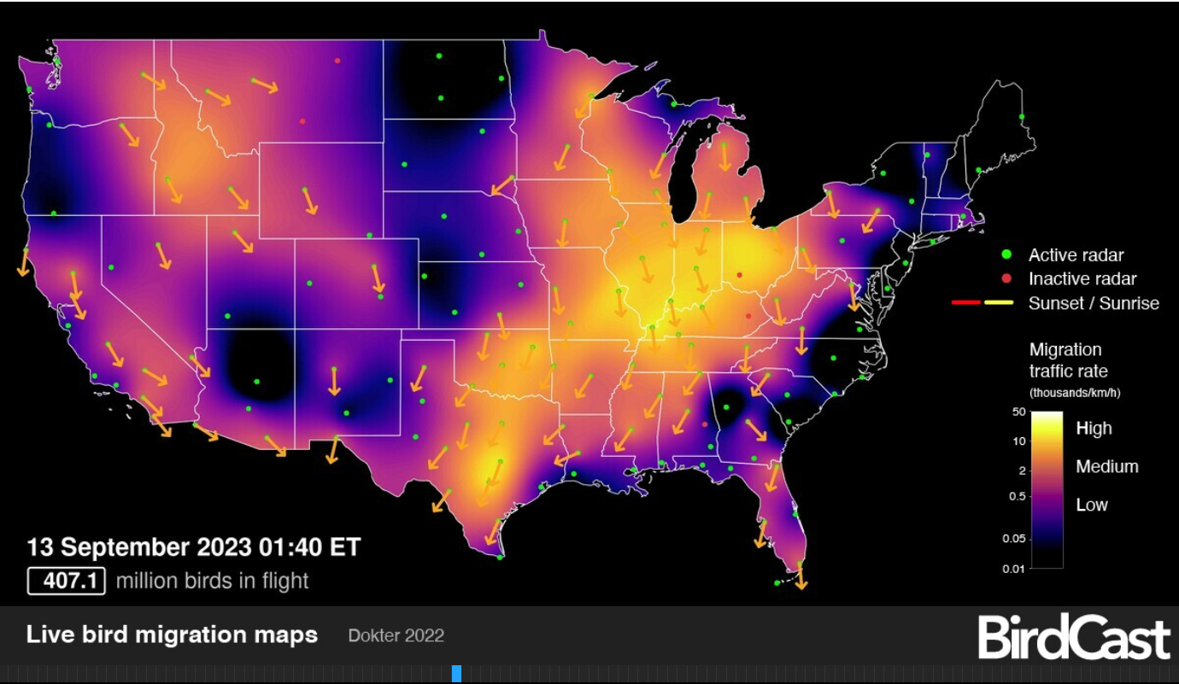
Wild Bird Migration
Notes:
The Wild bird migration is well underway with hundreds of millions of birds in flight now.

Slide 4
Wildlife H5N1 Avian Influenza
Dashboard Filtered from June 2 – Sept 13, 2023
Most suspect and H5 positive
ON – cormorant fully Eurasian H5N1
NS – common tern fully Eurasian H5N5
CWHC
Wild Bird Dashboard
Notes:
Image from filtering dashboard from Mar 3 – May 31

Slide 5
United States – HPAI Domestic Bird Detections
In Last 30 days there have been no domestic bird detections
Last ones were at end of July and August in a live bird market in New York State
Notes:
Washington:
https://www.seattletimes.com/seattle-news/health/wa-officials-warn-of-bird-flu-outbreak-in-state-park-more-than-1700-dead-birds-removed/
https://wahis.woah.org/#/in-review/4451?reportId=162659&fromPage=event-dashboard-url
https://www.fisheries.noaa.gov/feature-story/highly-pathogenic-avian-influenza-found-seals-marrowstone-island-puget-sound

Slide 6
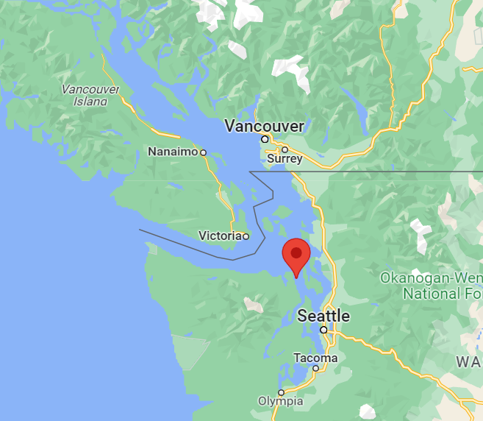
United States – Wild Bird Detections
Highly Pathogenic Avian Influenza Found in Seals on Marrowstone Island in Puget Sound | NOAA Fisheries
3 seals in Puget Sound (WA) have tested positive for HPAI H5N1
Found on Marrowstone Island in August
First incidence of HPAI in marine mammals on the West Coast of the USA
Rat Island (Wildlife preserve in Washington State) had >1700 Caspian terns and gulls removed
Notes:
Washington:
https://www.seattletimes.com/seattle-news/health/wa-officials-warn-of-bird-flu-outbreak-in-state-park-more-than-1700-dead-birds-removed/
https://wahis.woah.org/#/in-review/4451?reportId=162659&fromPage=event-dashboard-url
https://www.fisheries.noaa.gov/feature-story/highly-pathogenic-avian-influenza-found-seals-marrowstone-island-puget-sound
South Africa:
http://empres-i.fao.org/eipws3g/2/obd?idOutbreak=361464&rss=t
Nigeria: http://empres-i.fao.org/eipws3g/2/obd?idOutbreak=361689&rss=t
5098 cases (1878 deaths, 3220 destroyed)

Slide 7
HPAI Wild Birds in Europe
Notes:
Wild bird reports have been ongoing, and almost 38% greater numbers than reported in first 9 months of 2022

Slide 8
HPAI Viral Reassortment in Europe
‘BB’ genotype has emerged in 2023 – recombinant with H13
By May/June 90% ‘BB’
BB Genotype is now dominant
Both wild and farmed birds
Farmed fox and mink
Seabirds affected inland as well as on coasts
The increasing number of wild bird species involved in the A(H5) epidemic may alter the pattern of virus spread.
Avian influenza overview April – June 2023 (wiley.com)
Notes:
A(H5N1) virus continues to circulate in breeding colonies of black-headed gulls, affecting now also juvenile birds that have hatched and are fledging, resulting in high mortality. At the same time, as predicted in the last report ,the host range has been expanded to other gulls and terns, including Mediterranean gulls, black-legged kittiwakes, common terns and sandwich terns . During this reporting period, compared to the situation observed in 2022, seabird species were not only found along coastlines but also in land. The increasing number of wild bird species involved in the A(H5) epidemic may alter the pattern of virus spread.

Slide 9
HPAI - Domestic Birds in Europe
 | 2022 (to Sept 1, 2022) | 2023 (to Sept 1, 2023)
Number of European Countries Reporting HPAI in domestic birds (H5N1 and H5) | 24 | 24
Number of Domestic Bird Detections (H5N1 and H5) | 1863 | 480
In first 9 months of 2023:
Same number of countries reporting domestic cases (24)
Dramatic decline in cases in general (1863 to 480)

Slide 10
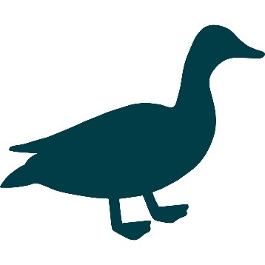
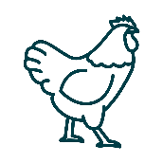
France – Domestic Ducks
Domestic ducks have been a large portion of the European cases detected in 2023
France has had the largest proportion of these cases
They have not been from independent introductions from wild birds
Genotyping indicates they are from farm to farm spread

Slide 11
Bird flu: the Landes group Maïsadour ready to vaccinate ducks from October 1st (francebleu.fr)
Vaccination of broiler ducks is mandatory
Plans to vaccinate between 60,000 and 80,000 ducks per week from October 1, 2023
Eighty million doses have been ordered by the French state from the German laboratory Boehringer Ingheleim
The first dose of will be given on 10-day-old ducklings
The second will have to be injected 18 days later.
The goal is to vaccinate between 800 and 1000 animals per hour.

Slide 12
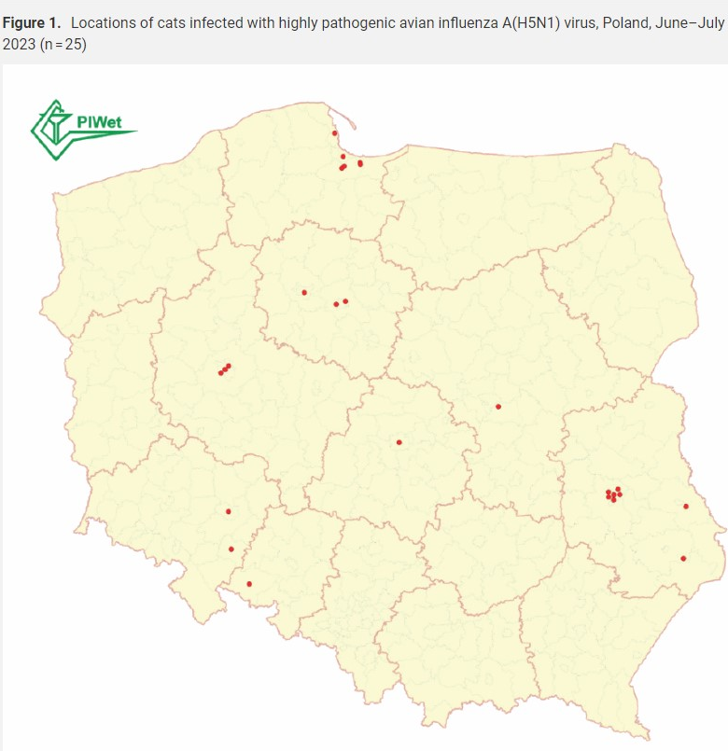
Poland – HPAI in domestic cats
June - Deaths of domestic cats in households across Poland
>70 suspect cases
H5N1 confirmed in 29/46 cats and 1 Caracal tested
Clinical signs: neurological and respiratory symptoms including seizures and difficulties breathing
Notes:
**One news source states that chicken purchased at a shop was given to a cat raw and this was chicken for human consumption.
*isolates all the same, closest to white stork (wildlife virus)

Slide 13
Poland – H5N1 in cats
Not all cats had access to the outdoors
Cause? Still under investigation
Raw chicken?
Feeding of raw chicken was implicated but has not been proven
5 feed samples tested, 1 was positive for infectious virus (BNO news—reliable source?)
Same genotype as wild birds & poultry
highly related to each other
Suspect common source – not identified yet
70 people identified as close contacts, all asymptomatic
Notes:
Sources:
https://www.eurosurveillance.org/content/10.2807/1560-7917.ES.2023.28.31.2300366
https://www.eurosurveillance.org/content/10.2807/1560-7917.ES.2023.28.31.2300390
Risk is assessed as low to moderate for those living with infected cats, low for the general population
No cat to cat transmission has been identified
https://www.gavi.org/vaccineswork/silence-cats-should-we-worry-about-deadly-bird-flu-outbreaks-mammals

Slide 14
South Korea: HPAI H5N1 in cats
H5N1 confirmed in 5 cats at two different shelters in Seoul
First shelter had 38 cats die in a month, 2 confirmed to have HPAI H5N1
Human contact tracing performed – no identified contacts are symptomatic to-date
Pet food was determined to be the likely source of the outbreak
Notes:
2 cats positive in 1 shelter, 3 cats positive in a 2nd
Anorexia & respiratory symptoms reported in cats
1 died in hospital under veterinary care
Food tested: “Nature’s row” – in May, 2023 found that they were manufacturing food without proper sterilization techniques
Media reports August 1st of cat food recall
Immediate order for the manufacture to stop manufacturing & selling the food and to recall products
Food was either “Balanced Chicken” or “Balanced Duck” by Tosil Tosil Kitchen
LINKS:
https://www.cidrap.umn.edu/avian-influenza-bird-flu/south-korea-detects-h5n1-avian-flu-shelter-cats
https://www.mafra.go.kr/home/5109/subview.do?enc=Zm5jdDF8QEB8JTJGYmJzJTJGaG9tZSUyRjc5MiUyRjU2Njk0OSUyRmFydGNsVmlldy5kbyUzRg%3D%3D
https://www.koreaherald.com/view.php?ud=20230730000086
https://www.reuters.com/business/healthcare-pharmaceuticals/south-korea-detects-h5n1-bird-flu-two-cats-shelter-2023-07-26/
https://afludiary.blogspot.com/search?updated-max=2023-08-02T08:48:00-04:00&max-results=6
Food manufacturer: https://smartstore.naver.com/tosiltosilrestaurant/notice/detail?id=5000553560

Slide 15
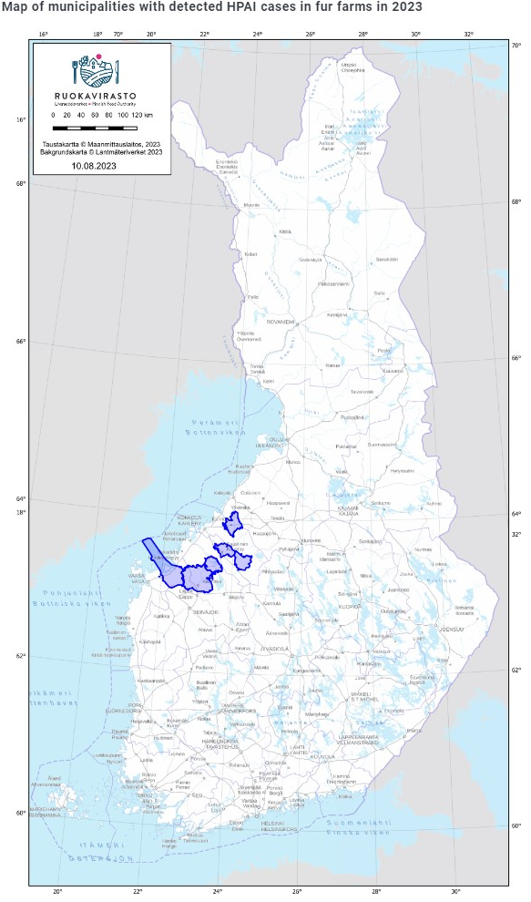
HPAI Finnish Fur Farms
Background:
>500 fur farms, mostly in Western Finland
Species farmed: American mink, arctic (blue) fox, red (silver) fox, fox crossbreeds, raccoon dog, and sable
Farms usually have a roof and no closed walls
July 13th – Finnish food authority reported AI detected in foxes on fur farms
26 fur farms
Affected farms vary in size from 600-50,000 animals
Notes:
First incidence in farmed fur animals – previously 2 detections in WILD foxes
With HPAI being added to list of diseases to be combated, animal health authorities have the right to take the necessary measures to eradicate the infection and prevent the spread of the disease. Owners will be entitled to receive compensation from the government for killed animals.
While the source of infection of these 5 farms remains unclear, authorities are looking at a variety of sources of contamination, including feed and feed storage facilities.
LINKS:
https://www.ecdc.europa.eu/sites/default/files/documents/communicable-disease-threats-report-week-28-2023.pdf
https://wahis.woah.org/#/in-review/5119?reportId=161810&fromPage=event-dashboard-url
https://www.ruokavirasto.fi/elaimet/elainten-terveys-ja-elaintaudit/elaintaudit/ajankohtaista-elaintaudeista/turkistarhan-ketuilla-todettu-lintuinfluenssaa/
https://www.ruokavirasto.fi/elaimet/elainten-terveys-ja-elaintaudit/elaintaudit/ajankohtaista-elaintaudeista/lintuinfluenssaa-myos-neljan-turkistarhan-elaimissa/
https://valtioneuvosto.fi/en/-//1410837/finland-intensifies-measures-to-combat-avian-influenza-at-fur-farms
https://www.ruokavirasto.fi/en/animals/animal-health-and-diseases/animal-diseases/poultry/avian-influenza/avian-influenza-in-finland/
https://afludiary.blogspot.com/

Slide 16
HPAI Finnish Fur Farms
BB genotype confirmed on the fur farms
Suspect introduction from wild birds as well as transmission between the fur animals
Detection in wild mammals: fox & otter in the West Finland (first wild mammalian detections of 2023 in the country)
Finnish Food Authority orders all animals to be euthanized from fur farms infected with avian influenza - Finnish Food Authority (ruokavirasto.fi)
Notes:
LINKS:
https://www.ecdc.europa.eu/sites/default/files/documents/communicable-disease-threats-report-week-28-2023.pdf
https://www.ruokavirasto.fi/en/animals/animal-health-and-diseases/animal-diseases/poultry/avian-influenza/avian-influenza-in-finland/
Map taken from this website
https://www.eurosurveillance.org/content/10.2807/1560-7917.ES.2023.28.31.2300400

Slide 17
Scientific Findings
Epidemiology-driven approaches to surveillance in HPAI-vaccinated poultry flocks aiming to demonstrate freedom from circulating HPAIV – ScienceDirect
Eurosurveillance | Highly pathogenic avian influenza A(H5N1) virus infection on multiple fur farms in the South and Central Ostrobothnia regions of Finland, July 2023
Frontiers | Age is a determinant factor in the susceptibility of domestic ducks to H5 clade 2.3.2.1c and 2.3.4.4e high pathogenicity avian influenza viruses (frontiersin.org)
H5N1 highly pathogenic avian influenza clade 2.3.4.4b in wild and domestic birds: Introductions into the United States and reassortments, December 2021-April 2022 - PubMed (nih.gov)
Early Release - Limited Outbreak of Highly Pathogenic Influenza A(H5N1) in Herring Gull Colony, Canada, 2022 - Volume 29, Number 10—October 2023 - Emerging Infectious Diseases journal – CDC
https://www.offlu.org/wp-content/uploads/2023/08/OFFLU-statement-HPAI-wildlife-South-America-20230823.pdf
Viruses | Free Full-Text | Recurring Trans-Atlantic Incursion of Clade 2.3.4.4b H5N1 Viruses by Long Distance Migratory Birds from Northern Europe to Canada in 2022/2023 (mdpi.com)

Slide 18
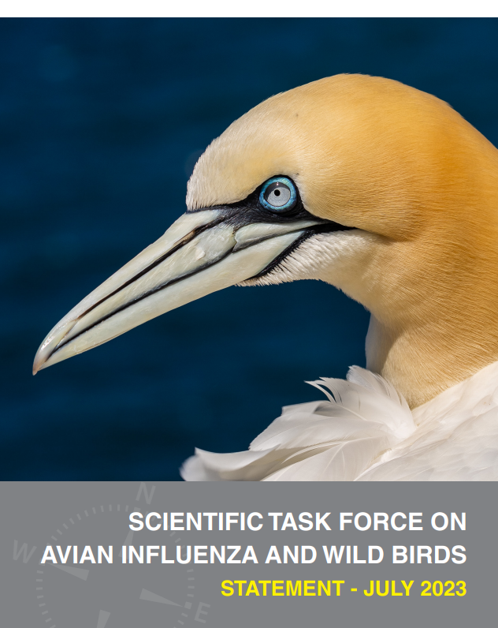
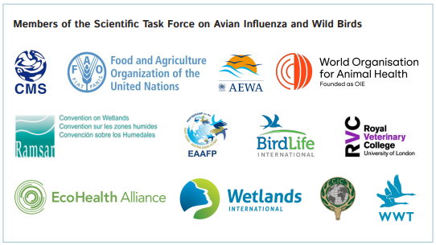
SCIENTIFIC TASK FORCE ON AVIAN INFLUENZA AND WILD BIRDS STATEMENT - JULY 2023
H5N1 High pathogenicity avian influenza in wild birds - Unprecedented conservation impacts and urgent needs
The purpose is to inform stakeholders in governments, disease control, wildlife management, site management, conservation and poultry sectors about HPAI viruses in wild birds and appropriate responses.
Notes:
The Convention on Migratory Species (CMS) and the Food and Agriculture Organization (FAO) co-convened the Scientific Task Force on Avian Influenza and Wild Birds in 2005. It works as a communication and coordination network and continues to review the role of wild birds in the epidemiology of AI and the impact of the disease on wild birds, promoting a balanced opinion based on currently available evidence. Task Force observers include the United Nations Environment Programme, World Health Organisation and World Organisation for Animal Health. Task Force members are displayed here.
Purpose
The purpose of the statement is to inform stakeholders in governments, disease control, wildlife management, site management, conservation and poultry sectors about HPAI viruses in wild birds and appropriate responses. The statement provides firstly a situation update and secondly recommendations and guidance for those responding to the threat of HPAI to wild birds.
https://www.cms.int/en/publication/h5n1-high-pathogenicity-avian-influenza-wild-birds-unprecedented-conservation-impacts

