Slide 1
Community for Emerging and Zoonotic Diseases Signals of Interest for CSHIN Q4
Dr Andrea Osborn
21 February 2023
www.cezd.ca

Slide 2
ASF spread – Q4 > 846 events reported (Empress i) in Q1 so far - 507
Notes:
No big differences in distribution of ASF globally from our last meeting.
Singapore reported its first case of ASF – Q1 detection in wild boar.
Most notable is the detection of ASF in the Czech republic.

Slide 3
ASF in the Czech Republic
December 2nd: Detection in a Wild Boar piglet for first time since April 2018
< 3km from the Polish border
< 30 km from German border
Czech Republic had declared freedom from ASF in 2019

Slide 4
ASF in the Czech Republic
Declared an infected area of 200 square kilometers
Entering forests is restricted
Hunting wild boar is prohibited
Game hunting and feeding wild boar prohibited
Inventory of all pigs required
All non-commercial pigs slaughtered
No outdoor housing of pigs

Slide 5
Viruses | Free Full-Text | Experimental Infection of Domestic Pigs with an African Swine Fever Virus Field Strain Isolated in 2021 from the Dominican Republic (mdpi.com)
24 h pi
Intra Muscular
Injection
Controls -
Cohabitation with IM injected animals
Oro-nasal
injection
Protracted severe presentation 14, 15 dpi
Protracted severe presentation 16 dpi
Mild Disease 28 dpi
Acute Disease
7 dpi
Protracted presentation 21 dpi
Notes:
Animals inoculated IM with ASFV-DR21 developed acute fatal disease.
ASFV-DR21 does not consistently produce an acute and fatal form of the disease unless it is inoculated IM, within a controlled laboratory setting.
Animals inoculated with ASFV-DR21 by the oronasal route or by contact with IM-inoculated animals developed a variable pattern of clinical disease with just a proportion of the animals developing an acute and fatal disease.
Most of these animals developed mild and prolonged clinical disease and, in some animals, survived with a transient or inapparent form of the disease during the entirety of the study period.
Viremia and viral shedding follow the clinical presentation
Animals with acute disease shows viremia 2-4 dpi, with viral shedding by 6-7 dpi
Animals with mild disease did not develop detectable viremia until well after the exposure period, those with the mildest disease had virtually no viral shedding (just one animal at 19 dpi with very low titres on nasal swabs.
The level of those antibody responses in the pigs with mild disease, is comparable to those elicited by live attenuated experimental vaccines.
These observations are in agreement with the description of field clinical cases of ASF in DR. Studies with ASF Georgia 2010 showed fatal infections regardless of the method of exposure (IM, in Contact, ON)
Take home message: A changed clinical presentation will result in a change to the sensitivity of the surveillance system. CanSPOT ASF becomes even more important in this situation.

Slide 6
Pathogens | Free Full-Text | Artificial Insemination as an Alternative Transmission Route for African Swine Fever Virus (mdpi.com)
Notes:
German and US collaboration, challenge studies carried out at the Friedrich-Loeffler-Institut
Four boars inoculated with ASFV isolate ‘Estonia 2014’ (thought to be an attenuated strain of ASF to allow animals to survive infection long enough to allow the study to be performed)
Started with Oronasal inoculation of the boars, but ended up having to use IM to get adequate infection.
Used pooled, extended semen to perform AI on 14 gilts.
Infectious virions were found in semen samples as early as day 2 post-IM inoculation, and semen samples remained positive by both qPCR and hemadsorption test for at least 20 days.
Gilts that contracted the virus via AI still implanted embryos, but most (70%) aborted upon development of a high fever. Moreover, we demonstrated that a proportion of fetuses harbored replicating viruses.

Slide 7
ASF Vaccine – Vietnam Update
October 2021
Research published on a live attenuated vaccine for ASF (gene deleted strain)
April 2022
First vaccinations occurring in July and August
Regulatory requirements for efficacy and safety passed (Vietnam)
Vaccinations halted due to pig deaths
September 2022
August 2022
June 2022
Virus did not revert to virulent strain
Safety profile acceptable
July and August 2022
Vaccine licensed in Vietnam
February 2023
Vietnam indicates that pig deaths were due to improperly administered vaccines and infection with additional pathogens
Vaccine expected to be distributed nationwide this month
Vaccination reinitiated, and report is promised after 600,000 pigs vaccinated
Notes:
Update for this month. The 600,000+ 8-10 week old pigs in the pilot project have been vaccinated, with 93% of those meeting the vaccination technical requirements. Reports on the efficacy are expected shortly. Reports indicate that vaccines may be distributed nationwide this month.

Slide 8
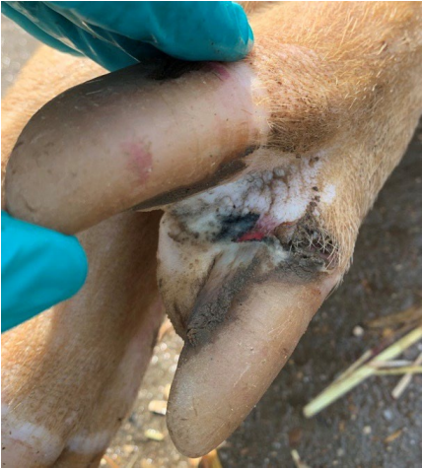
Great Britain pig quarterly report: disease surveillance and emerging threats (publishing.service.gov.uk)
1st detections of Seneca Valley Virus in UK
5 commercial breeding facilities between June and September
Strain shares a common ancestor with an SVV strain from the US
Negative tests for SVV in:
Feed and soy bean meal samples
Boars supplying semen tested negative
No imported animals on the farms
No indication of the source of the infection

Slide 9
MPox (monkeypox) - WOAH - World Organisation for Animal Health
Follow up to September 2022 report of mpox in piglets in DRC
2 ½ month old piglets
1 died and buried
1 with wounds, vesicles and scabs
2nd piglet necropsied
Blood samples and swabs taken from three other piglets
PCR positives for mpox at two laboratories in DRC
Blood samples and swabs taken from the breeder’s family members and neighbors
Cannot rule out contamination by humans
Source of disease remains unknown
No further investigation conducted due to lack of financial means

Slide 10
SHIC Follows-Up on APP15 Outbreak and Finds Unique Results – Swine Health Information Center
Serosurveys of 16 sow farms
12/16 seronegative sows
Suggests horizontal transmission of APP15 during the outbreak as their offspring were involved in outbreaks
4/16 seropositive sows (type 3, 6, 8 and 15)
Further testing of positive farms to occur
Identify sows positive only for APP15
Tonsil scrapings, bacterial isolation, PCR, whole genome sequencing
APP15 in November 2021
50% mortality in some herds
Geographic spread suggested lateral transfer between farms

Slide 11
SHIC Follows-Up on APP15 Outbreak and Finds Unique Results – Swine Health Information Center
Investigation into shedding pattern of APP
Nasal swabs
Tonsil scrapings
Oral Fluids
Affected site sampled post outbreak
67 pigs tested weekly over 6 week period
1st sampling 50% positive on nasal samples and tonsil scrapings
As time went on decrease in positive nasal samples, and increase in positive tonsil scrapings
Tonsil scrapings are a more sensitive sample

Slide 12
SHIC Follows-Up on APP15 Outbreak and Finds Unique Results – Swine Health Information Center
Oral Fluids
2nd and 3rd weeks – 50% positive
Unexpected result
Able to detect APP up to the last sampling period on tonsil scrapings and oral fluids
Some detection up to 9 weeks post outbreak
Unexpected finding, previous reports say it’s detectable only up to 7 days post infection
Environmental Sampling
Positive results found on
Office door
Door handles of all 3 barns
Rendering box
Feed plates
Floor samples in front of feeders
Floor by entrance door of one barn
Number of positive samples increased over the sampling period

Slide 13
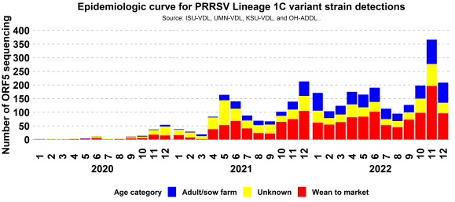
December SHIC report: High level of PRRS circulating in US
Highest numbers of PRRS 1-4-4 L1C since emergence in 2020
All age groups affected
Highest number of variant viruses were in Iowa, Minnesota and Missouri
Increased rate of lateral spread from grow-finish to grow-finish
Increased spillover to Sow farms

Slide 14
Does the PRRS virus have the ability to percolate through our soils? (nationalhogfarmer.com)
Researchers looking at pathogen's increasing incidence in breeding farms between October and December
Same time manure is spread on fields
Manure pits have been shown to be PCR positive for PRRS ~ 9%
Looking at virus’ ability to survive in soils
13 different soil types tested
5, 10, 20 grams of soil
3 strains of PRRS (1-7-4, 1-4-4 and 1-26-2)
All virus strains could percolate through all amounts and types of soil
Viral titre drops with increasing amount of soil

Slide 15
Assessment of temperature and holding times to inactivate PRRSV and PEDV on contaminated surfaces commonly found in supply entry rooms in swine farms
Aluminum surfaces took longer to reach the desired temperatures
Different half lives between PRRS isolate
Min times:
86F – 24 hours
104F – 12 hours
122F – 6 hours
Notes:
Major findings and implications
Aluminum surfaces took longer to reach the desired temperature;
Half-lives results suggests that there is a difference between PRRSV isolates because PRRSV 144 L1C variant had higher half-lives at higher temperatures than PRRSV MN184;
Virus was detected after 36 hours at 68ºF;
Although this was a controlled trial it provides practical information that can be applied in field conditions. Therefore, the minimum time that surfaces should be held at 86ºF is 24 hours, at 104ºF is 12 hours and at 122ºF is 6 hours;
To apply combinations of time and temperature to decrease virus concentration on surfaces, the type of material, size of the surface, the supply entry room insolation and size of the room should be considered.

Slide 16
Pathogens | Free Full-Text | Getah Virus (Alphavirus): An Emerging, Spreading Zoonotic Virus (mdpi.com)
Togaviridae, Alphaviridae
32 Alphaviruses known
Western and Eastern Equine Encephalitis are also in this family
1st isolated in 1955 in Malaysia
Spread from 0° North (Malaysia) to 60° North (Russia)
Found in 17 mosquito species, and one midge
# of disease outbreaks is increasing
Notes:
Togaviridae, Alphaviridae
32 Alphaviruses known
Western and Eastern Equine Encephalitis are also in this family
1st isolated in 1955 in Malaysia
Spread from 0 North (Malaysia) to 60 North (Russia)
Found in 17 mosquito species, and one midge
# of disease outbreaks is increasing
Since its original detection, different studies have found that GETV can be amplified in mosquitoes, transmitted to animals through bites, and virus-infected animals serve as a reservoir from which uninfected mosquitoes can acquire the virus. Thus, GETV undergoes a mosquito–vertebrate host–mosquito cycle in nature.
GETV infection causes disease in livestock with symptoms including fever, rash, oedema of the limbs and lymphadenopathy in horses and abortion in pigs.
Humans can be seropositive but no evidence of clinical disease or viral detection has been found to date.
Very low levels of seroconversion have been found in ducks and chickens.

Slide 17
Pathogens | Free Full-Text | Getah Virus (Alphavirus): An Emerging, Spreading Zoonotic Virus (mdpi.com)
Notes:
Image A. Orange coloured areas are where the virus was found from 1955 to 65.
Pale blue is current distribution. GETV group III has been emerging and spreading with a large host and vector range.
Image B. Shows the distribution and specific hosts and vectors affected in China
The transmission and migration routes of GETV in continental Asia are similar to those of Japanese Encephalitis virus that is widely distributed in natural hosts in the region.

Slide 18
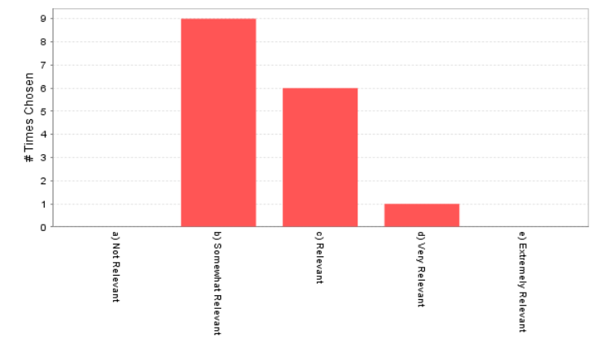
Pathogens | Free Full-Text | Getah Virus (Alphavirus): An Emerging, Spreading Zoonotic Virus (mdpi.com)
Clinical Signs in Piglets
Depression
Ataxia and Tremors
Diarrhea
Fever
Infected Sows
Stillbirths
Fetal mummies
Detection:
Serological tests
RT-PCR
Viral isolation

Slide 19
HPAI in Canada Update
As of Feb 17, 2023:
Total of 299 infected premises
93 currently active
>7 million birds
Increasing mammalian detections of H5N1
Mink to mink transmission in Spain
Sea lion to Sea lion transmission in Peru

