Slide 1
Communauté des maladies émergentes et zoonotiques Identification des risques émergents par l’intelligence collective
CMEZ – Point du réseau des maladies à transmission vectorielle du SCSSA
26 septembre 2023
www.cezd.ca

Slide 2
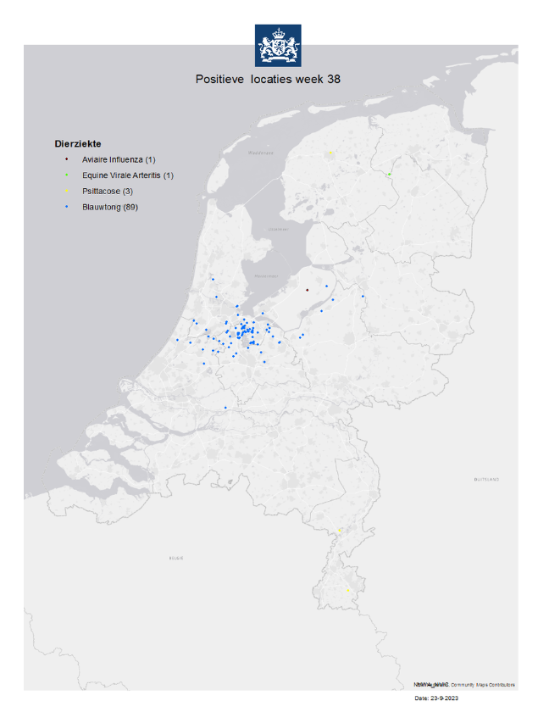
Fièvre catarrhale du mouton aux Pays-Bas
Le 5 septembre, les Pays-Bas ont signalé 4 cas de fièvre catarrhale du mouton, ce qui fait 89 cas en tout.
Sérotype 3 (pas de vaccin contre le sérotype 3)
Interdiction d’exportation imposée pour les ruminants vivants, y compris le sperme et les embryons
La source de l’infection est encore inconnue
Le VFC aux Pays-Bas en 2006 était de sérotype 8
Contrôlé avec un programme de vaccination
Dernier cas connu : 2009
Statut indemne déclaré en 2012
Récemment, la France a signalé 8 éclosions de VFC, considéré endémique
Notes:
AS of September 23, the Netherlands have reported 89 outbreaks of BTV on sheep farms in Noord-Holland and Utrecht. BTV was last reported in the Netherlands in 2009. The Netherlands will lose its EU disease-free status, meaning sheep will have to be vaccinated before they can be exported.
The bluetongue virus found on sheep farms in the Netherlands has been confirmed as serotype 3, the most recently reported serotype in Europe, and presumably entered from Tunisia to Italy; the source of infection with this serotype in the Netherlands is unknown
An investigation has begun into the source of the infection and the farms involved are no longer allowed to move live animals as a temporary measure.
Bluetongue is spread by midges, not by direct contact between animals, opening up the possibility of more cases in the next few weeks, Farmers have been told to use insect repellents to stop the disease from spreading.
Contrary to bird flu, foot and mouth disease or mad cow disease, no animals will have to be destroyed as a result of the disease, which is characterised by high fever, swelling of the lips and red to purply mucous membranes of the mouth and tongue.
In France - More than 300 herds in Aveyron have already been affected. At least one clinical case of BTV-8 has been confirmed in the neighbouring departments of Lot, Lozère, Cantal and Tarn-et-Garonne

Slide 3
Virus du Nil occidental
Les signalements sont en hausse, mais c’est la période saisonnière normale pour les cas
Ontario : plusieurs villes (Toronto, Sudbury, Peterborough, Chatham-Kent)
Infections humaines et gîtes larvaires de moustiques positifs
Manitoba et Alberta : infections humaines

Slide 4
Malaria
La Floride a signalé 1 autre cas de malaria contracté localement en juillet (7 cas en tout)
Le Maryland a signalé 1 cas transmis localement
Le 1er en 40 ans
Plasmodium falciparum (plus grave que P. vivax, trouvé en Floride et au Texas)

Slide 5
Stomatite vésiculeuse
Dernier rapport de situation de l’USDA
Le Nevada a signalé 1 exploitation positive à la fin juillet
201 exploitations ont été touchées par le VSV depuis le début de l’éclosion
Californie (198), Texas (2), Nevada (1)

Slide 6
Dermatose nodulaire contagieuse
Il continue d’y avoir des signalements dans des pays asiatiques : Inde, Sri Lanka, Népal
À la mi-juillet, la Libye a signalé sa première éclosion de DNC
Fin juillet : l’Indonésie a suspendu les importations de bovins vivants d’Australie après que la DNC a été détectée dans du bétail expédié d’Australie
Il n’est pas clair où les bovins ont été infectés; 16 bovins positifs en tout
La Malaisie a aussi suspendu ses importations
3 septembre – conclusion de l’enquête australienne : pas de DNC identifiée en Australie
L’Australie demeure indemne de DNC
Pas de banque de vaccins contre la DNC
Notes:
LSD has resurfaced in Assam, India, affecting ~40,000 cows in at least seven districts of the state.
In Nepal >47 000 cattle have succumbed to the disease in ~5 months
In Sri Lanka, LSD has spread further in the North Central province
Libya has reported its first outbreaks of LSD, reported a total of 8 outbreaks as of mid-July 2023
At the end of July 2023, Indonesia suspended imports of live cattle from four Australian export facilities, following the detection of LSD in livestock shipped from Australia. However, it is unclear if the cattle were infected in Australia as they were tested a number of days after they had entered Indonesia. LSD was first reported in livestock in Indonesia in March 2022. LSD has not yet been reported in Australia, but an analysis conducted last year found a 28% likelihood of an outbreak in the country within the next five years.
August 12, an additional three Australian cattle tested positive for LSD in Indonesia, for a total of 16 positive cattle.
September 3, the Australian investigation into the initial four export facilities has concluded and no cases of LSD were identified, Australia remains free of LSD. Rapid diagnostic testing of more than 1,000 head of cattle across northern Australia, across numerous properties spanning WA, Qld and the NT (across a distance of approximately 2,800 km). Testing did not detect LSD in Australia and the disease status has not changed.

Slide 7
Fièvre hémorragique de Crimée-Congo
Signalements en Iraq, en Iran, en Afghanistan, au Turkestan et au Pakistan
En Europe : la Macédoine du Nord a signalé quelques cas, ainsi que la Géorgie
Notes:
Reports have decreased in last 4 weeks

Slide 8
Dengue
Signalements dans de nombreux pays du monde
Amérique du Nord : en Floride, transmission locale dans le comté de Miami-Dade
Europe : transmission locale signalée en Italie et en France
Notes:
Asia
Bangladesh – most cases this year with 133,134 reported as of Sept 4, and 646 deaths
Taiwan – 2nd highest number of cases in past 10 years, ~1300 cases in the first week of Sept
Philippines - 2,413 cases this year vs 2,386 in all of 2022
South America
Colombia – 67,944 cases this year, those <15yrs affect the most (48.7% of cases)
Guatemala - declared national emergency 152% compared to last year
Paraguay - last three weeks 118 cases (90% cases from 5 regions) DEN-1, DEN-2
Jamaica – declared outbreak of dengue (565 suspected, presumed and confirmed cases of Dengue)
North America
USA – Florida local transmission in Miami-Dade County (9 cases) and Broward County (2)
Two hundred and four cases with onset in 2023 have been reported in individuals with travel history to a dengue-endemic area in the two weeks prior to onset
Africa
Chad – declared dengue outbreak mid-August
Ivory Coast and Mauritius have also reported cases
Europe
Italy – local transmission up to 27 (Lodi (21 confirmed cases), in the province of Latina (2 cases) and in the province of Rome (4 cases with exposures in different parts of the metropolitan city of Rome) – 181 travel cases this year
France reported a locally transmitted case of dengue in mid-August

Slide 9
Fièvre de la vallée du Rift
La FVR est une zoonose en réémergence
Sa répartition mondiale change lentement
Ses hôtes principaux sont les ruminants, les chameaux et les humains; grande échelle d’espèces
Maladie à transmission vectorielle propagée par les moustiques
Maladie à déclaration obligatoire au Canada – fiche de renseignements de l’ACIA
Bons contrôles à l’importation pour les animaux vivants et les produits d’origine animale venant des pays touchés
La translocation des moustiques vecteurs par avion est plausible
Autres voies de transmission

Slide 10
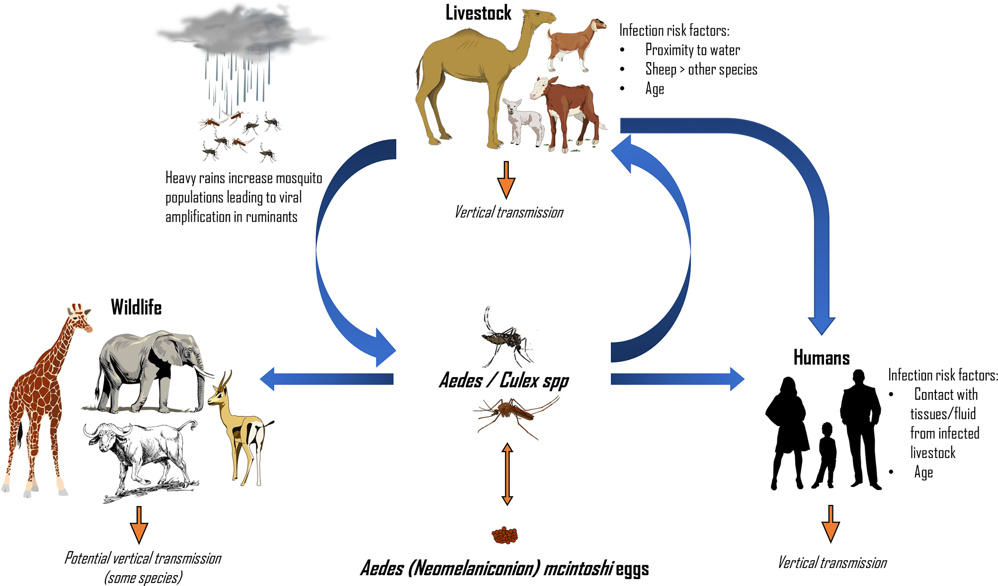
Fièvre de la vallée du Rift
J. Gen. Virol. 100, 1187 (2019);
https://doi.org/10.1099/jgv.0.001296
Notes:
“RVFV cycle. Between epidemics RVFV may be maintained through transovarial transmission in Aedes (Neomelaniconion) mcintoshi eggs. Wild ungulates and livestock can also harbour low-level infection. During heavy rains, a surge in mosquito populations leads to increased infection of livestock and viral amplification between numerous vector species and ruminants occurs. As more livestock become infected, the chances of spillover into humans increases. Human infection can occur via mosquito bite, or more commonly, via contact with infected animal tissue and fluid.”
Image and text here from J. Gen. Virol. 100, 1187 (2019); https://doi.org/10.1099/jgv.0.001296
Can cause serious illness in animals
Cattle
Sheep > other species
Goats
Camels
Young affected > adults
High rates of mortality and abortion
Significant economic impact
Horizontal, vertical and vector borne transmission are possible in humans and animals
Humans infected by contact with livestock, especially blood and body fluids; consumption of unpasteurized milk
Low level of virus circulation can exist in livestock as is evidenced by seropositivity with no clinical outbreak

Slide 11
Illustrations : ESFA Journal 2020
Son aire s’étend de l’Afrique de l’Est à l’Afrique du Sud, puis à l’Afrique de l’Ouest
Des signes d’infection sont maintenant attestés en Afrique du Nord, dans l’océan Indien et au Moyen-Orient
Notes:
Range Extension
1931 epidemic in Kenya – virus first isolated from sheep
Since then major outbreaks in
Egypt, Kenya, South Africa, Madagascar, Mauritania, Senegal, and Gambia
Sub-Saharan Africa
2000-2001 major outbreak in Saudi Arabia and Yemen
Turkiye and Tunisia
Comoros Archipelago in Indian Ocean – 2007
Re-emergence in 2018
Libya – 2020
2 cases
Sheep
Sheep and goats

Slide 12
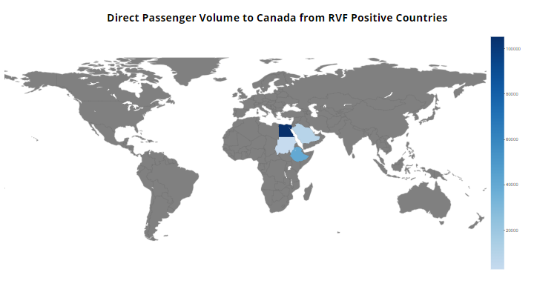
Fièvre de la vallée du Rift
 | Ontario | Québec | Total
Égypte | 95 208 | 10 062 | 105 270
Soudan | 0 | 2 678 | 2 678
Arabie saoudite | 8 967 | 0 | 8 967
Éthiopie | 40 088 | 0 | 40 088
Total | 144 263 | 12 740 | 157 003
Notes:
From 2018 to April 2023 – most traffic from Egypt, however last reported RVF outbreak was in 2003.

Slide 13
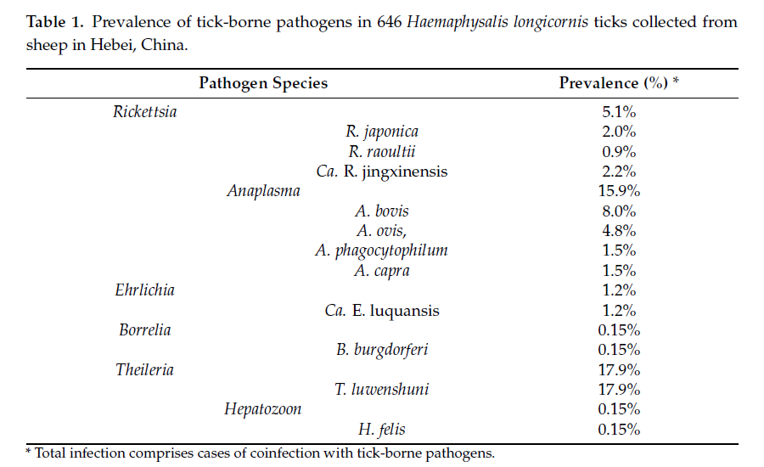
Tique longicorne d’Asie
Pathogens | Texte intégral gratuit | Molecular detection of tick-borne bacterial and protozoan pathogens in molecular detection of tick-borne bacterial and protozoan pathogens in Haemaphysalis longicornis (Acari: Ixodidae) ticks from free-ranging domestic sheep in Hebei Province, China (mdpi.com)
An established population of Asian longhorned ticks (Acari: Ixodidae) in Ohio, USA
Draft genome sequence data of Haemaphysalis longicornis Oita strain
Baseline susceptibility of Haemaphysalis longicornis to Organophosphate, Carbamate, and Pyrethroid Acaricides

Slide 14
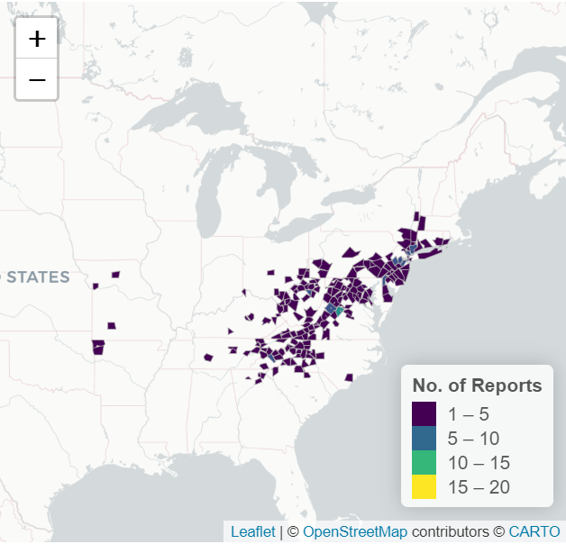
Répartition de la tique longicorne d’Asie aux États-Unis
Carte de l’Université de la Géorgie scwds.shinyapps.io/haemaphysalis/
Permet un tri par État et par comté
Les cartes diffusées périodiquement par l’USDA sont statiques

Slide 15
Résultats d’études scientifiques
Detection of Orientia spp. bacteria in field-collected free-living Eutrombicula chigger mites, United States
Geographic distribution of suspected alpha-gal syndrome cases — United States, January 2017–December 2022
Soft tick relapsing fever — United States, 2012–2021
Evidence of protozoan and bacterial infection and co-infection and partial blood feeding in the invasive tick Haemaphysalis longicornis in Pennsylvania
Ticks (Acari: Ixodida) on synanthropic small and medium-sized mammals in areas of the northeastern United States infested with the Asian longhorned tick, Haemaphysalis longicornis
Experimental acquisition, maintenance, and transmission of methicillin-resistant Staphylococcus aureus by the common bed bug, Cimex lectularius
Anaplasma bovis–like infections in humans, United States, 2015–2017

Slide 16
Résultats d’études scientifiques
Rapid epidemic expansion of Chikungunya virus East/Central/South African lineage, Paraguay. Emerging Infectious Diseases Journal, vol. 29, nº 9 (sept. 2023) - CDC
Heartland virus: an evolving story of an emerging zoonotic and vector-borne disease
Detection and characterization of Alongshan virus in ticks and tick saliva from Lower Saxony, Germany with serological evidence for viral transmission to game and domestic animals
Detection and phylogenetic analysis of Dabieshan tick virus and Okutama tick virus in ticks collected from Cape Toi, Japan
Surveillance, prevention and control of West Nile virus and Usutu virus infections in the EU/EEA

