Slide 1
Community for Emerging and Zoonotic Diseases Identifying emerging risks through collective intelligence
CEZD – CAHSS Bovine Network Update
15 March 2024
www.cezd.ca

Slide 2
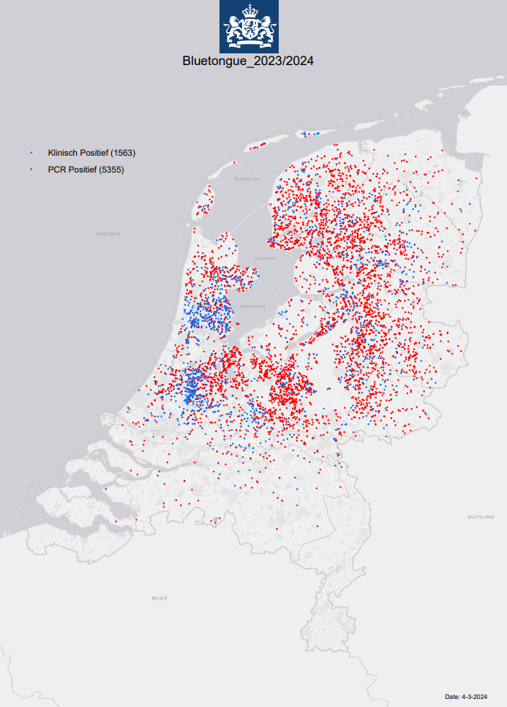
Bluetongue virus (BTV-3) in Europe
Netherlands
Initial cases reported end of Sept 2023
Serotype 3
Most recent reports
PCR positives - 5355
Clinically positive - 1563 (no PCR)
Cases in cattle and sheep
Rare case: 3.5 year old pregnant dog also tested positive
Lived on a dairy farm with both cattle/sheep
Source of introduction remains unclear
Notes:
Image shows the BTV-3 situation in the Netherlands as of March 4, 2023
Total ~6918 cases = 5355 PCR positive with 1563 with clinical signs
Cases have been reported in both cattle and sheep
There was also a case reported in a 3.5-year-old pregnant dog that lived on a dairy farm with both cattle and sheep, its unclear how the dog became infected;
BTV infection in dogs is rare and has only been previously reported in pregnant dogs
Source of introduction remains unclear

Slide 3
Bluetongue virus (BTV-3) in Europe
UK
Early Nov, 1st cases of BTV serotype 3 in cattle in Kent
Additional cases then continued to be reported
As of March 1, there have been 123 confirmed cases of BTV in England on 73 premises in 4 counties
116 cases in cattle, 7 cases in sheep
BTV serotype-3 has been found in Kent, Suffolk, Norfolk
There is still no evidence that BTV is currently circulating in midges in Great Britain, seasonally low vector period
On Feb 19, temporary control zones in Kent, Norfolk, and parts of Suffolk lifted
Notes:
From the Netherlands BTV3 has spread to a few other countries, most notable the UK where is was first reported on Nov 1 in cattle in Kent
Additional cases continue to be reported and as of March 1, there have been 123 confirmed cases of BTV in England on 73 premises in 4 counties (115 cattle, 7 in sheep)
A recent UKHSA report states that - There is still no evidence that BTV is currently circulating in midges in Great Britain, in a seasonally low vector period, so on Feb 19, the temporary control zones in Kent, Norfolk, and parts of Suffolk were lifted
Due to the current low vector period (where antibodies are low and test results indicate an older infection), animals that test positive for Bluetongue are not currently being culled. This is due to the lower temperature leading to a reduced risk on onward transmission.
UK has tested ~45,000 animals for BTV-3 and only found ~120 positives None had died and there were no clinical signs of disease in the animals so its quite different from what is happening in the Netherlands with 20% mortality in sheep and ~7,000 or more infected premises

Slide 4
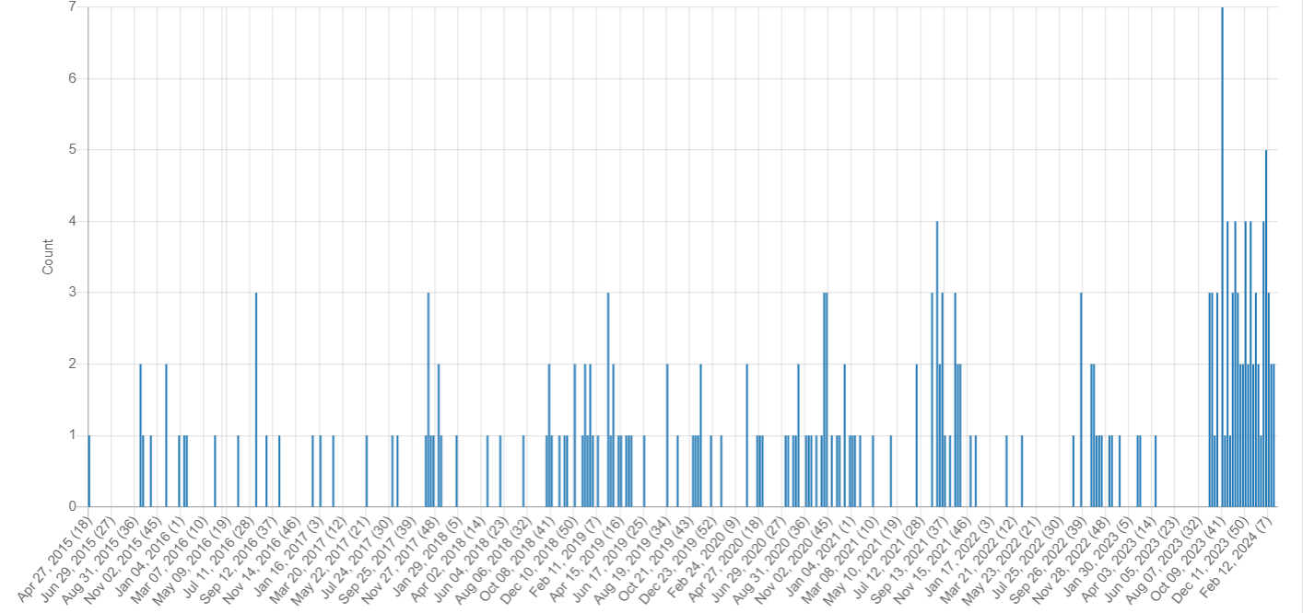
Bluetongue virus (BTV-3) in Europe
Belgium
End of Sept, 1st case of BTV serotype 3 in sheep in Merksplas
Close to border with Netherlands
No additional cases reported to WOAH, but a total of 7 on dashboard
Germany
Early Oct, 1st cases of BTV serotype 3 in Kleve
Close to border with Netherlands
Cases in both cattle and sheep
As of Feb 29th, 28 outbreaks reported
Westward spread
BTV Signals: April 2015 – March 2024
Notes:
What about any other European Countries?
We covered this in the previous network update but just to refresh – Belgium reported its first case of BTV in Sept 2023 in Merksplas, close to border with Netherlands, however they have not reported any additional cases to WOAH, but I recently found a dashboard that shows they have 7 cases reported, with 5 cases in 2023 all in sheep, the two detections in 2024 in cattle
Germany – first case reported October 2023 in Kleve(close to border with Netherlands), Germany continues to report cases in both cattle and sheep, as of Feb 29th, 28 outbreaks have been reported and there has been some westward spread in the country
So Netherlands, Germany, and Belgium are all reporting due to export, but others in EU are not doing surveillance if they don't have a market that requires it so there are still a lot of unknowns around BTV-3 distribution in Europe.

Slide 5
Bluetongue – Scientific Findings
A novel bluetongue virus serotype 2 strain isolated from a farmed Florida white-tailed deer (Odocoileus virginianus) arose from reassortment of gene segments derived from co-circulating serotypes in the Southeastern USA
This BTV-2 strain likely stemmed from the acquisition of genome segments from co-circulating BTV strains in Florida and Louisiana
Genetically uncharacterized BTV strains may be circulating in the Southeastern USA
Recovery of multireassortant bluetongue virus serotype 6 sequences from a mule deer (Odocoileus hemionus) and Dorset sheep (Ovis aries) in Colorado
Discovery of two bluetongue virus serotype 6 (BTV-6) reassortants recovered from a domestic sheep and a free-ranging mule deer in northern Colorado
Whole-genome sequencing of BTV-6 isolates in the Western U.S. have not been undertaken
Findings reflect movement of geographically distinct BTV serotypes into important agricultural areas of the U.S. and demonstrate reassortment with regionally circulating serotypes
Notes:
Two recent studies on BTV re-assortments, one from Colorado and the other in Florida
Florida - a BTV-2 strain was isolated from a farmed WTD, genome segments shows similarity with BTV strains from Florida and Louisiana
The other was a BTV-6 sequences from a mule deer and sheep in Colorado, nine segments showed greater homology with other strains (3, 10, 11, 13) – isolates likely evolved regionally as all segments from samples have endemically circulated with the US.
Both studies conclude that there is a need for ongoing surveillance/monitoring to assess prevalence and potential risks posed by different BTV strains, and the use of sequencing to detect regional changes in pathogen genomes

Slide 6
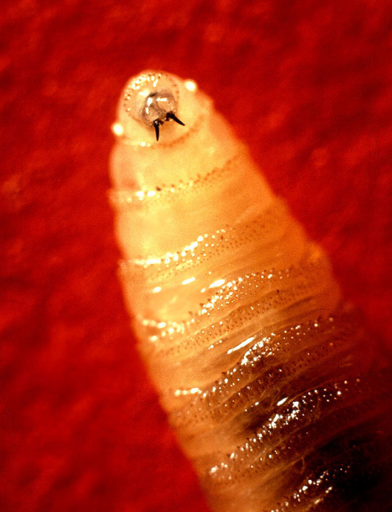
New World Screwworm in South America
Parasitic fly larva - Cochliomyia hominivorax causing wound myiasis
February 2024 – Costa Rica declared a sanitary emergency due to the presence and spread of new world screwworm; 203 cases have been treated in cattle, horses, pigs, sheep, goats and dogs
March 2024 – Costa Rica reports 1st human case in country
Panama has also reported 2 human cases this week, along with previous cases in cattle
Uruguay is developing a CRISPR gene drive to eradicate the screwworm
Notes:
New World Screwworm has been reported in Costa Rica and Panama
- the screwworm in a parasitic fly larva that cause wound myiasis
In February 2024 – Costa Rica declared a sanitary emergency due to the presence and spread of new world screwworm; 203 cases have been treated in cattle, horses, pigs, sheep, goats and dogs
March 2024 – Costa Rica reports 1st human case in country
And I believe last week, Panama also reported 2 human cases, along with previous cases in cattle
Now I wasn’t sure if I should include this as I’m not sure its considered a VBD? It’s a fly a vector spreading its parasitic larva?
USDA-APHIS has it listed under cattle vector borne diseases?
In 2016, the United States had a re-emergence of New World Screwworm (NWS) after ~30 years. The larvae were found infesting the endangered key deer in the Florida Keys
Uruguay is developing a CRISPR gene drive to eradicate the New World screwworm,

Slide 7
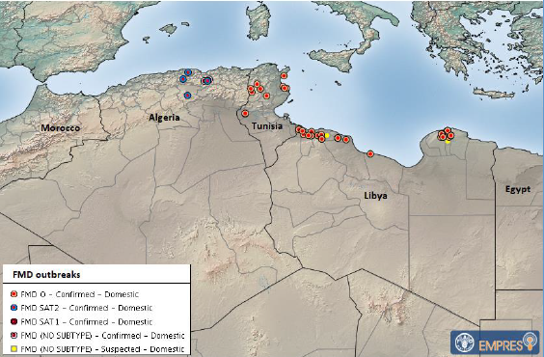
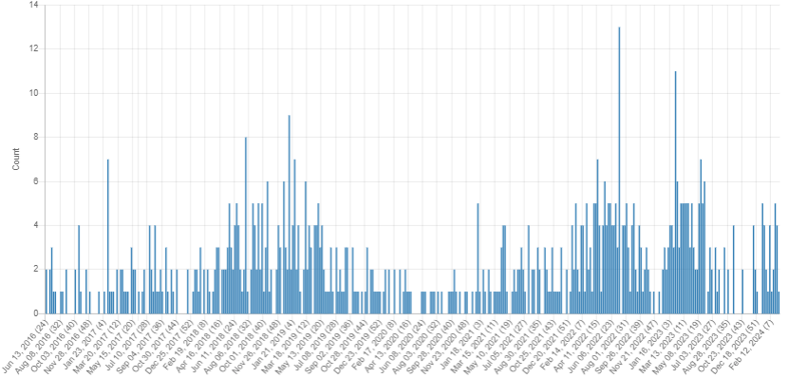
Foot and Mouth Disease
Countries in northern Africa have reported FMD outbreaks: Libya, Algeria, Tunisia
Tunisia and Libya have reported outbreaks of type O
Algeria has reported SAT-2 for the first time
Eastern Africa – Comoros reported an outbreak of SAT-1 in January 2024
FMD Signals June 2016 – March 2024
Notes:
Libya – 51 outbreaks on total – serotype O since Dec 2023 - meat prices have also increased due to storm Daniel, which destroyed more than 40% of livestock, and the spread of foot-and-mouth disease, - as of a recent promed article mentions no vaccination applied
Tunisia – 10 outbreaks of serotype O, - some in areas where there has been a delay in implementing vaccination.
Algeria has reported for the first time FMD serotype SAT-2 in the country. Which has been spreading in the Middle East over the last ~two years. Vaccination programs in surrounding African countries are currently focused on serotypes A and O, and are ineffective against SAT-2. Additionally, due to the upcoming Ramadan period in North Africa, an intensification of animal movement is expected in the area
Comoros reported and outbreak of SAT-1 in January 2024, - This is the second time ever that serotype SAT1 is reported in the Comoros, after the outbreak occurred in December 2022, always in Njazídja.

Slide 8
Bovine Tuberculosis
Canada
Update on Saskatchewan bTB investigation as of March 1, 2024
All testing of trace-in herds is complete
Trace-out herd tracing work is continuing
United States
Michigan reported a 4-year-old doe harvested in Benzie County tested positive for bovine tuberculosis
Human Disease due to Mycobacterium bovis Linked to Free-Ranging Deer in Michigan
Notes:
Michigan has reported that a 4-year-old doe harvested in Benzie County during the 2023 deer hunting season has tested positive for bovine tuberculosis. this is the first bTB-positive wild deer from that county.
Bovine TB was identified in free-ranging deer in northern lower Michigan in 1994, with subsequent evidence of transmission to local cattle herds. Between 2002 and 2017, 3 Michigan deer hunters with M. bovis disease were previously reported. This study looks at an additional 4 human cases linked to the zoonotic transmission from deer, utilizing genomic sequencing to confirm close associations among human, deer and cattle M. bovis isolates.

Slide 9
Scientific Findings
Detection of foot-and-mouth disease viruses from the A/AFRICA/G-I genotype in the Sultanate of Oman
Theileria orientalis Ikeda in Cattle, Alabama, USA
Influenza D in Domestic and Wild Animals
First Report of Bovine Coenurosis in North Macedonia
Ability of a dynamical climate sensitive disease model to reproduce historical Rift Valley Fever outbreaks over Africa

Slide 10
Survey of Network Groups
Are CEZD quarterly reports providing value?
Anything we can do better?
Anything we should stop doing?
Notes:
We’re asking all of our network groups for feedback on whether what is being done for the network is providing value. So just a thumbs up/thumbs down survey.
If you have any feedback on what we could do better, or should stop doing that would be valuable – now or later. Given our limited resources, we don’t want to put effort into things that don’t have value.

