Slide 1
Community for Emerging and Zoonotic Diseases Identifying emerging risks through collective intelligence
CEZD – CAHSS Bovine Network Update
21 March 2025
www.cezd.ca

Slide 2
Foot and Mouth Disease – Hazard Trend
Hungary
COVID
Indonesia
SAT-2
Middle East
Germany

Slide 3
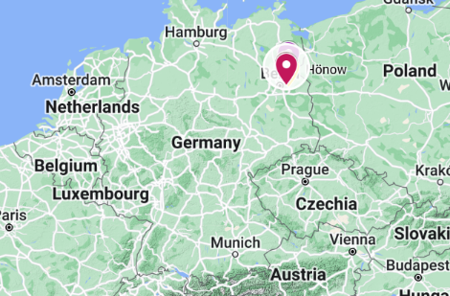
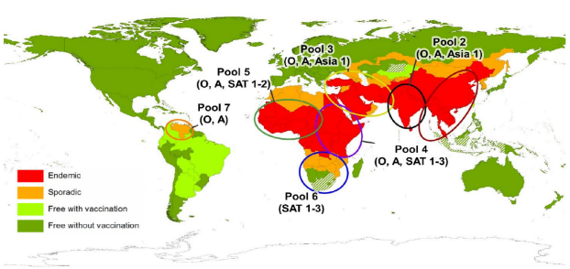
Foot and Mouth Disease in Germany - Recap
Germany reported a case of FMD in water buffalo in Brandenburg (Jan 10)
First occurrence since 1988
Three buffalo died and the rest of the herd (11) were culled
Identified as serotype O – vaccines available in German FMD antigen bank
Closest to strain from Türkiye in Dec 2024
Vaccine was made but was not used
Backyard farm “organic”, feed hay from own fields
No trade within epidemiologically significant period
Source of infection is still unknown
Foot-and-mouth disease - European Commission
Global Distribution of FMD – Merck Veterinary Manual
Notes:
Germany reported an outbreak of FMD in water buffalo in Honow, outskirts of Berlin, on Friday (Jan 10th).
This is the first report of FMD in the country since 1988 (which occurred in lower saxony). And the last outbreak in Europe was reported in Bulgaria in 2011. FMD remains endemic in Turkey, the Middle East, Africa, parts of Asia and South America.
In this event - three water buffalo in Honow have died and the entire herd (remaining 11 buffalo) were culled as a precautionary measure. You can see on the map on the top right where this is in Germany.
The serotype has been identified as O – which is closely related FMD viruses are found in the Middle East and Asia, - You can see from the bottom right image the different pools for FMD worldwide and serotype O is present in all of them except for pool 6 which is in southern Africa. But the closest in proximity to Europe would be those circulating in the middle east (pool 3)
The sequence is closest to strains from Turkiye in December 2024 https://food.ec.europa.eu/animals/animal-diseases/diseases-and-control-measures/foot-and-mouth-disease_en but has also been found in India, Nepal and Iran
The exact origin and route of entry is still unknown, and Germany is now saying they believe the source is human wrongdoing.
But it also shows that the risk of introduction of this virus into a susceptible population can happen anytime.

Slide 4
Foot and Mouth Disease Germany - Update
No additional FMD cases reported
Germany has regained freedom without vaccination for most of the country
Controls still in place in restricted zone (6 km zone)
Import restrictions remain in place for Canada and many other countries
Disease Freedom from FMD
European Commission Presentations
Notes:
Germany has not reported any additional cases of FMD, since the original finding in water buffalo in Brandenburg
In the UK, a technical glitch allowed high-risk German meat imports into the country for about a week after the FMD alert was issued

Slide 5
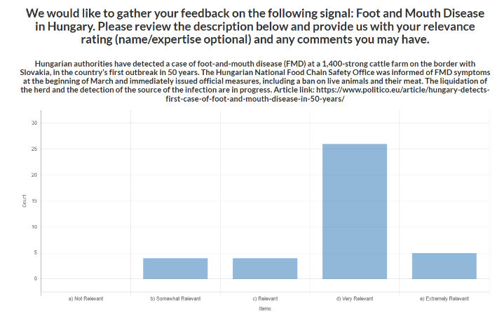
Foot and Mouth Disease Hungary – reported March 6, 2025
CEZD Ping Results
Virtually identical CEZD Member response as FMD Germany
CFIA has import restrictions for commodities/products from Hungary (required to maintain our free status)

Slide 6
FMD Hungary – Reported March 6, 2025

Slide 7
Foot and Mouth Disease - Hungary
Index Case:
Dairy farm ~1400 animals
In Contact
‘Fattening farm’ ~370 animals
Animal movements and daily feed movements between the sites ~3km away (same owner)
Clinical signs started March 3rd
Loss of appetite and water consumption
March 4, 2025
Same clinical signs, changed moldy bedding
March 5, 2025
Fever, vesicles in mouths, on muzzles, coronary bands and interdigital spaces
80% of heifers affected
March 6th, 2025
Confirmation
Control Zones established
72-hour movement ban
Estimated date of infection 27-28 February
Notes:
In contact site had the same owner, feed movement between sites daily, animal movement between sites

Slide 8
March 8th
Contact holding animals euthanized
March 9 – 15
Euthanizing index site animals
Movement restrictions extended to March 12
Movement for direct slaughter allowed, but no other movements permitted until March 17th
Presentation - Foot and Mouth disease in Hungary
Presentation - Foot and Mouth disease - EUVET mission to Hungary

Slide 9
FMD Hungary
Carcass disposal at site ~30 km away
Deep Burial
Nearest rendering facility 150 km away

Slide 10
FMD Hungary - Tracing
Notes:
There are a lot of contacts being traced…in particular 35 linked by animal byproducts transport (assumption that ABP stands for animal byproducts)

Slide 11
FMD Hungary
The Hungarian National Reference Laboratory has identified the serotype of the virus:
O serotype
Its sequence shows the highest similarity with a strain isolated in Pakistan in 2017-18 (98-99%)
The subtype of the strains is FMDV/O/ME-SA/Pan-Asia2/ANT-10
The full analysis by the European Union Reference Laboratory is ongoing.
Questions:
What exposure method would result in 80% of heifers showing clinical signs at once
Is burial offsite a reasonable disposal method? Ground looks sandy, any concerns for virus entering groundwater?

Slide 12
FMD cases globally (since last meeting Jan 15, 2025)
Europe
Germany 1 (O)
Hungary 1 (O)
Asia
Israel 3(O + ?)
Iraq 2(?) underestimate
South Korea 5-9 (O)
China 2 (O,?)
Cambodia 5(?)
Africa
Tunisia 25 (O)
South Africa 6 (SAT-2)
Libya 4(O)
Algeria 1(O)
https://empres-i.apps.fao.org/general
Notes:
Most cases have been within endemic areas, the two real outliers are Germany and Hungary.
Iraq only has two cases in the Empressi data, but news reports suggest there are many more cases than 2, notes in WOAH report indicate that during the last vaccination campaign some owners refused vaccination, which may explain the ongoing cases now.
South Korea has reported a recurrence of FMD, last reported in May 2023, only 1 case on the map, but at least 9 cases have been reported in the news

Slide 13
Industry Notice – Saskatchewan cattle herd declared infected with bovine tuberculosis - inspection.canada.ca
Bovine Tuberculosis in Canada
Investigation status as of 2025-03-13
The depopulation of the infected herd is in progress. Reactor animals identified during live animal testing will be slaughtered first for postmortem inspection and laboratory testing.
The CFIA has started the process for animals and herds connected to the infected herd. This will include:
the testing of herds that have been in contact with infected herd
the tracing of animals that left the infected herd in the last 5 years and the testing of implicated herds as required
the tracing of animals that provided animals to the infected herd in the last 5 years and the testing of implicated herds as required
Notes:
Strain of bovine TB identified
Laboratory culture results from the November 29, 2024 infected animal found a strain that has never been identified in animals or humans in Canada, and the origin of the strain is unknown. It is not closely related to any of the recent strains in Western Canada.

Slide 14
Bovine Tuberculosis in the USA
Michigan
confirmed a case of bTB in a beef herd from Alcona County (located in Modified Accredited Zone)
identified during routine surveillance
first case of bTB identified in Michigan since 2022 and Michigan’s 83rd cattle herd to be found with bovine TB since 1998
South Dakota
confirmed multiple cases of bTB in a cow/calf herd in Kingsbury County, identified through traceback efforts on a steer from a Hamlin County feedlot that tested positive in October 2024
traceback efforts continue to track animals sold from the Kingsbury herd over the past five years to prevent further spread of the disease

Slide 15
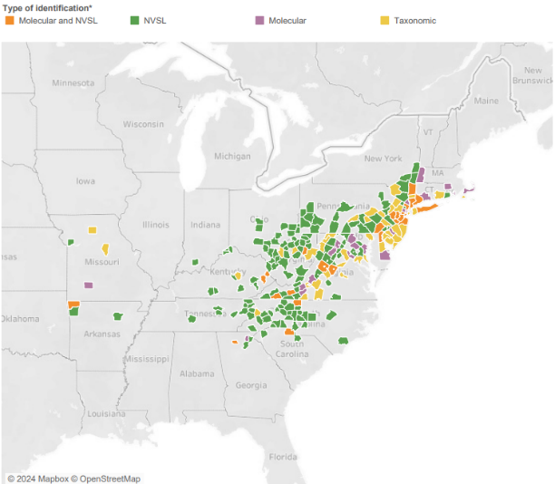
Longhorn Tick and Theileriosis in the USA
Over the winter break a lot of samples were analyzed, lots of new county additions (7 states)
Dog and cat findings have significantly increased
Ohio (from late summer 2024) – 8 counties reporting Theileria positive cattle
Found Theileria in one ALHT in one county
https://scwds.shinyapps.io/haemaphysalis/
USDA Haemaphysalis longicornis (Asian longhorned tick) Situation Report – March 2025
Notes:
New County additions in Ohio, North/South Carolina, Virginia, West Virginia, Kentucky, and Missouri

Slide 16
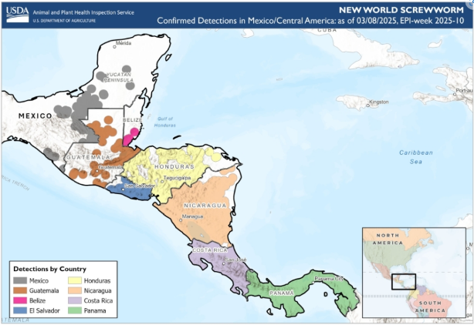
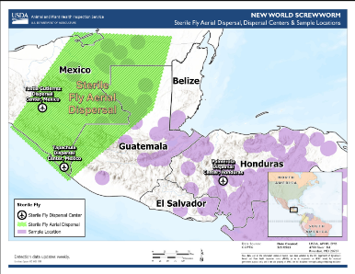
New World Screwworm in Central America and Mexico
NWS has now been found as far north as the Yucatan peninsula
COPEG maps not being updated
Sterile fly release moved to Mexico to try and prevent further northward movement
USDA states that the eradication of NWS in Central America with re-establishment of controls at the Darian gap are the aim of the program
Human cases have now been reported in Mexico, Nicaragua, and Honduras
Vampire bat involvement in spread
COPEG
Notes:
Mexico has reported cases in all five southern regions: Chiapas (169 outbreaks), Campeche (31), Quintana Roo (4), Tabasco(42), and Yucatan(1)
Cases in animals continue increasing, although copeg maps not updated anymore

Slide 17
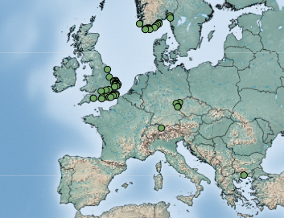
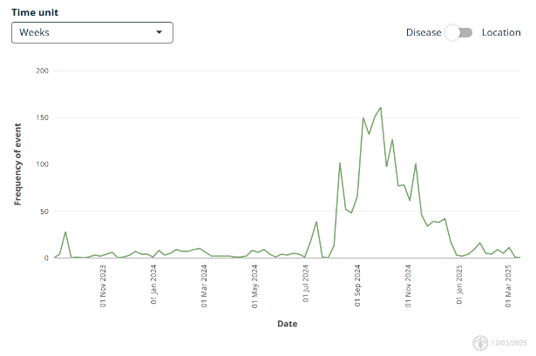
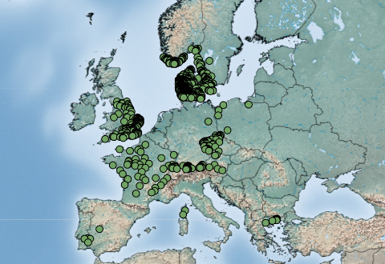
Bluetongue virus (BTV-3) in Europe
First reported Sept 5, 2023 in the Netherlands
Source of infection has never been identified
Continued reports of cases throughout the winter but significant decrease in cases now
BTV-3 Jan 1, 2025 – March 12, 2025
Empres-Plus
BTV-3 Sept 1, 2024 – March 12, 2025
Notes:
Norway continues to report cases of BTV-3, and has been reporting cases throughout the entire winter

Slide 18
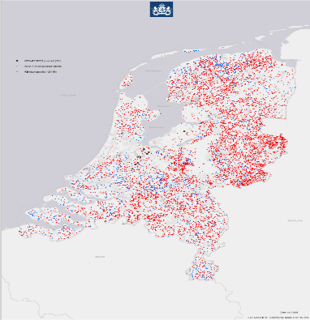
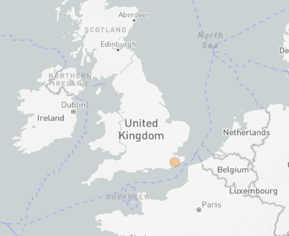
Bluetongue virus (BTV-12 & 4) in Europe
BTV-12
The Netherlands reported their first cases of BTV-12 on October 10, 2024, in a sheep on a farm in Kockengen and in a cow and her calf on a farm in Harmelen
Netherlands still only reporting 12 cases of BTV-12
England BTV-12 for the first time on February 2, 2025
Unclear how it was introduced, wind?
BTV-4
Slovenia reported a reoccurrence of BTV-4, previously reported in December 2016
Three cases were reported in cattle in the north of the country
Notes:
Bluetongue serotype 12 was also been detected in Europe for the first time in the fall of 2024, in the Netherlands last October and they have reported a total of 12 cases so far and England reported BTV 12 for the first time in February of this year on a farm with 15 cows, 1 positive for BTV 12 and three positive for BTV3
It is unknown how BTV-12 was introduced to the Netherlands, the serotype is common in other parts of the world, reported to WOAH by Israel (2010) and Australia (2015). However, it is commonly found in African countries, as is serotype 3.
The Netherlands is retrospectively examining their BTV-3 samples for evidence of BTV-12. Though it seems to be less virulent than BTV-3, the case in the UK had no clinical signs.
Unclear how these different serotypes keep being identified in the Netherlands [BTV-3 (2023), now BTV-12 (2024), and previously BTV-6 (in 2008)]. Is their diagnostics capacity better and its just going undetected in certain countries, or is it another transmission pathway directly into the Netherlands?
BTV-4 has recurred in the Slovenia after being absent for 9 years.

Slide 19
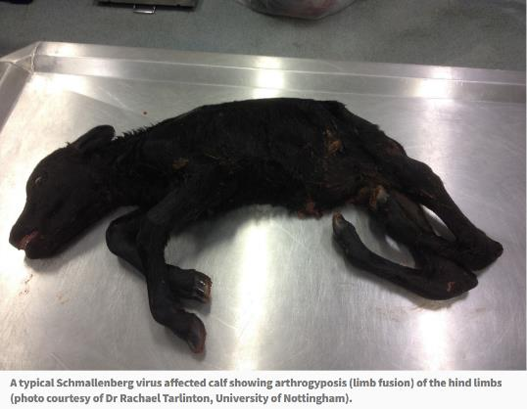
Schmallenberg virus in United Kingdom
Farmers fear being 'wiped out' if any more diseases strike (Scotland)
Ireland and Scotland reporting cases of SBV
Not notifiable, many cases going unreported across Europe
Spread by culicoides, may be experiencing increase in reports as with BTV
AHS - Current News (agriculture.gov.ie)
Notes:
Schmallenberg virus can affect cattle, sheep, and goats. Is transmitted by biting midges, and can cause fever, reduced milk yield, and in pregnant animals, abortions or birth defects
It was first detected in Germany in 2011 and then spread across Europe..

Slide 20
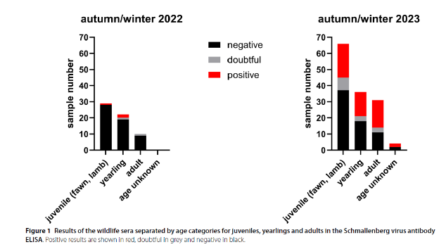
Extensive Schmallenberg Virus circulation in Germany, 2023
Sero-surveillance of wild ruminants for BTV and SBV
All animals seronegative for BTV
In 2022, seroprevalence in tested animals was 4.92% (n=61)
Red Deer and Roe Deer
In 2023, 40.15% of the animals tested positive (n=137)
Red Deer, Roe Deer, Mouflon and unknown species
Notes:
Schmallenberg virus can affect cattle, sheep, and goats. Is transmitted by biting midges, and can cause fever, reduced milk yield, and in pregnant animals, abortions or birth defects
It was first detected in Germany in 2011 and then spread across Europe.
Serosurveillance over 2 years shows variability between the years, which matches the waves of infection that seem to occur in Schmallenberg in farmed ruminants.

Slide 21
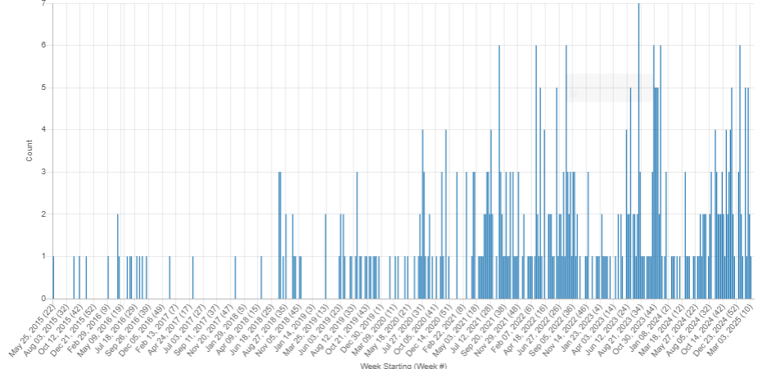
Lumpy Skin Disease
No additional cases of LSD reported in Japan
Initial case reports occurred in cattle in Itoshima city, Fukuoka prefecture
22 total outbreaks reported
Namibia reported LSD cases in the Otjozondjupa Region in June 2024
Has now spread to multiple regions with 1,564 clinical cases and 443 deaths recorded
LSD Signals: May 2015 – March 2025

Slide 22
Scientific Findings
WOAH-FAO Quarterly FMD Reference Lab Report October-December 2024
Zoonotic tuberculosis in Catalonia, Spain: Phylogenetic insights into Mycobacterium bovis and M. caprae transmission at the human-livestock interface
Oral delivery of bovine tuberculosis vaccine to free-ranging white-tailed deer
Phylogenetic analysis of Mycobacterium bovis reveals animal and zoonotic tuberculosis spread between Morocco and European countries
Isolation and molecular characteristics of D2 genotype of Aichivirus D in dairy cattle in China
Novel Rodent Coronavirus-like Virus Detected Among Beef Cattle with Respiratory Disease in Mexico
The first report of schmallenberg virus seroprevalence and associated risk factors in cattles in northern Algeria

