Slide 1
Community for Emerging and Zoonotic Diseases
Identifying emerging risks through collective intelligence
CEZD – CAHSS Bovine Network Update
10 April 2026
www.cezd.ca
Notes:
~3-4 Environmental Scanning update on bovine related signals

Slide 2

Bovine Theileriosis in Canada
Bovine theileriosis is caused by Theileria protozoa
T. orientalis Ikeda has been shown to cause severe illness in the USA
  Transmitted primarily by the ALHT, but may also occur through re-use of needles or during transfusions
The CFIA confirmed Canada’s first case of T. orientalis Ikeda in Kawartha Lakes, Ontario in October 2025
  The cow was imported from the USA on July 15, 2025
  No control measures are undertaken to control the disease
Mid-December 2025, T. orientalis Ikeda was confirmed in a second cow on the same farm in Kawartha Lakes
  The second cow was born in Canada, no known travel history, identified through herd testing
  Showed no clinical signs of illness
  Investigation into potential transmission mechanisms? Flies?
2
Notes:
2

Slide 3
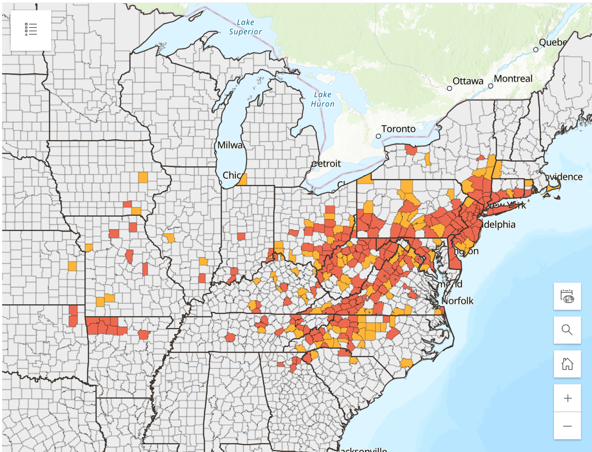
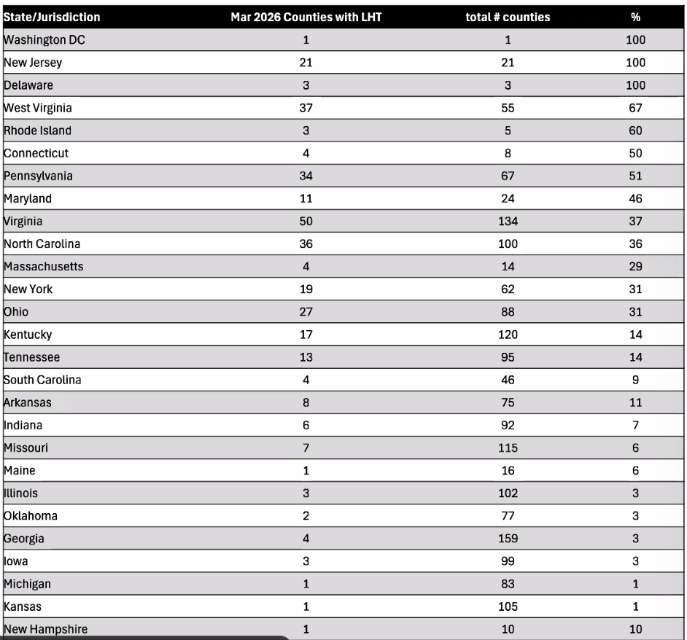
Asian Longhorn Tick and Theileriosis in the USA
Since the last CAHSS call, New Hampshire has reported its first ALHT finding
  Collected in June 2025, eastern state border
26 states + Washing D.C. now affected
Haemaphysalis longicornis ticks as a competent vector for ‘Candidatus Mycoplasma haemobos’ in experimental transmission studies
  First experimental proof that H. longicornis transmits ‘Ca. M. haemobos’
  ‘Ca. M. haemobos’ is maintained transovarially and transstadially in ticks
  Cattle may be exposed continuously
New Website Now Live:
Red = established
Orange = reported
Haemaphysalis longicornis and Theileria | Exotic and Invasive Vector and Vector-borne Disease
Notes:
3

Slide 4
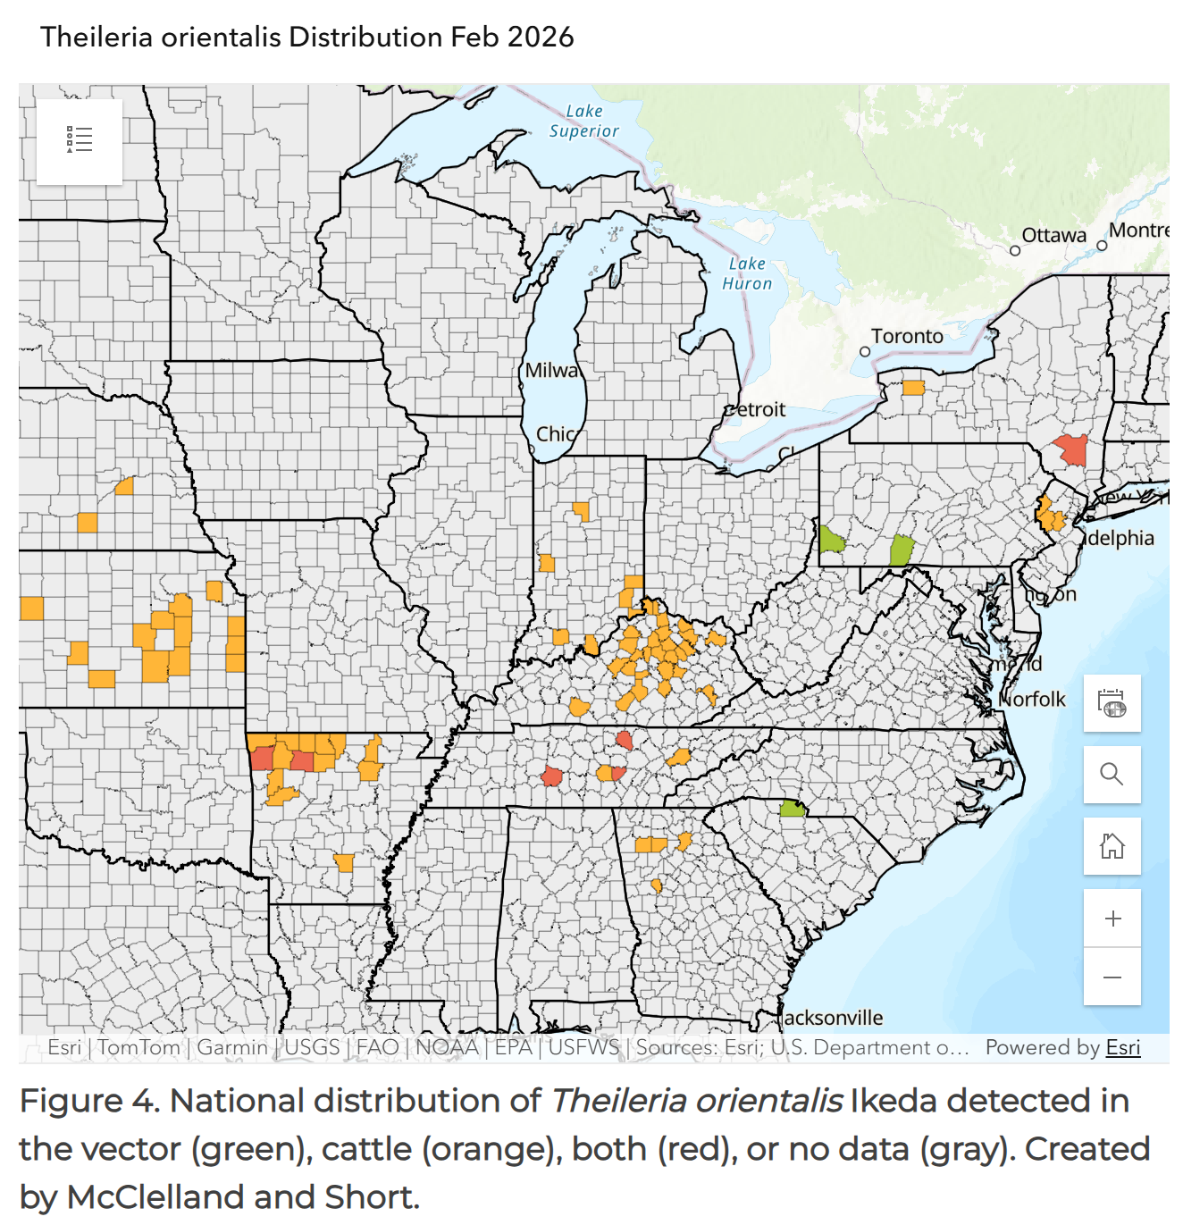
Asian Longhorn Tick and Theileriosis in the USA
Map is not comprehensive but gives an overview
  From voluntary data/submissions
  Some states with lots of Theileria not submitting data
22 states are positive for T. orientalis, reports of cattle with Theileria moving around (some states have a prevalence of >75% positive)
In Missouri, T. orientalis has now been reported in 60 counties, moving westwards throughout the state
Case Report: Retrospective discovery of Theileria orientalis Ikeda in Haemaphysalis longicornis Neumann ticks on a cow-calf farm in Tennessee (US)
Detection of T. orientalis Ikeda in nymphal ALHT collected from cattle, domestic cats, raccoons, and Virginia opossums
Protozoan DNA was not found in the blood of these hosts
Haemaphysalis longicornis and Theileria | Exotic and Invasive Vector and Vector-borne Disease
Notes:
4

Slide 5
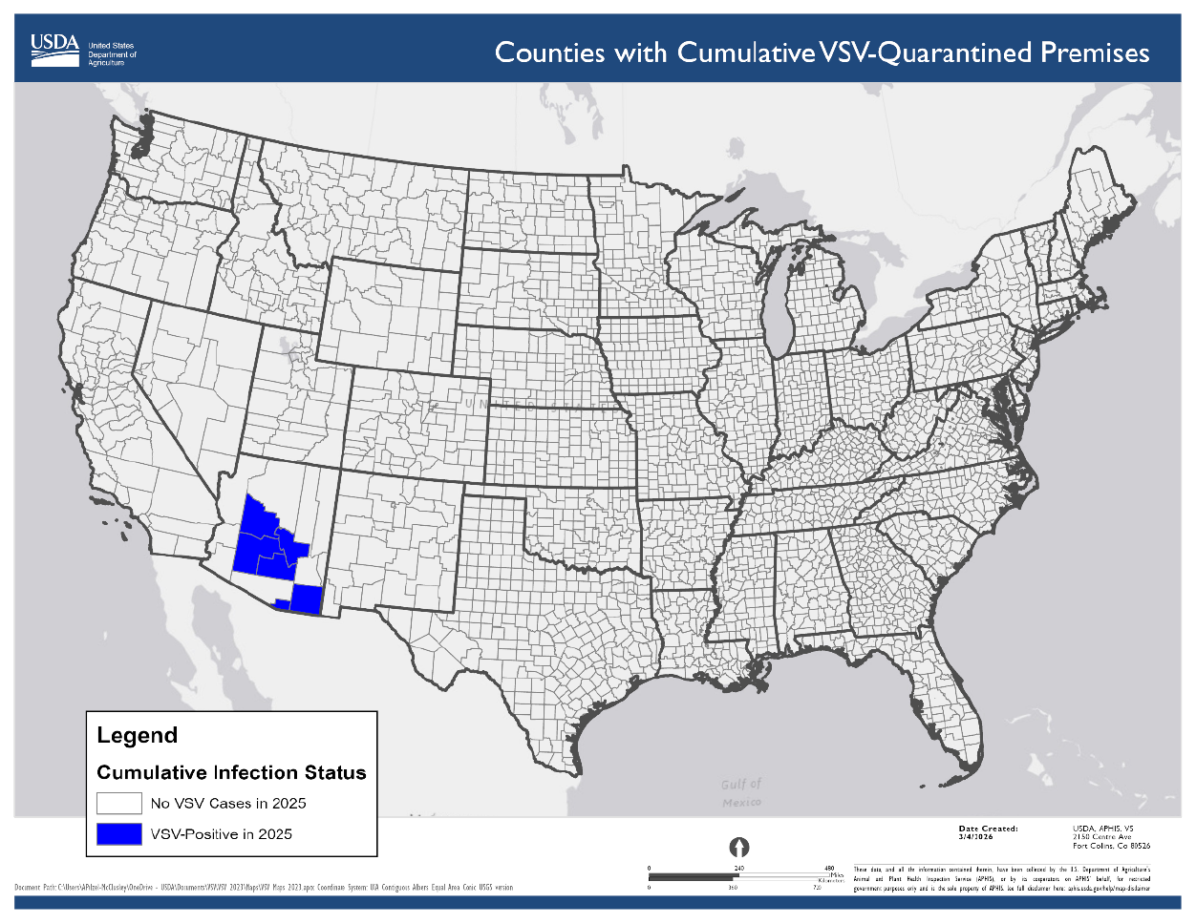
Vesicular Stomatitis in Arizona
USDA VSV Situation Report
Began in Arizona in October 2025
New Jersey Strain virus
13 premises affected across 6 counties
  Cochise County (2 initial cases - 2 released)
  Gila County (2 cases – 1 released)
  Santa Cruz County (2 cases – 2 released )
  Maricopa County (4 cases - 3 released)
  Pinal County (1 case – 1 released)
  Yavapai County (2 cases – quarantine)
No recent livestock movements onto the index premises
Suspect that vector movements across the border are the source of the outbreaks
5
Notes:
5

Slide 6
Bovine Tuberculosis in Canada
Investigation status as of 2026-04-02
Manitoba (June 9, 2025):
The CFIA reported bovine TB in a 7-year-old dairy cow originating from the Pembina Valley Region, Manitoba
1 Infected herd - depopulation completed,
Strain found in the infected herd is not a close match to any strain previously reported in livestock or wildlife in North America
66 trace-out herds identified with 59 herds released from quarantine or no quarantine required; 6 trace-in herds identified and released from quarantine or no quarantine required; 6 proximity herds identified with 4 herds released from quarantine or no quarantine require
CFIA continues to identify lifeline, trace-out, and contact herds and prepare for testing
Saskatchewan (November 29, 2024):
The CFIA reported bovine TB in a 6-year-old cow originating from Saskatchewan that was slaughtered at a federally registered abattoir in Alberta
1 Infected herd - humanely depopulated with 27 cases of bovine TB to date, cleaning/disinfection underway
Strain found in the infected herd is not a close match to any strain previously reported in livestock or wildlife in North America
7 lifeline herds identified with 6 herds released from quarantine; 128 trace-out herds identified with 127 herds released from quarantine or no quarantine required; CFIA applying for modified trace in period - 14 trace-in herds identified with 10 herds released from quarantine or no quarantine required; 1 contact herd identified and released from quarantine or no quarantine required; 13 proximity herds identified with 9 herds released from quarantine or no quarantine required
CFIA continues to identify contact herds and prepare for testing
Bovine tuberculosis investigations - inspection.canada.ca

Slide 7
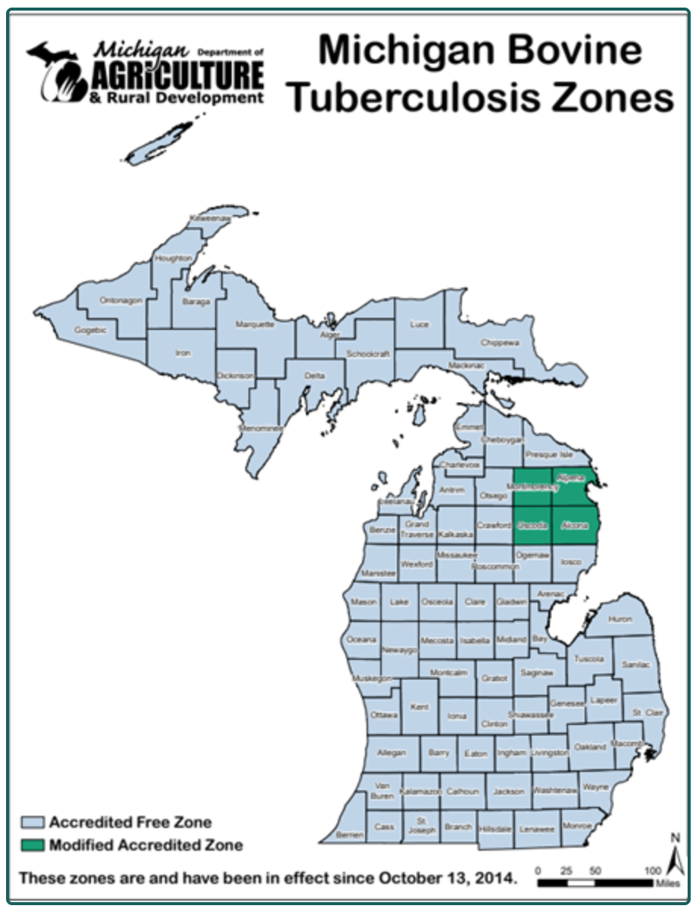
Bovine Tuberculosis in the United States
Michigan has reported cases of bTB in:
  a dairy herd in Charlevoix County, located west of Michigan’s MAZ
  two cattle herds from Alpena (MAZ) and Presque Isle (north of MAZ) counties
    detected during the annual whole-herd surveillance tests for each herd
    in areas where bovine TB is known to be present in the free-ranging white-tailed deer population
MDARD - Bovine Tuberculosis

Slide 8
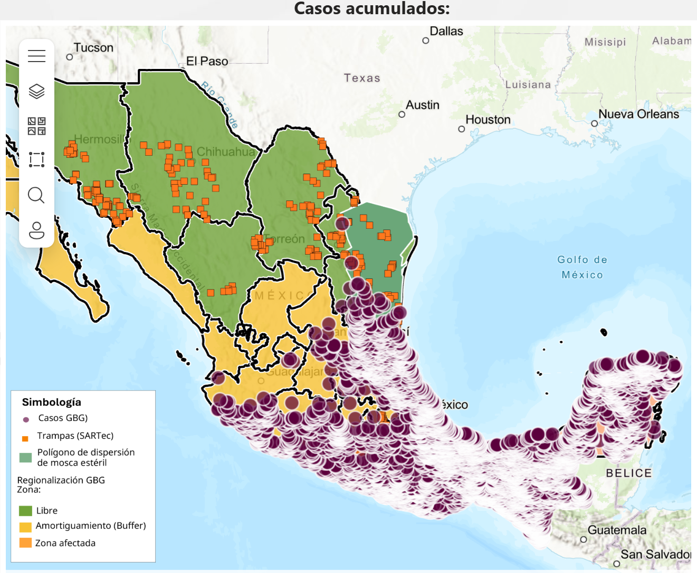
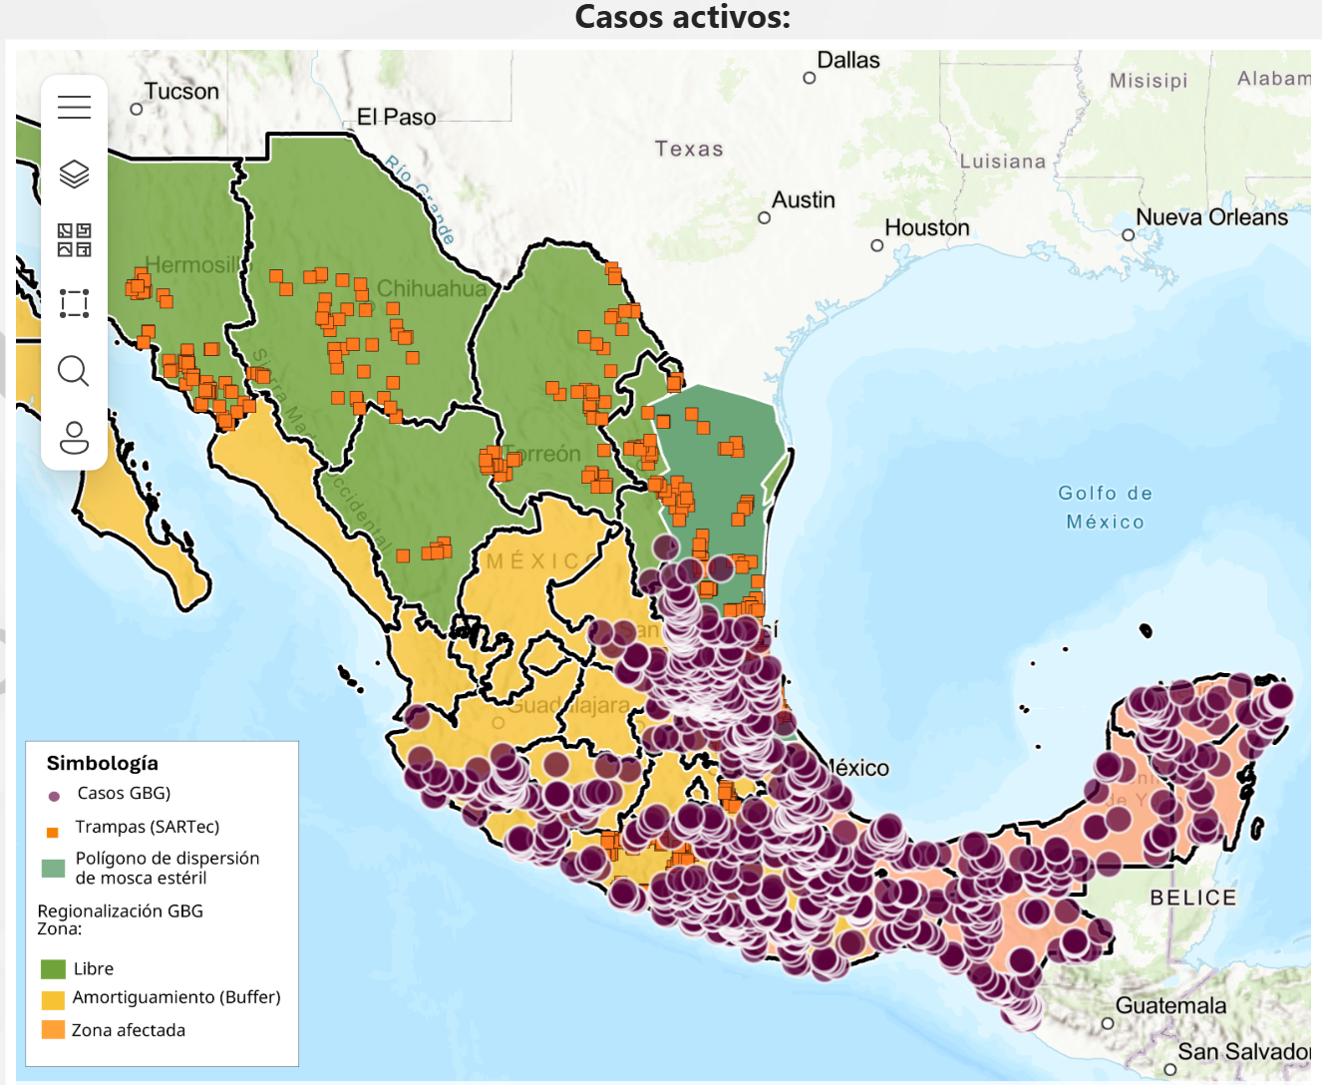
New World Screwworm
Mexico’s interactive dashboard displays 1,236 active cases of NWS in animals (19,744 cumulative)
NWS continues to spread northwest throughout the country
Mexico – 3,234 (~16.4%) cases in dogs, 86 cases in cats,
  Cases also reported in wildlife (red deer, howler monkey)
Mexico human cases now 204 (primarily in Chiapas)
Honduras reported 76 NWS human cases for 2026
USA - Florida reported NWS in a horse imported from Argentina
February - Sterile fly dispersal facility completed in Texas, dispersal shifted northwards
USA/Mexico border remains closed – recent discussions about limited “reopening strategy”
8
Notes:
8

Slide 9
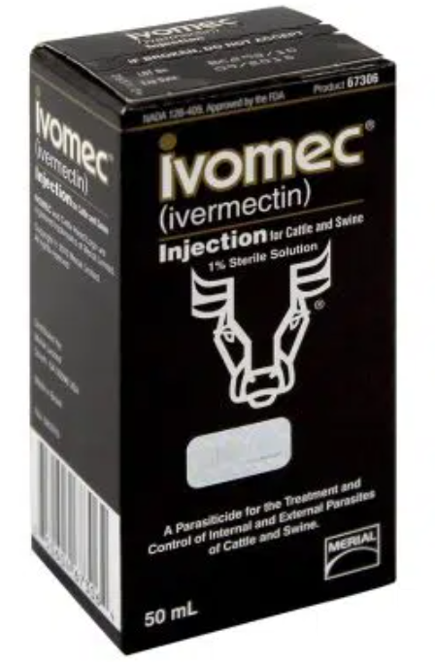
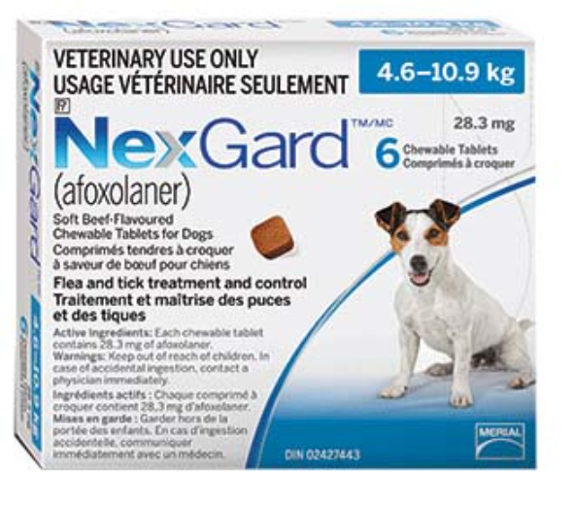
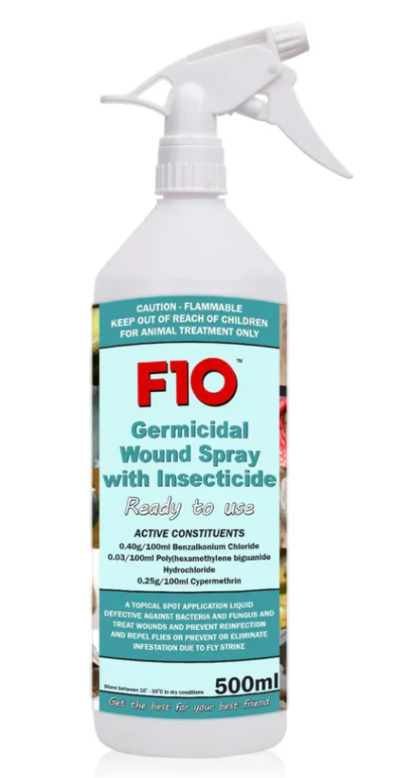
New World Screwworm
Previously - FDA Conditionally Approved Treatments
  Credelio Quattro-CA1 (Elanco) chewable tablets for dogs
  Exzolt Cattle-CA1 (Merck) fluralaner topical solution for beef cattle
  Dectomax-CA1 (Zoetis) injectable for cattle
Recent - FDA Emergency Use Authorizations
Ivomec (10 mg/mL of ivermectin) injectable solution for cattle (excluding female dairy cows)
NexGard (afoxolaner) chewable tablets for the treatment of NWS in dogs & NexGard COMBO (esafoxolaner, eprinomectin, and praziquantel topical solution) for NWS in cats
F10 Antiseptic Wound Spray with Insecticide (benzalkonium chloride, polyhexanide, and cypermethrin topical solution) for the prevention and treatment of NWS
9
Notes:
9

Slide 10
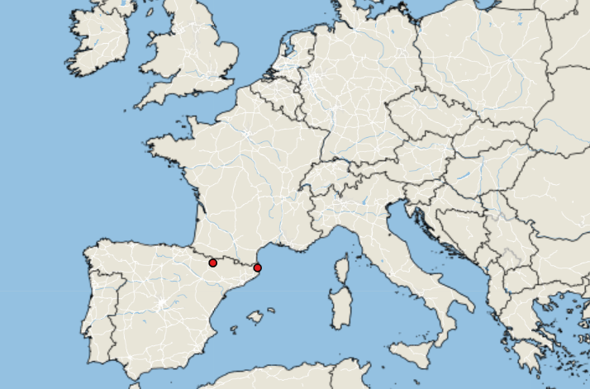
Lumpy Skin Disease in Europe & Asia
LSD Cases: January 1, 2026 – April 7, 2026
Empress +
Europe:
Situation appears to have stabilized, due to vaccination and colder weather
France: 117 total outbreaks reported
Italy: 80 total outbreaks, concentrated in Sardinia, with one cases in Lombardy (linked to animal movement from Sardinia), no new outbreaks reported since early November 2025
Spain: 20 total outbreaks - two new outbreaks reported in February/March – in the Huesca region (previously unaffected) close to French border
Asia:
Indonesia confirmed LSD in Bali after months of unofficial reports
10
Notes:
10

Slide 11
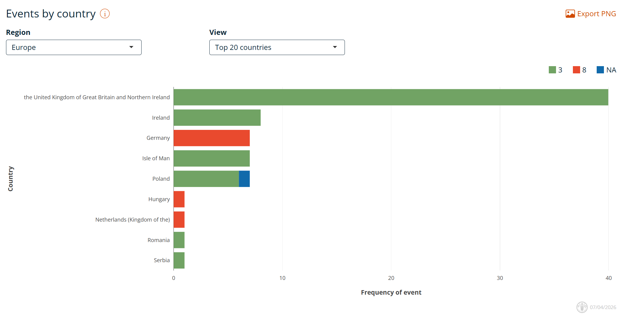
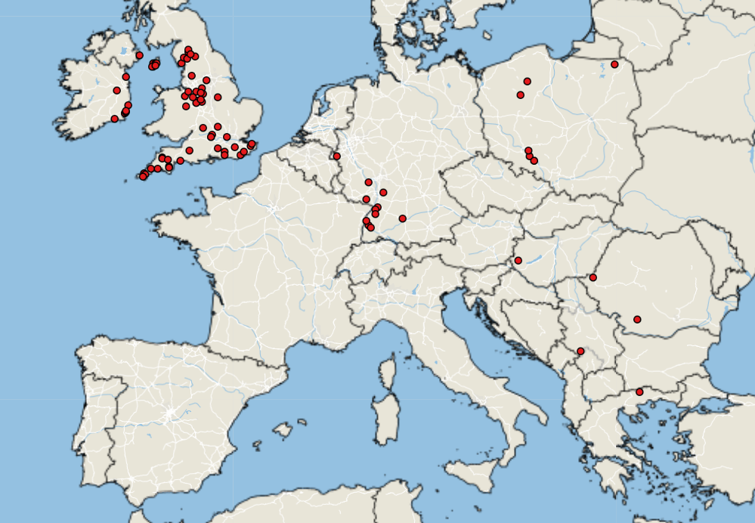
Bluetongue virus in Europe
Empres-Plus
BTV cases January 1, 2026 – April 7, 2026
Notes:
11

Slide 12
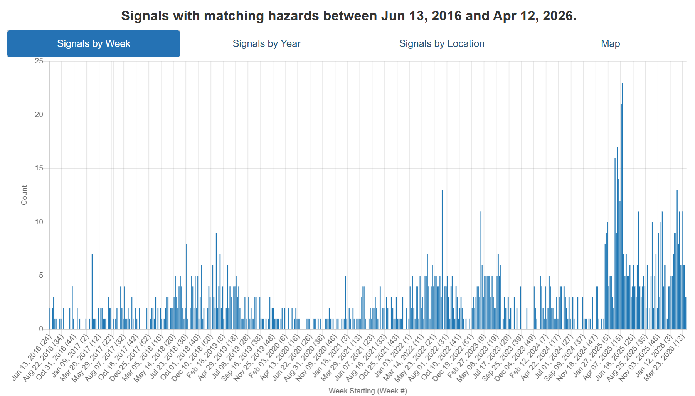
Foot and Mouth Disease – Hazard Trend
Slovakia
COVID
Indonesia
SAT-2
Middle East
Hungary
SAT-1
Middle East, Europe, China
Germany

Slide 13
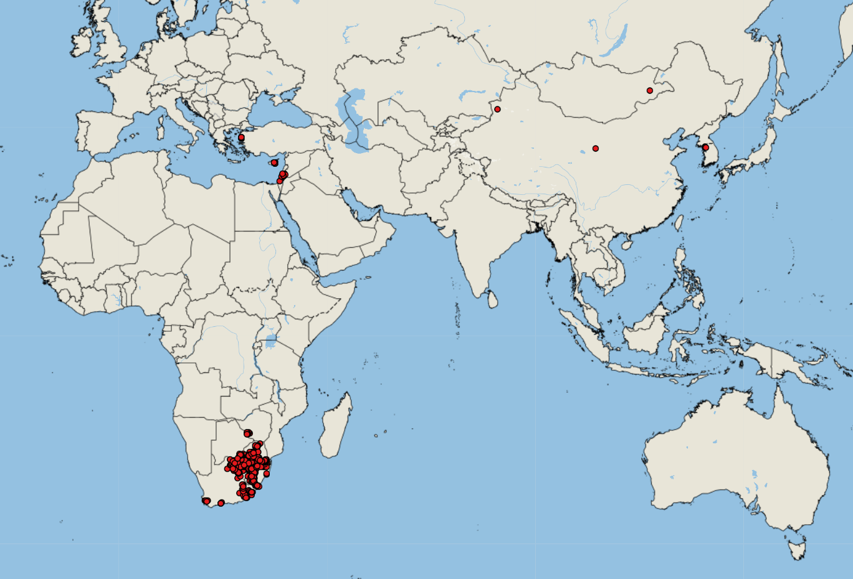
FMD cases reported by FAO Empres-i (since January 1, 2026)
Asia (underestimates)
Cyprus (33 SAT-1) - 66 outbreaks*
China (SAT-1) - 2 outbreaks*
Israel (5 SAT-1)
Palestine (SAT-1)* - 1 outbreak
South Korea (3 O)
Mongolia (1 O)
Iraq*
Africa
Swaziland (40 SAT-1, 3 SAT-2, 4 N/A)
South Africa (318 SAT-2)
Botswana (5 SAT-1, 1 N/A)
Lesotho (6 N/A)
Zimbabwe (2 SAT-1)
53
https://empres-i.apps.fao.org/general

Slide 14
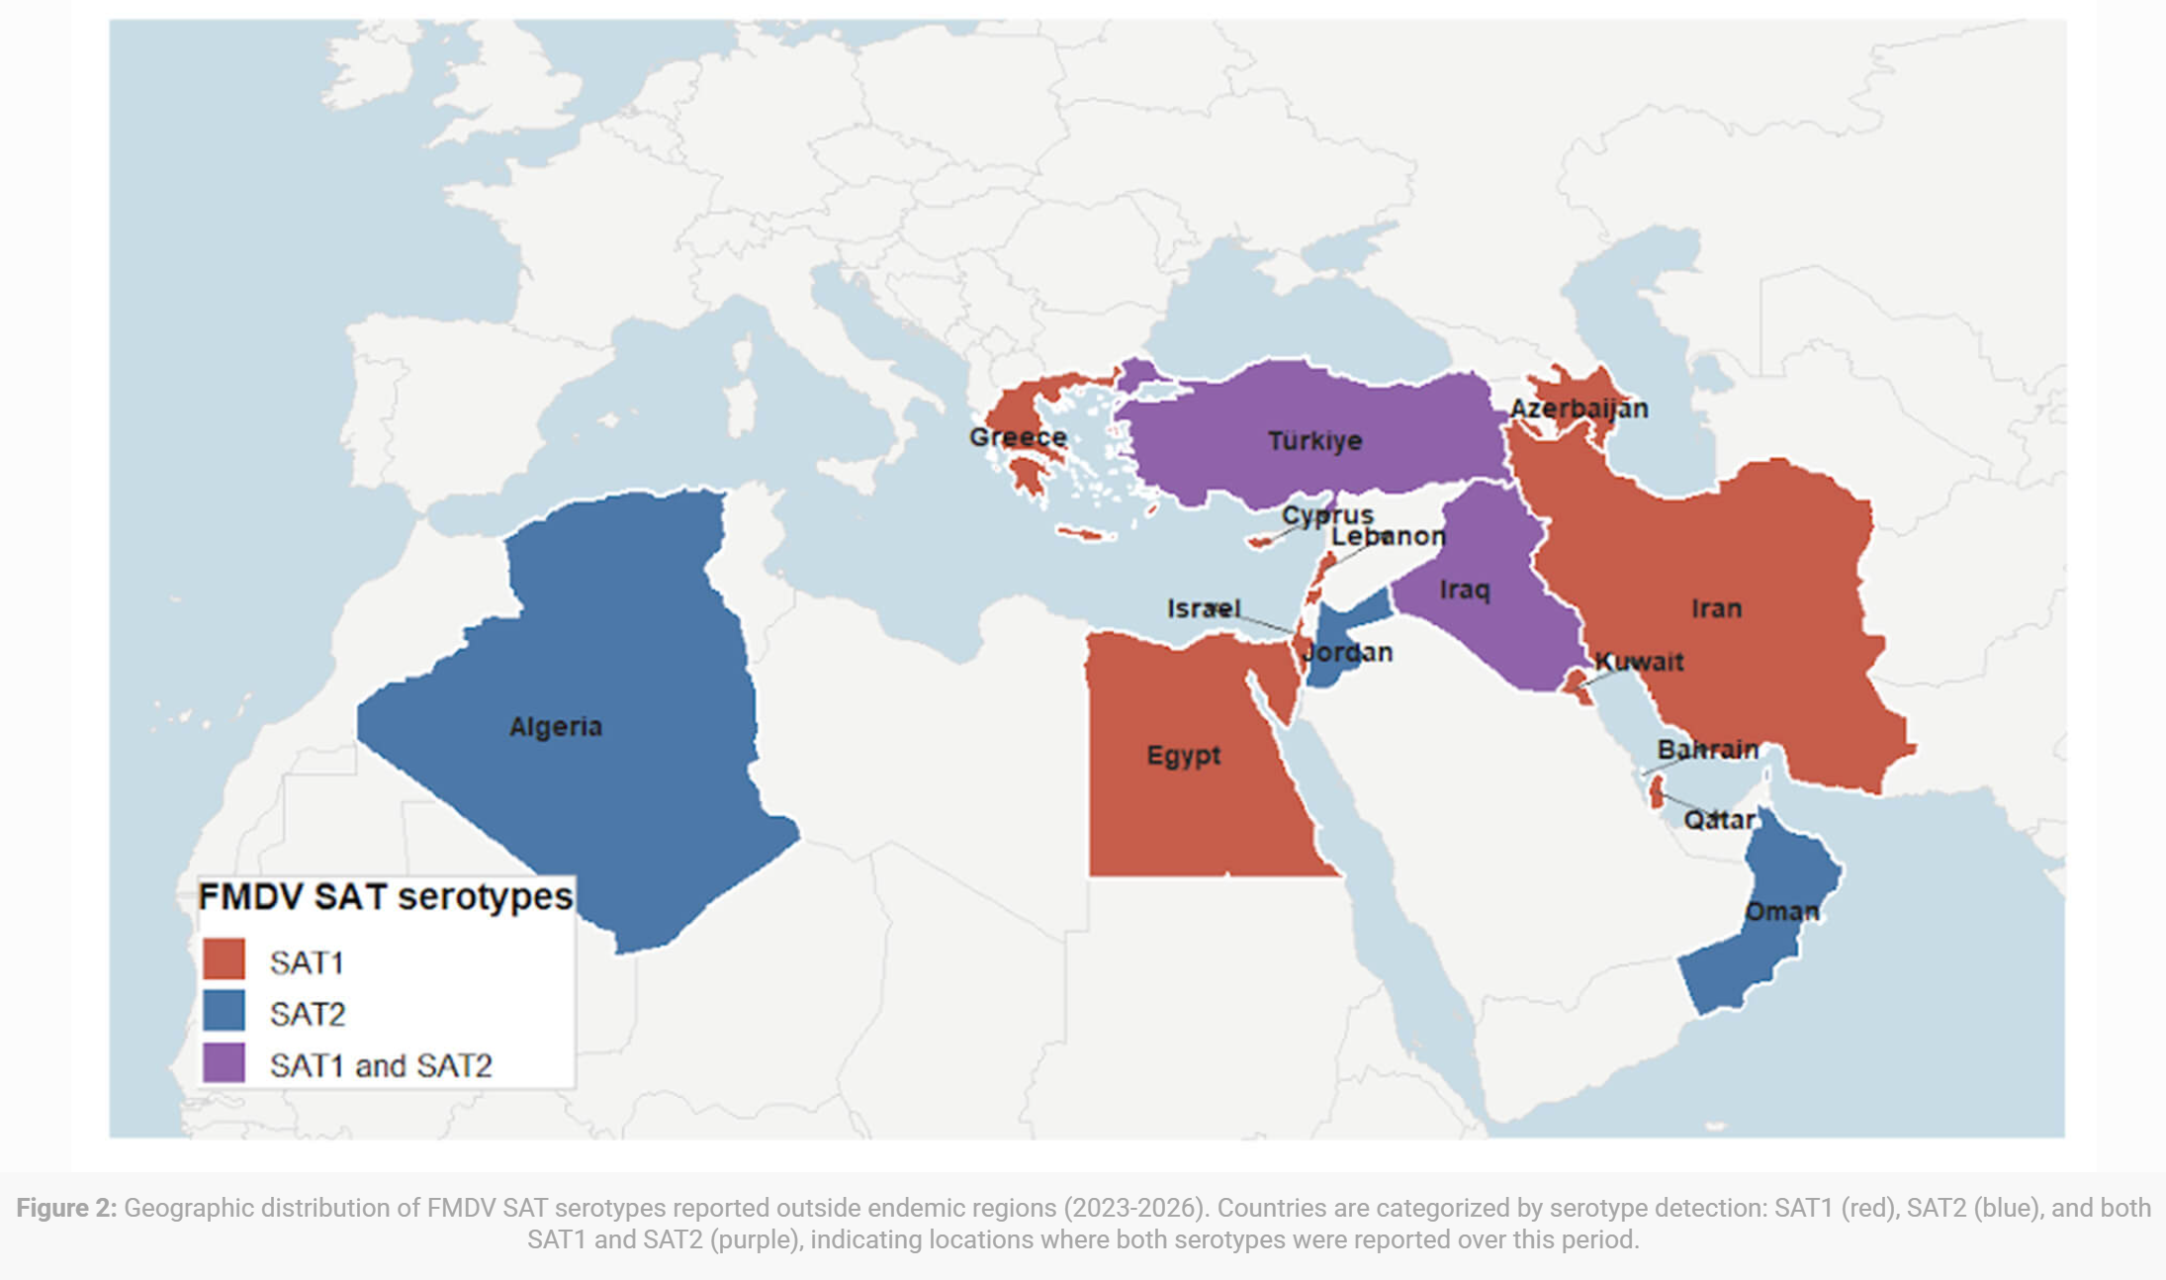
FMD SAT-1 Spread
Emergence and Global Expansion of Foot-and-Mouth Disease Virus Serotype SAT1 – Swine Health Information Center
Since 2025, SAT-1 has expanded beyond its traditional range in sub–Saharan African, with confirmed detections in Western Asia, Middle East, and Europe - a significant shift in global FMD epidemiology
Two co‑circulating SAT-1 topotypes (SAT-1/I and SAT-1/III) have been identified in newly affected regions, suggesting multiple introductions or rapid regional spread
This expanding geographic range increases the risk of transboundary spread, including potential incursions into South‑East Europe and other previously unaffected region

Slide 15
FMD SAT-1 in Europe (Cyprus and Greece)
Cyprus
  On December 13 2025, FMD SAT-1, was reported for the first time on a cattle farm in Lapetos, in Northern Cyprus (Turkish region – no official reports)
  On February 21, 2026, FMD SAT-1 outbreaks were reported in Larnaca spread via contaminated hay (EU control – official reports)
  No impacts on Halloumi cheese imports
  EU - Total number of outbreaks now 70 across two regions (Larnaca and Nicosia)
  Second phase of vaccination 67% cattle, 44% sheep/goats, 84% swine in infected zones
Greece
  On March 16 2026, FMD SAT-1 was reported on Lesvos Island
  First FMD outbreak since after 1994, 32 years ago
  Total number of outbreaks now 22
  Source of introduction – unknown but similar to Cyprus, the island of Lesvos is very close to Türkiye
  No vaccination, focus on culling and biosecurity measures in order to keep disease free status for international trade

Slide 16
FMD SAT-1 in Asia (Israel, Palestine, and China)
China
  News reports from April 2, 2026
  Not officially reported to WOAH
  219 cases of FMD SAT-1 were reported across two cattle herds in Gansu Province and Xinjiang Uyghur Autonomous Region
  Current domestic vaccines (O & A) offer no cross-protection, urgent development of SAT-1 vaccines
Palestine
  Initial WOAH report April 5, 2026 – 1 case of FMD SAT-1 reported in cattle in West Bank start date March 20
Israel
  Official initial report on January 29, 2026
  Feedlot calves from free ranging beef cattle – vaccinated against serotype O
  As of April 9, 26 outbreaks have been reported
  Spillover of FMD reported in wildlife as well – in mountain gazelles in Nahal Tavor and Yissachar nature reserves

Slide 17
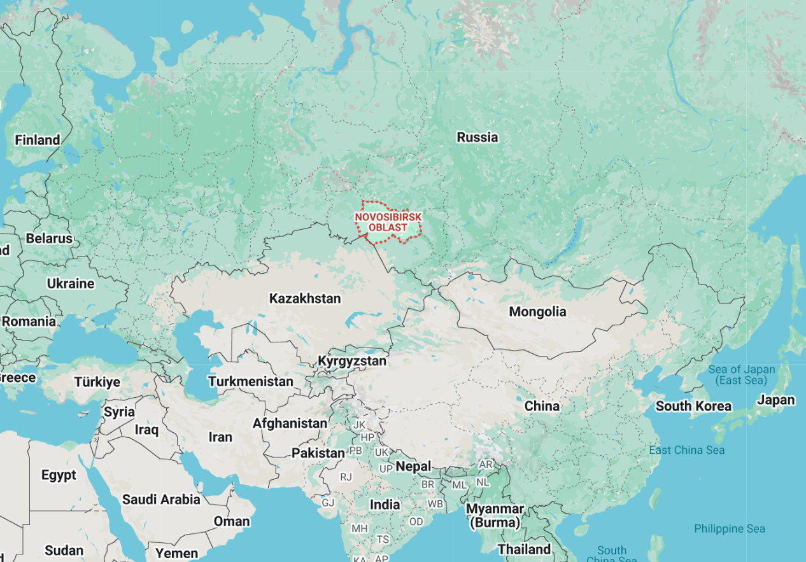
Suspected FMD in Russia and Turkmenistan
Mid March, Russian veterinary authorities declared a state of emergency in response to a cattle disease outbreak (officially attributed to pasteurellosis) in Siberia, with a particular focus on Novosibirsk Oblast
Reports that 15-18 regions of the country are affected
Scale and response appear atypical for pasteurellosis
  Mass seizure and culling of livestock (cattle, small ruminants, and pigs)
  Movement restrictions across multiple regions
Kazakhstan has imposed restrictions on Russian livestock products/ animal feed
Putin has signed a decree overhauling Russia’s animal vaccine industry, consolidating state producers into a single entity
Turkmenistan also recently reported cattle mortalities, mostly likely suspected to be FMD

Slide 18
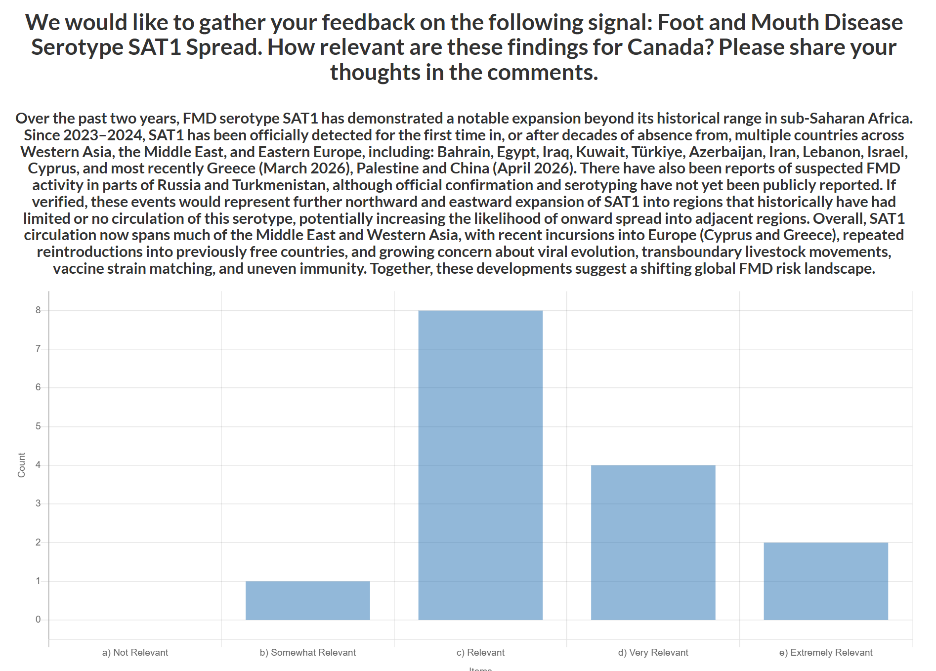
CEZD Ping: FMD SAT-1 Spread
Considering the emergence and spread of FMD SAT1 across the Middle East, Western Asia, and Europe, how relevant is the current global SAT1 situation to Canada?
N = 15 Avg = 3.5
Comments:
  Emergence and spread in China significantly amplifies concern due to scale and connectivity
  Pattern is reminiscent of ASF’s global expansion in the late 2010s
  Overall likelihood of SAT‑1 introduction into Canada remains low
  Risk is not immediate but is increasing due to global trends and cumulative exposure
  Spread into tourist destinations elevates risk due to high travel volumes

Slide 19
FAO - Rapid risk assessment: FMD SAT-1
Country | Likelihood/Uncertainty | Impact/Uncertainty
Afghanistan | Likely/High | Severe/Moderate
Armenia | Likely/Moderate | Low/Moderate
Bulgaria | Unlikely/Low | Low/Low
Cyprus | Likely/Moderate | Low/Moderate
Georgia | Very Likely/Moderate | Moderate/Moderate
Greece | Likely/Moderate | Low/Low
Israel | Likely/Moderate | Low/Moderate
Jordan | Likely/High | Moderate/High
Lebanon | Likely/High | Moderate/High
Libya | Very Likely/High | Severe/High
Country | Likelihood/Uncertainty | Impact/Uncertainty
Oman | Likely/Moderate | Low/Moderate
Pakistan | Likely/Moderate | Severe/Moderate
Qatar | Likely/Low | Low/Low
Russian Federation | Likely/High | Moderate/Moderate
Saudi Arabia | Likely/High | Moderate/Moderate
Syrian Arab Republic | Very Likely/High | Severe/High
Turkmenistan | Likely/High | Moderate/High
United Arab Emirates | Unlikely/Moderate | Low/Low
West Bank & Gaza Strip | Likely/High | Moderate/High
Yemen | Very Likely/High | Severe/High
Likelihood – Border sharing, trade networks, veterinary services, SAT-1 vaccination, historical entry of FMD/other diseases
Notes:
FAO projections indicate that SAT1 spread is very likely over the next three months, particularly through informal movements of small ruminants, which may be sub-clinically infected yet capable of shedding the virus.

Slide 20
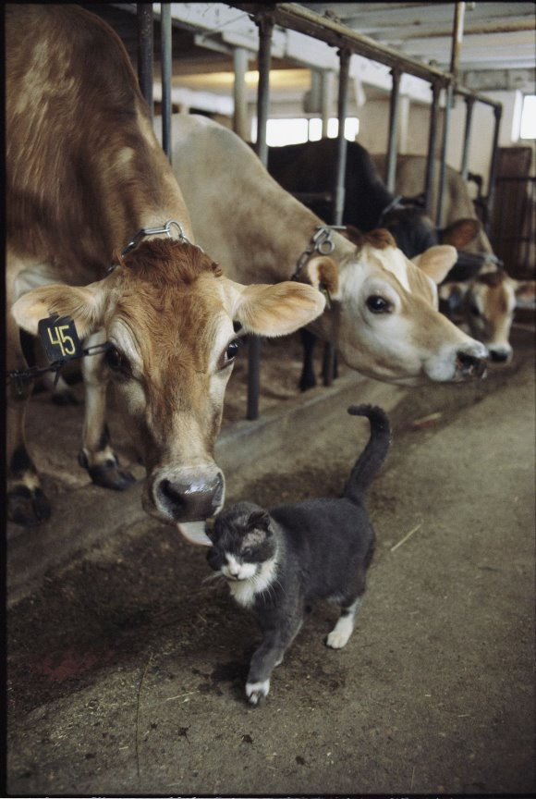
HPAI in dairy cattle in the Netherlands
December 24, 2025, kitten on farm H5N1 positive
  Infected with DI.2.1
Cattle on farm tested mid-January
  One cow had clinical signs in mid-December
  At least five cows with H5N1 antibodies
  Kitten exposed to milk from clinical cow (but also wild birds)
Cattle on pasture until late November 2025, farmer reported die-off of waterfowl
Retrospective study underway
First detection of H5N1 antibodies in cattle outside of US
National Geographic

Slide 21
Scientific Findings
Incubation phase transmission of foot-and-mouth disease virus in cattle: experimental evidence and simulated impacts
Novel Astrovirus Detected in Nasal Swabs of Sick Cattle, Mexico
First isolation report of bovine adenovirus type 10 in Japan: virological and pathological characteristics
Seroprevalence and risk factors of epizootic hemorrhagic disease and bluetongue in Northwestern Tunisia: a comprehensive seroepidemiological study
Bluetongue in China: Current Status of Viruses, Vectors, Detection Methods, and Vaccines
Detection of Anaplasma marginale (Rickettsiales: Anaplasmataceae) in host-seeking adult Dermacentor variabilis (Acari: Ixodidae) on cattle pastures, Missouri, United States
Trap shape affects efficacy of sticky traps for New World screwworm, Cochliomyia hominivorax (Diptera: Calliphoridae)
Mycoplasma bovis outbreaks in United States bison (Bison bison) herds: A case-control survey
DEFRA – Lumpy Skin Disease in Europe: 3 March 2026
DEFRA – Foot and Mouth Disease (FMD) in Greece and Cyprus: 17 March 2026

