Slide 1
Community for Emerging and Zoonotic Diseases Identifying emerging risks through collective intelligence
CEZD – CAHSS Companion Animal Network Update
02 July 2024
www.cezd.ca

Slide 2
Viruses | Free Full-Text | Natural Infection with Highly Pathogenic Avian Influenza A/H5N1 Virus in Pet Ferrets (mdpi.com)
1 juvenile with severe dyspnea, neurological signs died
2 juveniles recovered fully
RT-PCR from all 5 animals was positive for H5N1
All had been fed commercially available poultry meat
Different batches of meat fed to adults and juveniles
Concurrent with cat deaths in Poland due to H5N1
Case from Poland
Household with 5 ferrets
3 juveniles (9 weeks) - sick
Mother – clinically healthy
One clinically healthy adult
Juveniles presented with lethargy, pulmonary distress, unwillingness to move

Slide 3
CDC Reports A(H5N1) Ferret Study Results | Bird Flu | CDC
Ferret challenge study
Used virus from Texas human case
Infected ferrets spread H5N1 to naïve ferrets efficiently with direct contact
Did not spread via respiratory droplets
Opposite of what is seen with seasonal influenza
H5N1 from Texas human case is lethal in ferrets
Seasonal flu is not lethal in ferrets
No change in assessment of risk to public health
Low risk to those without animal exposures
Notes:
Findings from this study are largely consistent with recent A(H5N1) studies in ferrets, as well as past reports of serious human illness resulting from this virus. These findings also suggest; however, that current A(H5N1) viruses would need to undergo genetic changes to spread more easily via respiratory droplets, which is reassuring. Efficient respiratory droplet spread, like what is seen with seasonal influenza viruses, is needed for sustained person-to-person spread to happen. These findings do not change CDC's immediate risk assessment for the general public who do not have animal exposures, which is low.

Slide 4
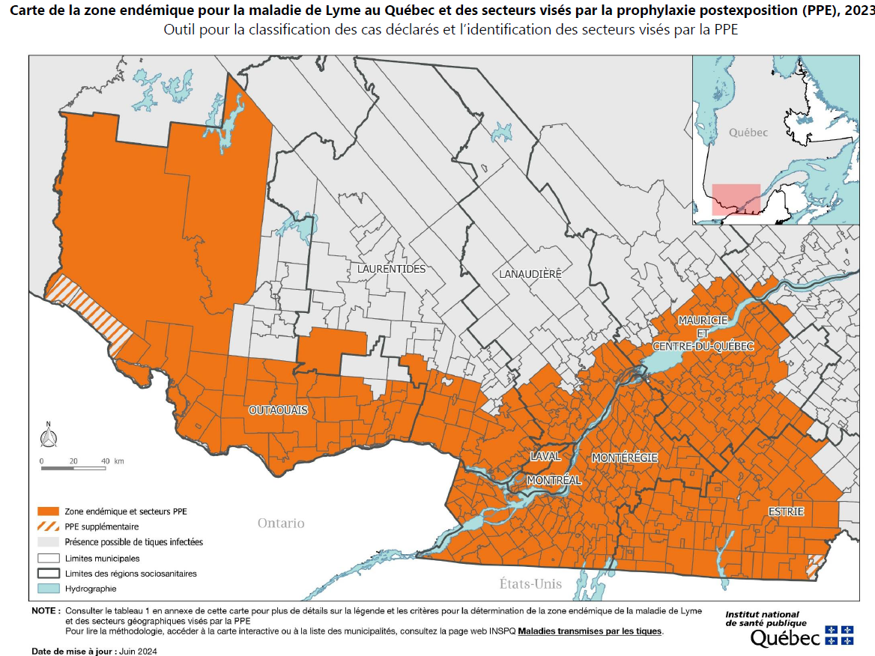
Lyme Disease
21 confirmed cases of Lyme disease in May: Public Health Ontario (chch.com)
60 human cases so far in 2024
Increasing signals from Quebec as well
Signals from New England (CT, NY) also showing increases
Lyme disease might be more common, but this tick-borne disease is on the rise in Canada | Radio-Canada.ca

Slide 5
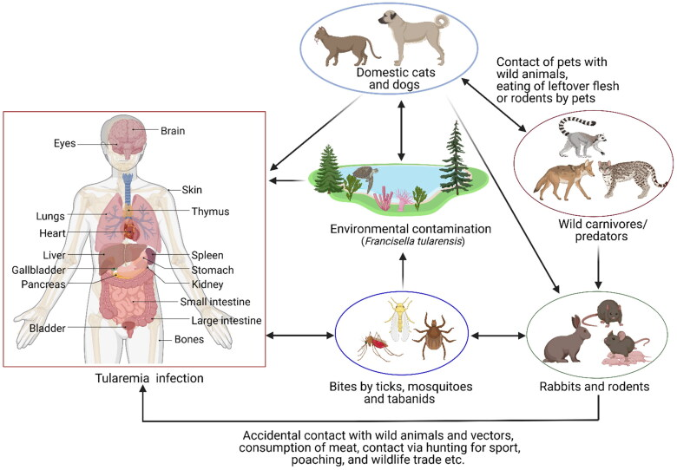
Tularemia infection surge prompts warning, especially for cat owners (startribune.com)
Minnesota issued a warning to cat owners about Tularemia (June 20)
21 animal cases in 2023, triple normal rate
7 cases confirmed so far in 2024
Vets reporting fever, swelling and skin sores in untested animals
Wild Animals Test Positive For Tularemia Disease - Mid-Utah Radio (midutahradio.com) (April)
Department Notes Unexpected Increase in Tularemia Reports - Wyoming Department of Health (June 27)
Question: Have any increases in Canada been noticed?
Tularemia – a re-emerging disease with growing concern - PMC (nih.gov)
Notes:
Squirrels, rabbits and mice are reservoirs
Dogs generally sub-clinically infected
Spread via cuts, scratches as well as vector borne (ticks, biting flies)

Slide 6
Scientific Findings
Notes from the Field: Toxigenic Corynebacterium ulcerans in Humans and Household Pets — Utah and Colorado, 2022–2023 | MMWR (cdc.gov)
Global seroprevalence and prevalence of infection of influenza in dogs (Canis familiaris): A systematic review and meta‐analysis – Leung - 2024 - Reviews in Medical Virology - Wiley Online Library
4 more cats test positive for H5N1 bird flu in the U.S. - BNO News
Dogs on the move: Estimating the risk of rabies in imported dogs in the United States, 2015–2022 - Pieracci - Zoonoses and Public Health - Wiley Online Library
Case Series of Jamestown Canyon Virus Infections with Neurologic Outcomes, Canada, 2011–2016 - Volume 30, Number 5—May 2024 - Emerging Infectious Diseases journal - CDC

Slide 7
Scientific Findings
Prevalence of Baylisascaris procyonis in wild rodents in central Georgia, USA - PubMed (nih.gov)
Microorganisms | Free Full-Text | Upper Respiratory Tract Disease in a Dog Infected by a Highly Pathogenic Avian A/H5N1 Virus (mdpi.com)
Sporotrichosis Cluster in Domestic Cats and Veterinary Technician, Kansas, USA, 2022 - Volume 30, Number 5—May 2024 - Emerging Infectious Diseases journal – CDC

