Slide 1
Community for Emerging and Zoonotic Diseases Identifying emerging risks through collective intelligence
CEZD – CAHSS Equine Network Update
12 September 2024
www.cezd.ca

Slide 2
Contagious Equine Metritis in Florida
USDA Reports of CEM in Florida
CEM is detected sporadically in the United States, the last time it was detected was 2013
Case count as of 28 August 2024
39 animals
15 domestic ponies (2 stallions, 1 mare, and 12 geldings)
12 riding horses (all geldings), and
12 draft horses (all geldings)
Notes:
In the previous CAHSS presentation in June, there were 3 animals (2 pony stallions and 1 pony mare) that were confirmed positive for CEM in central Florida.
CEM is detected sporadically in the United States, the last time it was detected was 2013.
The case counts have increased in the last few months. As of August 28, 2024, a total of 39 cases have been confirmed positive for Taylorella equigenitalis on a single premises in Orange County, Florida:
15 domestic ponies (2 stallions, 1 mare, and 12 geldings)
12 riding horses of various breeds (all geldings), and
12 draft horses (all geldings)

Slide 3
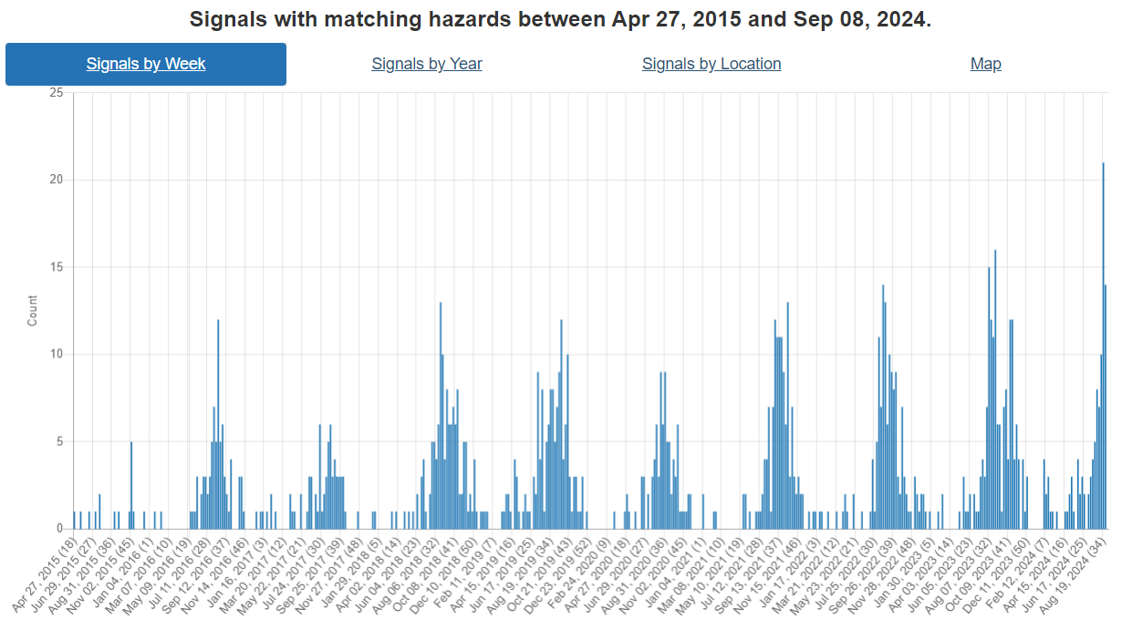
West Nile Virus
Increasing number of signals over the summer months in Canada and USA
Notes:
With early detections reported in April and May, WNV detections have increased over the summer months in Canada and USA.
We can see from the hazard trends graph in this slide that the peak appears to have been reached in the middle of August, much higher than previous years, but the peak this year occurs roughly around the same time as previous years (mid-end of August).

Slide 4
WNV – June/July
JUNE
Canada
Two crows in North Bay
USA
Mosquitoes in 13 Illinois counties and Southern Nevada
JULY
Canada
Horse case in Région du Saguenay (Quebec)
Human case in Ottawa (Ontario)
USA
Horse cases in Nevada, Oklahoma, and California (horse and stallion)
Human cases in Texas, Illinois, and Louisiana
Mosquitoes positive in New Jersey and Pittsburgh
Notes:
A few signals seen in June and July in Canada and USA:
For Canada:
WNV was detected in two crows as reported by the North Bay-Parry Sound District Health Unit
- First human case of 2024 in Ottawa
A horse confirmed positive in Quebec
In USA (do not need to go into detail) – The USA has reported finding WNV in mosquito pools, equine cases in Nevada, Oklahoma, and California, as well as a few human cases.
…………………………………………………………………………………………………………………………….
Cases in horses:
- Two horses in Nevada, located in Clark and Nye counties, recently tested positive for WNV.
- A 16-year-old Quarter Horse gelding in Yuba County, California, tested positive for WNV
- A 6-year-old Andalusian cross stallion in Placer County, California, tested positive for WNV
Cases in humans:
Three of the nine reported human cases of WNV in Texas had the more severe form of the disease, also known as West Nile neuroinvasive disease
- First human WNV case of 2024 in Cook County in Illinois
- The Louisiana Department of Health’s (LDH) Office of Public Health (OPH) has confirmed four human cases of West Nile neuroinvasive disease in the Northeast Louisiana community of Winnsboro
Mosquitoes testing positive:
- The areas that tested positive for WNV in New Jersey include Upper Township, Cape May City, the borough of Woodbine and Lower Township.
- Mosquitoes have tested positive for West Nile virus in six Pittsburgh neighbourhoods: Brighton Heights, California-Kirkbride, Elliott, Sheraden, Esplen and Marshall-Shadeland.

Slide 5
WNV – August/September
CANADA
Horse cases:
Other cases:
Surveillance - Public Health Ontario
As of 31 August 2024 - 12 human cases, 196 positive mosquito pools
Essex-Windsor (human)
London (human)
Algoma District (human)
North Bay (hawk)
Grey-Bruce (crow)
Perth County and Chatham-Kent (mosquitoes)
USA
Horse cases:
Human cases:
California
Colorado
Delaware
Florida
Georgia
Idaho
Indiana
Kentucky
Michigan
Missouri
New York
North Dakota
Oklahoma
Oregon
Pennsylvania
Texas
Utah
Wisconsin
Norfolk Country
Simcoe County
United Counties of Prescott and Russell
Témiscamingue
Maryland
Michigan
Wisconsin
Utah
Notes:
August saw a peak in signals of WNV in both Canada and the US.
In Canada
Positive cases reported in Ontario included:
An unvaccinated, 11-year-old Standardbred mare in Norfolk County
An unvaccinated, 7-year-old Appaloosa stallion in Simcoe County
An unvaccinated, a 5 year old gelding in the United Counties of Prescott and Russell.
Quebec reported a positive WNV case:
In Témiscamingue
Public Health Ontario Surveillance Week 35 (Aug 25-31, 2024)
Overall Ontario Trends
As of Week 35, there has been 12 human WNV cases. Note: travel-related cases reported prior to mosquito season are excluded.
As of Week 35, there has been 196 WNV-positive mosquito pools; there has been one EEEV-positive mosquito pool (OTT).
Also in Ontario:
First cases of WNV in human in Windsor-Essex, London region, and in Algoma (where a human case of WNV was confirmed for first time in six years).
First cases of WNV were reported in mosquitoes Perth County and Chatham-Kent, and in a crow in Grey-Bruce in Ontario
And a third confirmed case of WNV was reported in a bird (hawk) in the Parry Sound District (North Bay)
For the USA
US states with signals of cases of WNV in horse and humans in August are listed.
….........................................................................................................................................................................................................................................
Cases in Horses:
Vaccinated California Horse Tests Positive for WNV – The Horse
California Thoroughbred Positive for WNV – The Horse
California Gelding Positive for WNV – The Horse
Unvaccinated Colorado Horse Euthanized Due to WNV – The Horse
2 Colorado Horses Test Positive for WNV – The Horse
Colorado Gelding Positive for WNV – The Horse
2 Delaware Horses Positive for WNV – The Horse
Florida Mare Euthanized After Contracting WNV – The Horse
Georgia Horse Positive for WNV – The Horse
Idaho Filly Positive for WNV – The Horse
2 Indiana Horses Positive for WNV – The Horse
WNV-Positive Horse Euthanized in Indiana – The Horse
4 Indiana Horses Test Positive for WNV – The Horse
2 Indiana Horses Test Positive for WNV – The Horse
WNV Confirmed in Kentucky Pony – The Horse
Kentucky Mare Tests Positive for WNV – The Horse
Kentucky Gelding Tests Positive for WNV – The Horse
Unvaccinated Kentucky Horse Positive for WNV – The Horse
MDARD - MDARD Confirms First Case of West Nile Virus for 2024 in an Eaton County Horse (michigan.gov)
Michigan Colt Tests Positive for WNV – The Horse
Michigan Gelding Tests Positive for WNV – The Horse
Missouri Horse Positive for WNV – The Horse
New York Gelding Tests Positive for WNV – The Horse
New York Horse Positive for WNV – The Horse
Unvaccinated New York Gelding Contracts WNV – The Horse
North Dakota Horse Positive for WNV – The Horse
Oklahoma Horse Positive for WNV – The Horse
Oklahoma Filly Positive for WNV – The Horse
Oregon Horse Positive for WNV – The Horse
12 Pennsylvania Horses Test Positive for WNV – The Horse
WNV Case Confirmed in Pennsylvania Horse – The Horse
Pennsylvania Horse Positive for WNV – The Horse
Texas Filly Positive for WNV – The Horse
3 Utah Horses Positive for WNV – The Horse
Utah Horse Tests Positive for WNV – The Horse
Unvaccinated Wisconsin Horse Positive for WNV – The Horse
Unvaccinated Wisconsin Mare Tests Positive for WNV – The Horse
Unvaccinated Wisconsin Yearling Positive for WNV – The Horse
Cases in Humans:
First human case of West Nile virus confirmed in Maryland, officials say (wjla.com)
Michigan’s first human case of West Nile virus detected in Livingston County (wilx.com)
First case of West Nile Virus found in Wisconsin – WTMJ
First human case of West Nile Virus confirmed in Utah County (ksltv.com)

Slide 6
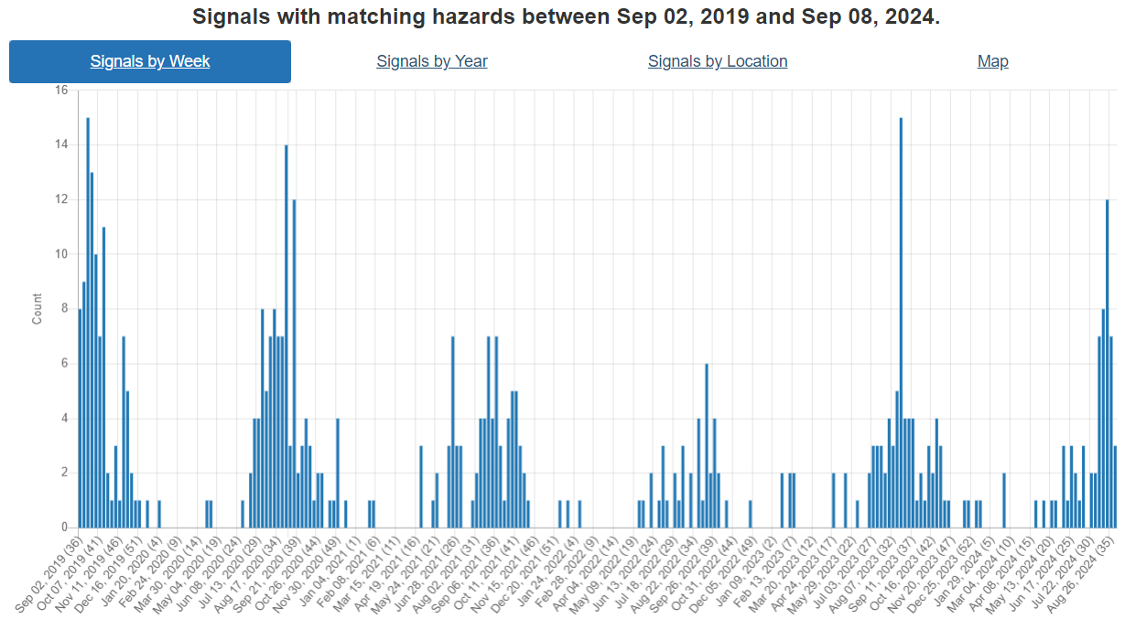
Eastern equine encephalitis
Summary of reports – Canada:
Horse cases in Ontario and Quebec
Lanark County (various cases)
United Counties of Leeds and Grenville (various cases)
Ottawa (various cases)
District of Parry Sound
United Counties of Prescott and Russell
Lanaudière
MRC Haut-Saint-Laurent, Montérégie (various cases)
MRC Thérèse-De Blainville
Other case in a donkey in Ontario:
United Counties of Leeds and Grenville
Many more equine cases reported from the USA
also reports of EEE in a deer, turkey, and humans
some towns in Maine, Vermont, and Massachusetts have issued voluntary curfews
Notes:
Cases of Eastern equine encephalitis have been increasing over the summer months. Not a huge trend compared to previous years, but still seeing lots of activity.
Summary of case reports in Canada. Equine cases mostly from Ontario and then Quebec
A 2-year-old Quarter Horse filly as well as a yearling Quarter Horse filly in Lanark County, Ontario
In the United Counties of Leeds and Grenville there were cases of a yearling Quarter Horse filly, a 3-year-old Percheron gelding, an 18-year-old Quarter Horse mare, and a suckling foal
A 12-year-old Quarter Horse mare in the United Counties of Prescott and Russell
A foal in Ottawa and a 15-year-old Thoroughbred gelding
A 3-year-old Miniature Horse in the District of Parry Sound
A horse in Lanaudière, Quebec
A horse and a 27-year-old mare in MRC Haut-Saint-Laurent, Montérégie
A yearling in MRC Thérèse-De Blainville
Also, a 4-year-old donkey in Ontario in the United Counties of Leeds and Grenville was reported positive for EEE.
The USA has also reported increasing cases of EEE in horses from numerous states. But they have also identified the virus in deer, turkeys, emu’s, and humans.
The human cases now total ~8 for 2024, and some towns in Maine/Vermont/Massachusetts have issued voluntary curfews for residents. Suggesting residents be indoors at ~8pm due to high mosquito activity.

Slide 7
Case Report: Co-infection with EEE, WNV, St. Louis Encephalitis
Man from New Hampshire
First hospitalized on August 8, 2024
Several days for diagnosis
In the ICU for the past few weeks
Brain swelling, unsure which virus causing it
One article mentions it was from a single mosquito bite
New Hampshire man suffering from 3 mosquito-borne viruses, including EEE (boston.com)
Notes:
Interesting human case report of a man in New Hampshire co-infected with 3 different vector borne diseases (EEE, WNV, St Louis encephalitis). A ~54-year-old man from New Hampshire hospitalized on August 8, 2024, waited several days for diagnosis – then diagnosed with 3 different VBDs. In the ICU for past few weeks, doctors unsure which virus is causing his symptoms. Interesting here to note that one article mentions that it was from a single mosquito bite.

Slide 8
Strangles
June
Positive cases confirmed in
Ontario (5 in Peterborough Country, 1 in the United Counties of Prescott and Russell, 1 in the Regional Municipality of Waterloo)
Quebec (1 in Laval)
Various cases reported in Florida, Michigan, Ohio, Wisconsin and Washington
July
Various cases reported in Florida and Michigan
August
Various cases reported in Michigan and Wisconsin
September
Ontario (Wellington County, United Counties of Leeds and Grenville, Ottawa)
Notes:
June saw reports of strangles in Ontario and Quebec.
In the summer months reports of positive cases of strangles came from Florida, Michigan, Ohio, Wisconsin and Washington.
In early September a few positive cases reported in Ontario:
A 15-year-old Standardbred mare in Wellington County
A 13-year-old Paint mare in the United Counties of Leeds and Grenville
A 6 year old pony mare in Ottawa was tested to confirm clearance of infection following signs/symptoms in July, but was not tested at that time.

Slide 9
Lyme Disease
435 confirmed human cases in Quebec (1 January to 31 August 2024):
349 acquired in Quebec
24 acquired outside of Quebec
62 unknown place of acquisition
https://www.inspq.qc.ca/sites/default/files/2024-06/carte_risque_acquisition_lyme2024.pdf
Notes:
Number of reported cases of Lyme disease in Quebec between 1 January and 31 August, 2024, by health region (HSR) of residence and place of acquisition, Province of Quebec
Overall total is 435, with 349 acquired in Quebec, 24 outside of Quebec, and 62 Unknown place of acquisition.
The map shows endemic area of Lyme disease in Quebec and areas covered by post-exposure prophylaxis (PEP), 2024 (updated June 2024)
Data sources: Surveillance of confirmed and probable human cases of Lyme disease acquired in Quebec and reported to public health (2004-2023); active acarological surveillance (2010-2023); passive acarological surveillance (2009-2023).

Slide 10
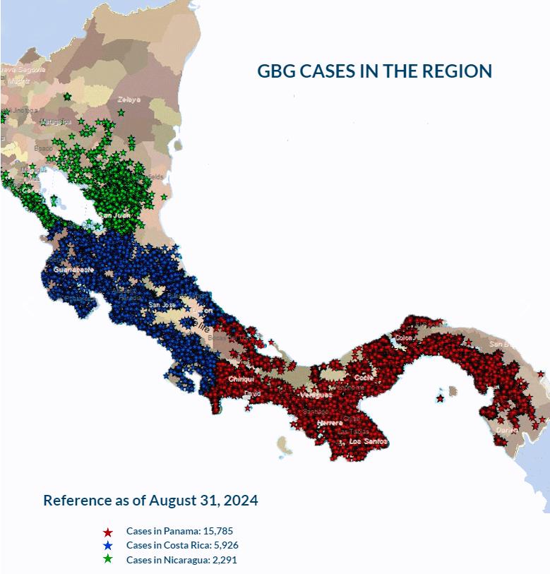
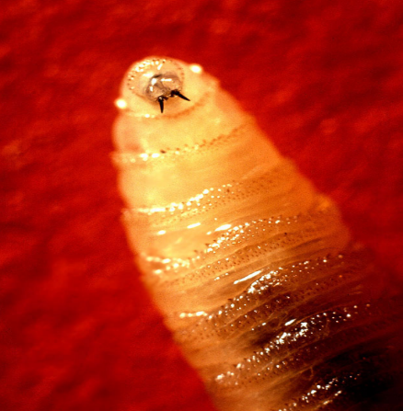
New World Screwworm in South America
Parasitic fly larva - Cochliomyia hominivorax causing wound myiasis
Continued increase in reported positive cases in Costa Rica, Nicaragua and Panama over the last few months
Costa Rica declared a sanitary emergency in February 2024
Nicaragua declared an animal health alert in April 2024
As of August 31, 2024, according to COPEG:
Panama – 15,785 cases
Costa Rica – 5,926 cases
Nicaragua – 2,291 cases
July 29, 2024 – Costa Rica reported 22 human cases
July 29, 2024 – Panama reported 49 human cases
Increase in cases may be due to more aggressive fly as well as increased rainfall
COPEG
Notes:
From the previous CAHSS equine report, there is a continuous increase in positive cases of New World Screwworm reported in Costa Rica, Nicaragua and Panama
As mentioned in previous updates – Costa Rica declared a sanitary emergency in Feb 2024, and reported their first human cases in March 2024. Nicaragua declared an animal health alert for the screwworm in April 2024.
As of August 31, 2024, according to COPEG:
Panama – 15,785 cases
Costa Rica – 5,926 cases
Nicaragua – 2,291 cases
Note Copeg cases – unsure if this include human cases along with the animal cases
Now wrt human cases:
Panama had previously reported 21 human cases, Costa Rica had 3 human cases, and Nicaragua hadn’t reported any human cases as of our last call.
Now as of July 29 2024, Costa Rica has reported 22 human cases and Panama has reported 49 human cases (age range from 1 year to 95 years). Nicaragua has not yet reported any human cases.
The increase in cases in Costa Rica may be due to a more aggressive strain of fly, that moves faster and prefers to mate with field flies (as opposed to sterile flies), which has reduced the effectiveness of the sterile fly control program. Increased rainfall leading to more parasitic activity has also been mentioned.
There is also concern that wildlife (deer, wild boar, coyotes…) may also be infected in these countries, but due to their habitats it’s hard to determine the exact number of animals impacted.

Slide 11
Scientific Reports
Molecular Epidemiology of Western Equine Encephalitis Virus, South America, 2023–2024
WEEV reemerged in December 2023 in Argentina and Uruguay,
The outbreak resulted in:
217 human cases (12 fatal)
2,548 equine cases
Characterized 3 fatal equine cases caused by a novel WEEV lineage
Epidemiology of Lyme Disease Diagnoses among Older Adults, United States, 2016–2019
Medicare data estimates Lyme disease rate 7 times higher than surveillance shows
Notes:
Molecular Epidemiology of Western Equine Encephalitis Virus, South America, 2023–2024
WEEV is a mosquito-borne virus that reemerged in December 2023 in Argentina and Uruguay, causing a major outbreak.
The authors investigated the outbreak using epidemiologic, entomological, and genomic analyses, focusing on WEEV circulation near the Argentina‒Uruguay border
During November 2023‒April 2024, the outbreak in Argentina and Uruguay resulted in 217 human cases, 12 of which were fatal, and 2,548 equine cases. The authors determined cases on the basis of laboratory and clinical epidemiologic criteria.
They characterized 3 fatal equine cases caused by a novel WEEV lineage identified through nearly complete coding sequence analysis, which they propose as lineage C.
https://wwwnc.cdc.gov/eid/article/30/9/24-0530_article
Epidemiology of Lyme Disease Diagnoses among Older Adults, United States, 2016–2019
- In total, 88,485 Medicare enrollees were diagnosed as having LD from 2016 to 2019, with an average incidence of 123.5 cases per 100,000 person-years, 7.4 times higher than the 34,183 cases picked up by surveillance during the same period (average rate, 16.6 cases/100,000 persons).
- Most diagnoses occurred among residents of high-incidence states, in summer, and among men. Incidence of diagnoses was substantially higher than that reported through public health surveillance.
(https://wwwnc.cdc.gov/eid/article/30/9/24-0454_article; https://www.cidrap.umn.edu/lyme-disease/medicare-data-estimate-lyme-disease-rate-7-times-higher-surveillance-shows )

