Slide 1
Community for Emerging and Zoonotic Diseases Identifying emerging risks through collective intelligence
CEZD – CAHSS Poultry Update
07 June 2024
www.cezd.ca

Slide 2
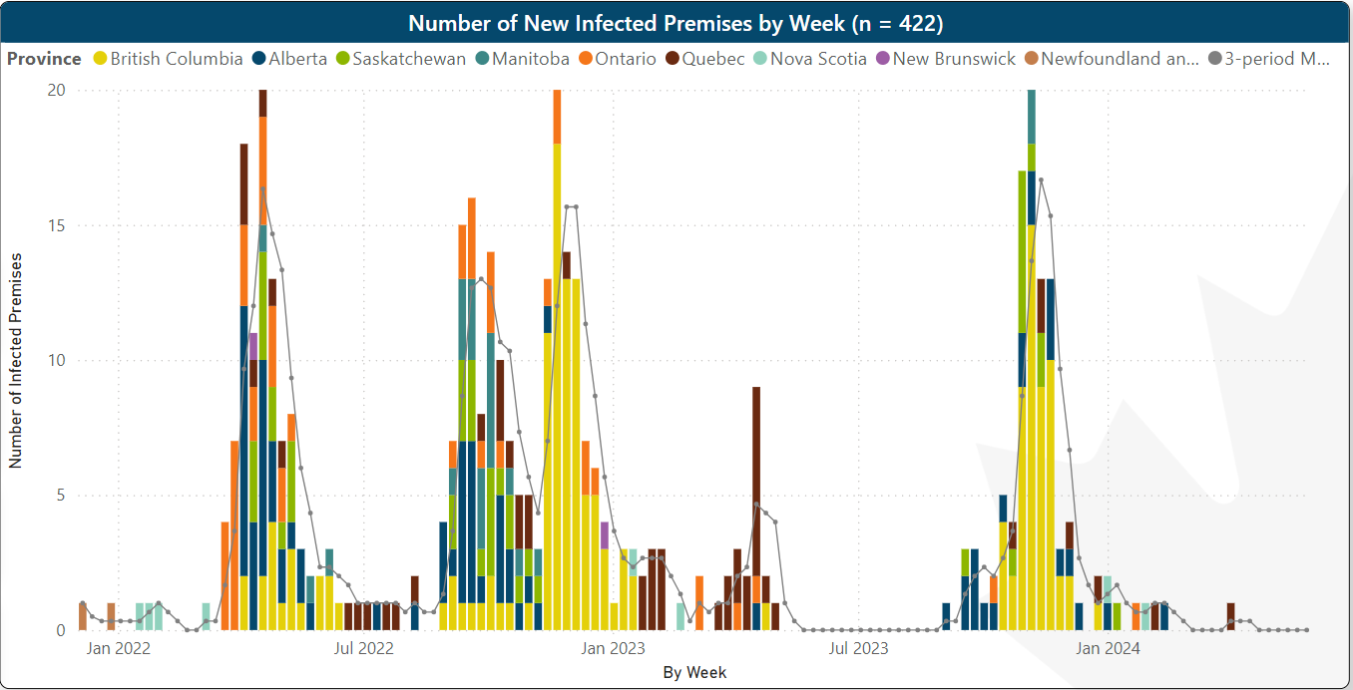
HPAI in Domestic Birds in Canada
Microsoft Power BI
Notes:
Domestic birds in Canada, our last case was on April 1 in Quebec.
This spring has been excellent compared to spring of 2022, while spring of 2023 was also significant, specifically for Quebec.

Slide 3
Wildlife H5N1 Avian Influenza
Dashboard Filtered from March 1 2024 – June 6, 2024
44 confirmed
No new species
H5N5 – New Province
Quebec – Crow
PEI – Raccoon and Striped Skunk
Nova Scotia – Red Fox
CWHC
Wild Bird Dashboard

Slide 4
United States – HPAI Domestic Bird Detections Last 30 days
6 states have had outbreaks in the last 30 days
15 flocks
9 commercial
6 backyard
Confirmations of Highly Pathogenic Avian Influenza in Commercial and Backyard Flocks | Animal and Plant Health Inspection Service (usda.gov)
Notes:
The most significant thing about these cases is that many of them have been the same strain as those on Dairy Farms
We don’t know the total numbers that have B3.13, but recent cases in Minnesota and Iowa have found the strain in poultry before the reporting of cases in Dairy Cattle in those states. The two cases in Iowa, 4+ million layers as well as a case on a turkey farm were B3.13,

Slide 5
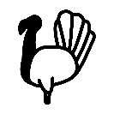
Iowa Poultry B3.13 cases Highly Pathogenic Avian Influenza Detected in an O’Brien County Dairy Herd | Iowa Department of Agriculture and Land Stewardship (iowaagriculture.gov)

Slide 6
Minnesota B3.13 cases in May 2024
Uncertain how many of the poultry cases are B3.13
Goat case is not linked to the dairy case
“The Board has also seen a recent rise in poultry cases in the state with eight sites confirmed positive in May. Early investigations from some of those sites reveal birds were infected with the same virus strain detected in cows across the country.”

Slide 7
US Wild Bird Detections May 5 – May 24 2024
Mostly peri-domestic birds
Pigeons
House sparrows
Grackles
Tanager
Purple dot is a Red Tailed Hawk in Pennsylvania (June 3)
HPAI Detections in Wild Birds (usda.gov)
Notes:
This is an image from USDA for the wild bird detections over approximately the last 30 days. This is a little surprising to me given the intensity of the spring migration in May.

Slide 8
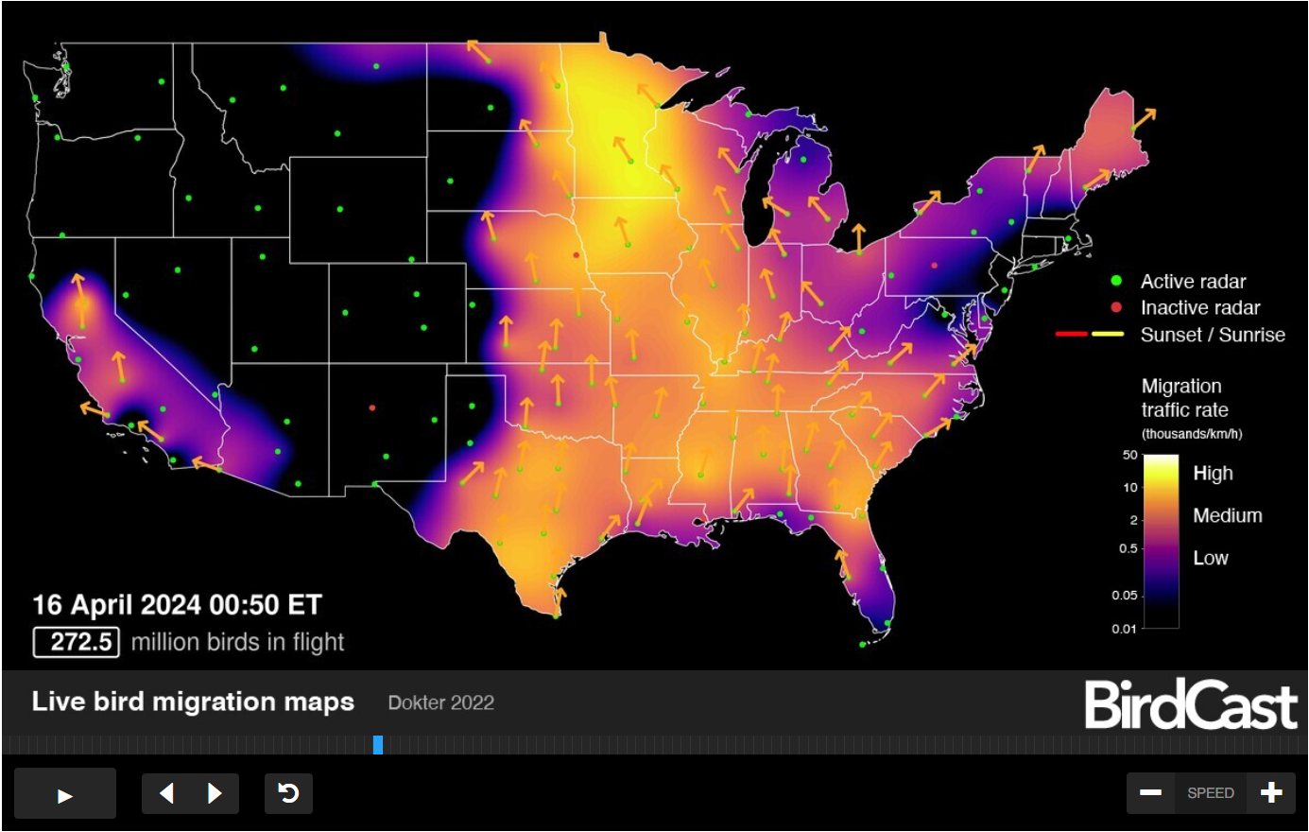
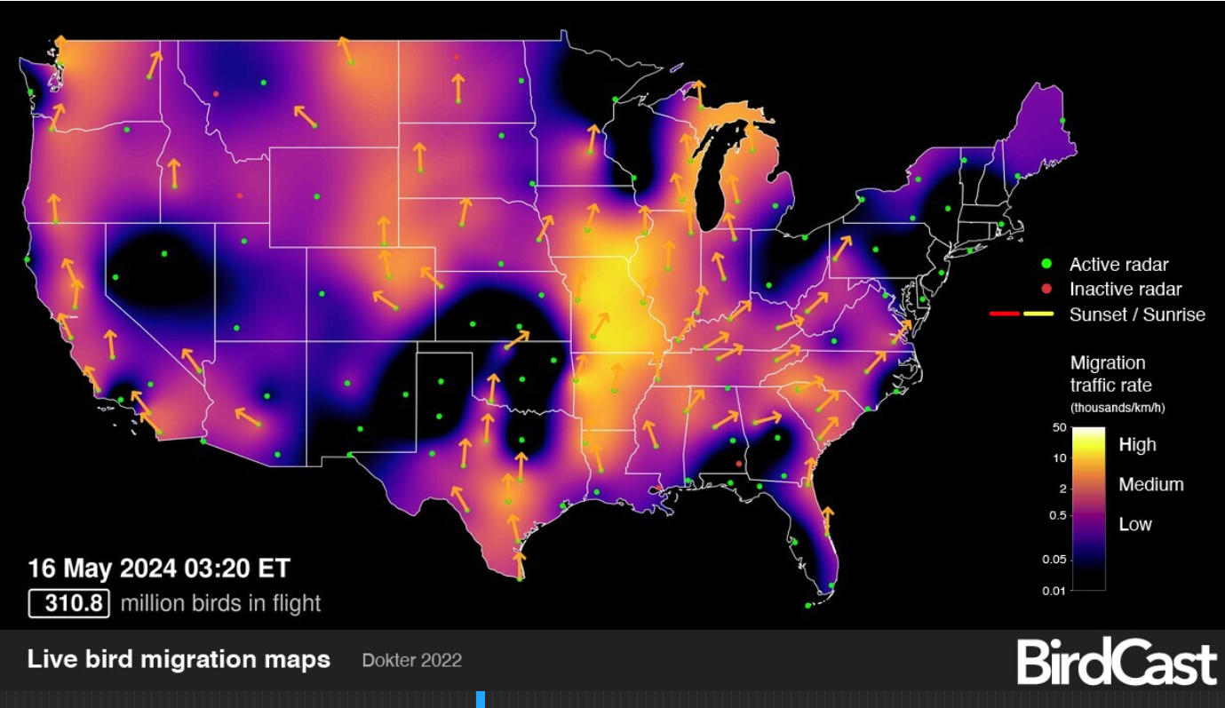
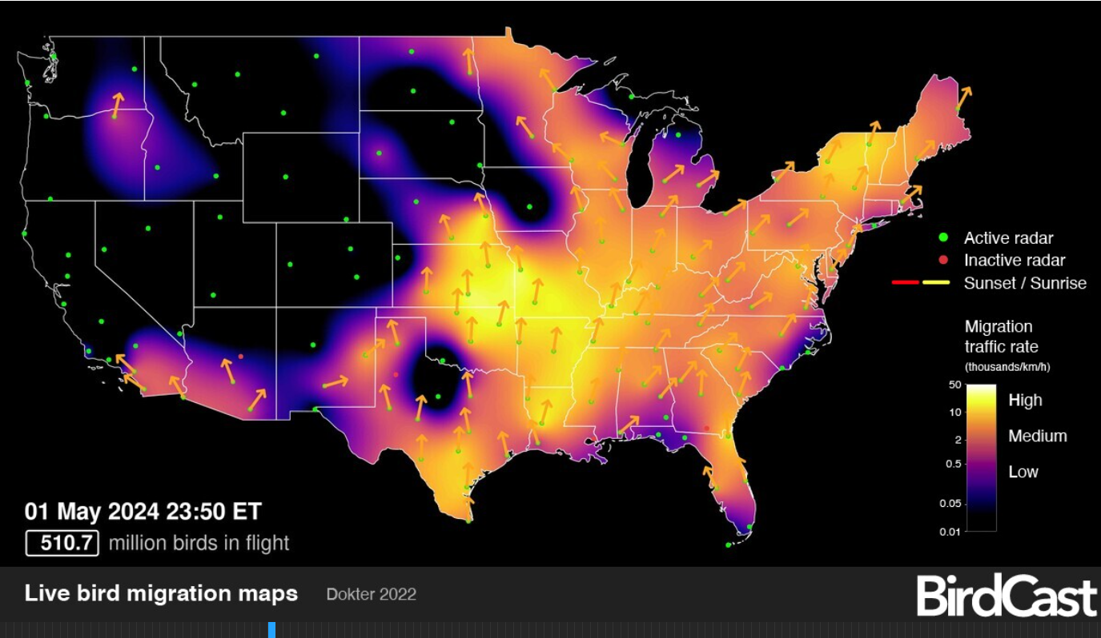
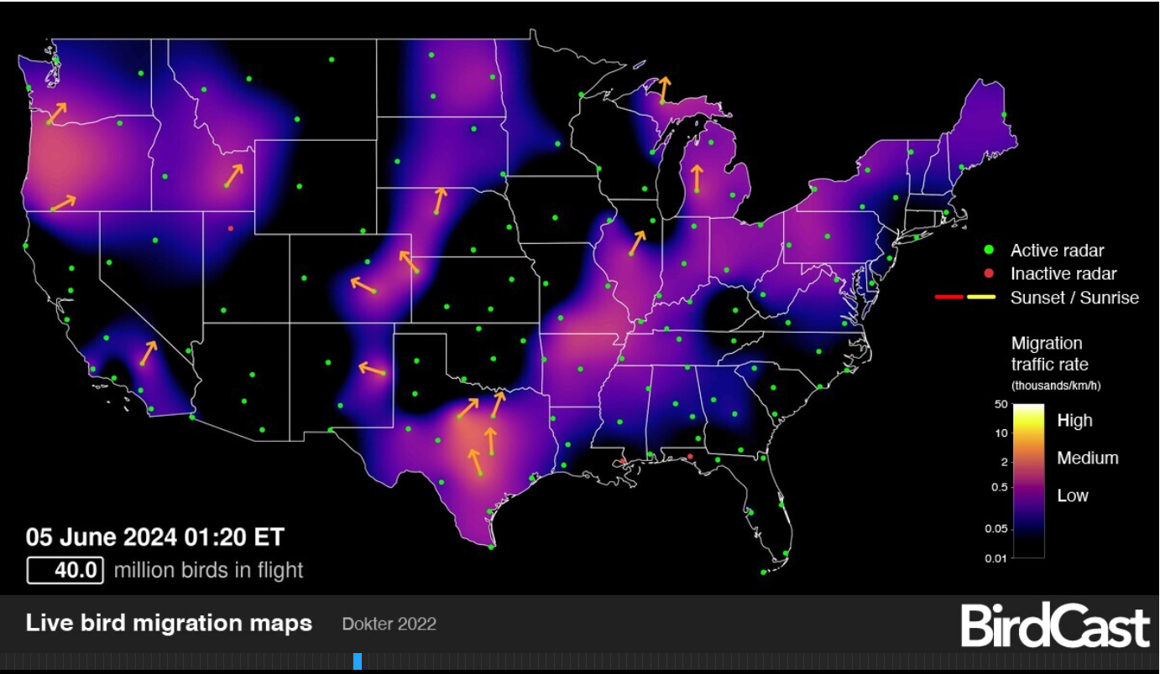
Wild Bird Migration

Slide 9
Globally
Europe
Australia
H7N3 and H7N9 in domestic birds
Asia
Reassortant of 2.3.4.4b with 2.3.2.1c in Vietnam
More cases in Japan, Taiwan, India and Iraq
Antarctica
Scientists investigate thousands of dead Antarctic penguins for bird flu | Reuters
South America
Brazil
UK has declared freedom from HPAI
Since our last meeting only 4 countries in Europe have reported domestic cases
Hungary (8)
Bulgaria (8)
Poland (2)
Sweden (1)
16 European Countries have reported wild bird detections

Slide 10
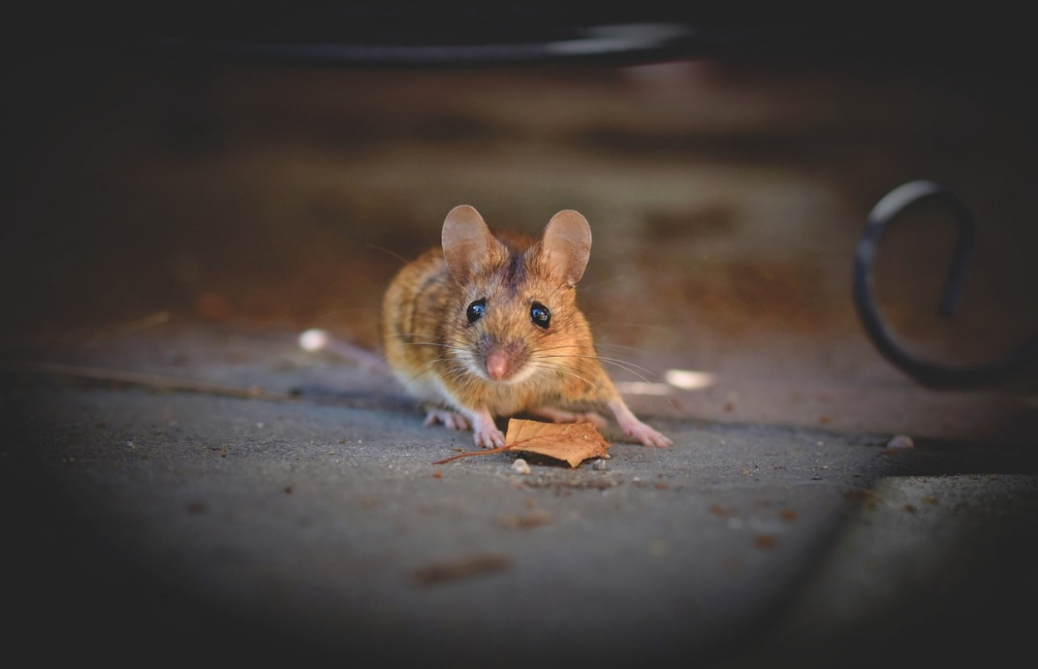
HPAI Additional Info
France presents successful HPAI vaccination for ducks
64 million vaccinated
French vaccination program hailed a success
26 million received first dose
21 million have had second dose (April)
3 new species reported affected by HPAI (all in US)
Goats
Alpacas
House Mice

Slide 11
Human Cases of Avian Influenza
H9N2 in China
4 cases
H9N2 in Vietnam
Severe illness
H5N1 in Vietnam
Died
H10N3 in China
Rapid risk assessment update: Avian influenza A(H5N1) clade 2.3.4.4b in livestock, public health implications for Canada - Canada.ca
3 US Dairy workers with H5N1 2.3.4.4b B3.13
Mild Illnesses
1 Child in Australia with H5N1 2.3.1.2a (strain circulating in Asia)
Severe illness + recovered
H5N1 Cambodia
5 people, 1 death
H5N2 in Mexico
Died
Person had multiple comorbidities
H5N1 in China (person from Vietnam)
Recovered
H5N6 in China (exposure to poultry)
Died
Notes:
The overall risk to the general population in Canada from avian influenza A(H5N1) clade 2.3.4.4b is low. Those with higher-level exposure to domestic or wild birds or wild mammals are at increased risk of infection.
For the general population in Canada, the likelihood of human infection with avian influenza A(H5N1) clade 2.3.4.4b acquired from livestock (e.g., cattle, goats, swine) in the next 3 months is very low due to a very low likelihood and level of exposure to infectious virus. Given the small number of human cases reported to date globally despite frequent high-dose exposures in certain populations, the virus appears to have a limited capacity to infect humans. Therefore, the likelihood is at most low for people with higher level of exposure to infectious livestock.

Slide 12
Psittacosis – European region (who.int)
5 countries report unusual and unexpected increase in cases of Chlamydia psittaci
Late 2023 and Early 2024
Sweden
Denmark
Netherlands
Germany
Austria
Notes:
Overall, five countries in the WHO European region reported an unusual and unexpected increase in reports of cases of C. psittaci. Some of the reported cases developed pneumonia and resulted in hospitalization, and fatal cases were also reported.
Sweden has reported a general increase in psittacosis cases since 2017, which could be associated with the increased use of more sensitive polymerase chain reaction (PCR) panels. The increase in reported psittacosis cases across all countries requires additional investigation to determine whether it is a true increase in cases or an increase due to more sensitive surveillance or diagnostic techniques.
While birds that carry this disease could be crossing international borders, there is currently no indication of this disease being spread by humans nationally or internationally. Generally, people do not spread the bacteria that causes psittacosis to other people, so there is a low likelihood of further human-to-human transmission of the disease. If correctly diagnosed, this pathogen is treatable by antibiotics.
WHO continues to monitor the situation, and based on the available information, assesses the risk posed by this event as low.

Slide 13
Psittacosis in Europe
CNPHI Ping (cnphi-rcrsp.ca)
Rated somewhat relevant to relevant by members
In Ontario, we generally see a handful of domestic bird cases every year, usually asymptomatic cases picked up on routine screening for vet clinic boarding.
In the past year we seem to have been seeing cases more frequently, although that may be due to better reporting. No human cases have been diagnosed in Ontario in the past 10 years.
What is interesting is the mention of sources for human cases: pet birds, poultry, wild birds and environment. Is there a shift from pets/poultry to wild birds and environment such as bird feeders?

Slide 14
Psittacosis in Argentina
Cases of atypical pneumonia increased and authorities suspect an outbreak of psittacosis | TN
Signal at same time cases in Europe being seen
Nothing further has arisen on these cases

Slide 15
Results from CFIA’s Immediately Notifiable Diseases Reporting by Labs
All cases in birds, many are pet birds. This is expected to be a significant underestimation of cases

Slide 16
Avian Metapneumovirus
Avian Metapneumovirus (aMPV) Detected in Ontario - Ontario Animal Health Network (oahn.ca)
Multiple cases reported in Ontario (aMPV-B) and Manitoba (aMPV-a)
WAHIS (woah.org)

Slide 17
Scientific Findings
The role of mammals in Avian Influenza: a review - - 2024 - EFSA Supporting Publications - Wiley Online Library
H5N1 high pathogenicity avian influenza virus in migratory birds exhibiting low pathogenicity in mallards increases its risk of transmission and spread in poultry - PubMed (nih.gov)
Drivers for a pandemic due to avian influenza and options for One Health mitigation measures (europa.eu)
Long‐Distance Avian Migrants Fail to Bring 2.3.4.4b HPAI H5N1 Into Australia for a Second Year in a Row - Wille - 2024 - Influenza and Other Respiratory Viruses - Wiley Online Library
High pathogenic avian influenza A(H5) viruses of clade 2.3.4.4b in Europe—Why trends of virus evolution are more difficult to predict | Virus Evolution | Oxford Academic (oup.com)
Vaccination of poultry against highly pathogenic avian influenza – Part 2. Surveillance and mitigation measures (wiley.com)
Emergence and interstate spread of highly pathogenic avian influenza A(H5N1) in dairy cattle | bioRxiv
Notes:
A few relevant articles that popped up that might be of interest.

Slide 18
Scientific Findings
The avian and human influenza A virus receptors sialic acid (SA)-α2,3 and SA-α2,6 are widely expressed in the bovine mammary gland | bioRxiv
Full article: A multi-species, multi-pathogen avian viral disease outbreak event: Investigating potential for virus transmission at the wild bird - poultry interface (tandfonline.com)
Iceland: an underestimated hub for the spread of high-pathogenicity avian influenza viruses in the North Atlantic | Microbiology Society (microbiologyresearch.org)
HAIRS risk statement: Avian influenza A(H5N1) in livestock - GOV.UK (www.gov.uk)
Technical Report: Highly Pathogenic Avian Influenza A(H5N1) Viruses | Avian Influenza (Flu) (cdc.gov)
Rapid risk assessment update: Avian influenza A(H5N1) clade 2.3.4.4b in livestock, public health implications for Canada - Canada.ca

