Slide 1
Community for Emerging and Zoonotic Diseases
Identifying emerging risks through collective intelligence
CEZD – CAHSS Vector Network Update
7 April 2026
www.cezd.ca
1
Notes:
1

Slide 2

Bovine Theileriosis in Canada
Bovine theileriosis is caused by Theileria protozoa
T. orientalis Ikeda has been shown to cause severe illness in the USA
  Transmitted primarily by the ALHT, but may also occur through re-use of needles or during transfusions
The CFIA confirmed Canada’s first case of T. orientalis Ikeda in Kawartha Lakes, Ontario in October 2025
  The cow was imported from the USA on July 15, 2025
  No control measures are undertaken to control the disease
Mid-December 2025, T. orientalis Ikeda was confirmed in a second cow on the same farm in Kawartha Lakes
  The second cow was born in Canada, no known travel history, identified through herd testing
  Showed no clinical signs of illness
  Investigation into potential transmission mechanisms? Flies?
2
Notes:
2

Slide 3
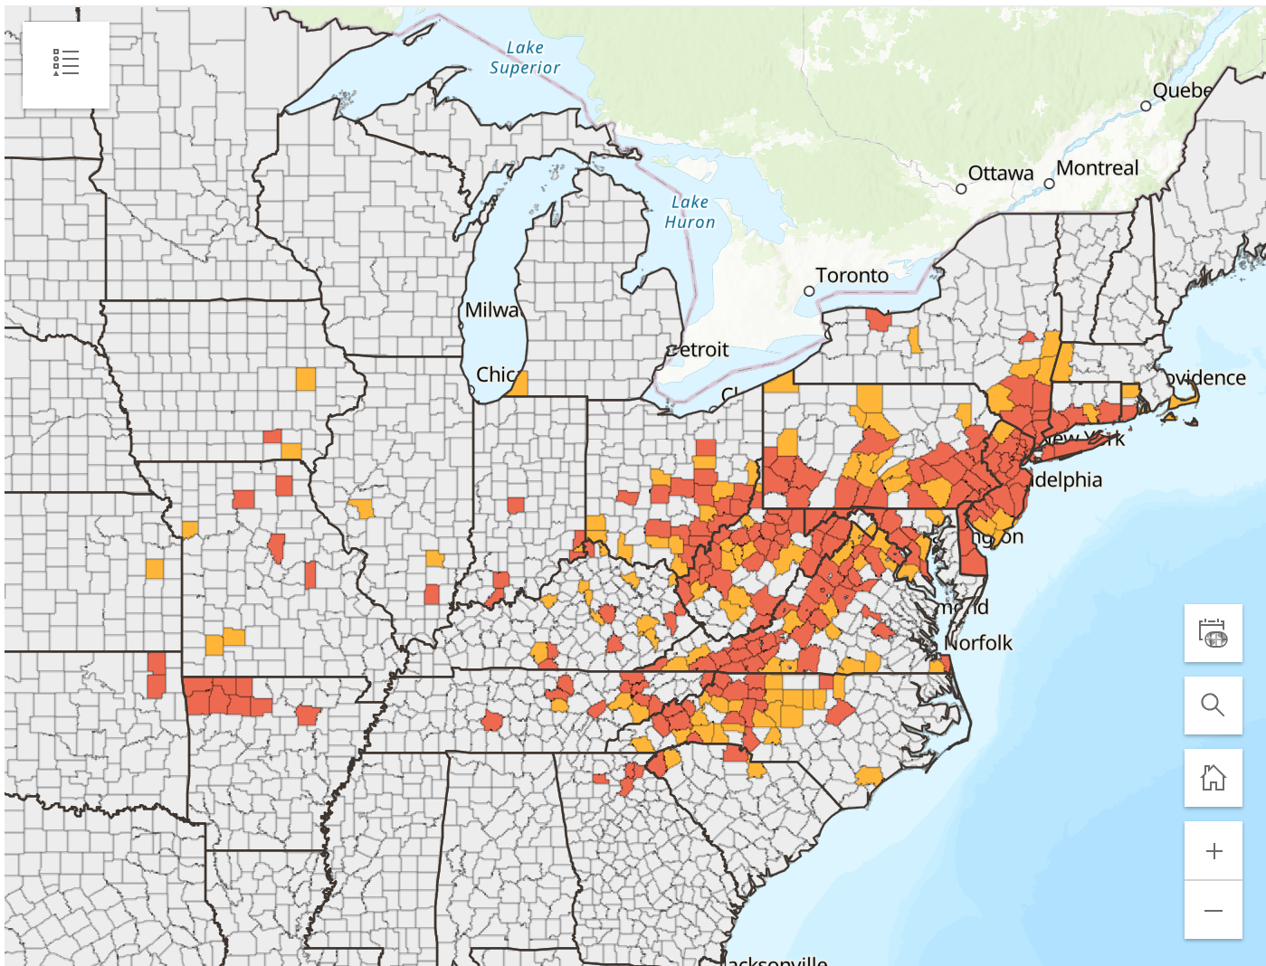
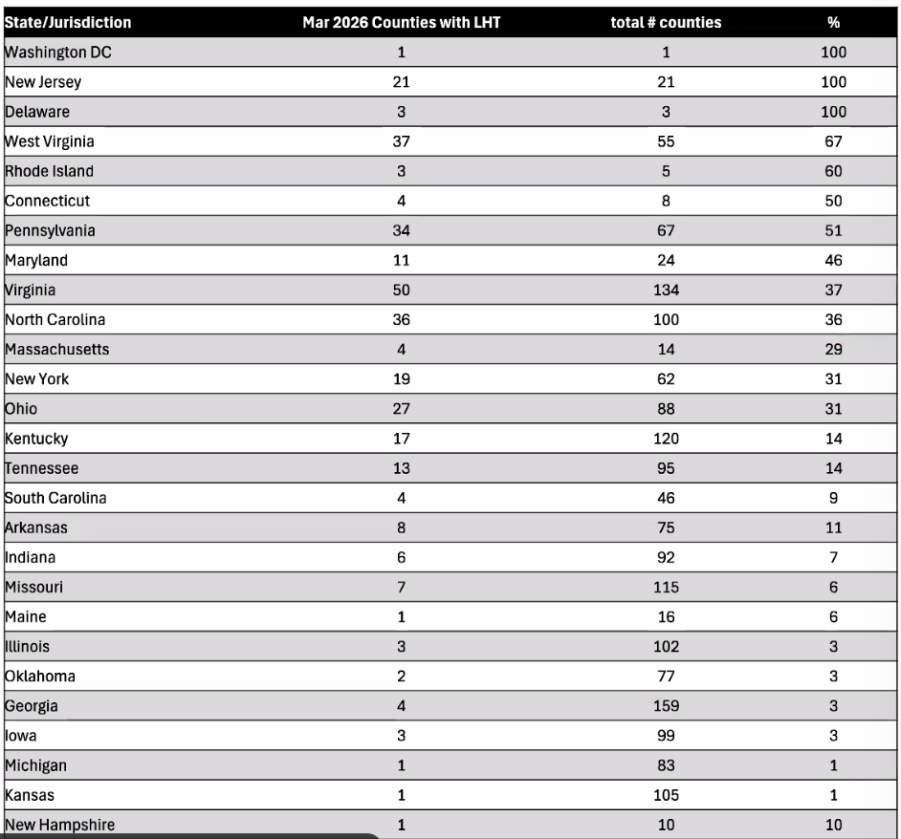
Asian Longhorn Tick and Theileriosis in the USA
Since the last CAHSS call, New Hampshire has reported its first ALHT finding
  Collected in June 2025, eastern state border
26 states + Washing D.C. now affected
Haemaphysalis longicornis ticks as a competent vector for ‘Candidatus Mycoplasma haemobos’ in experimental transmission studies
  First experimental proof that H. longicornis transmits ‘Ca. M. haemobos’
  ‘Ca. M. haemobos’ is maintained transovarially and transstadially in ticks
  Cattle may be exposed continuously
New Website Now Live:
Red = established
Orange = reported
Haemaphysalis longicornis and Theileria | Exotic and Invasive Vector and Vector-borne Disease
Notes:
3

Slide 4
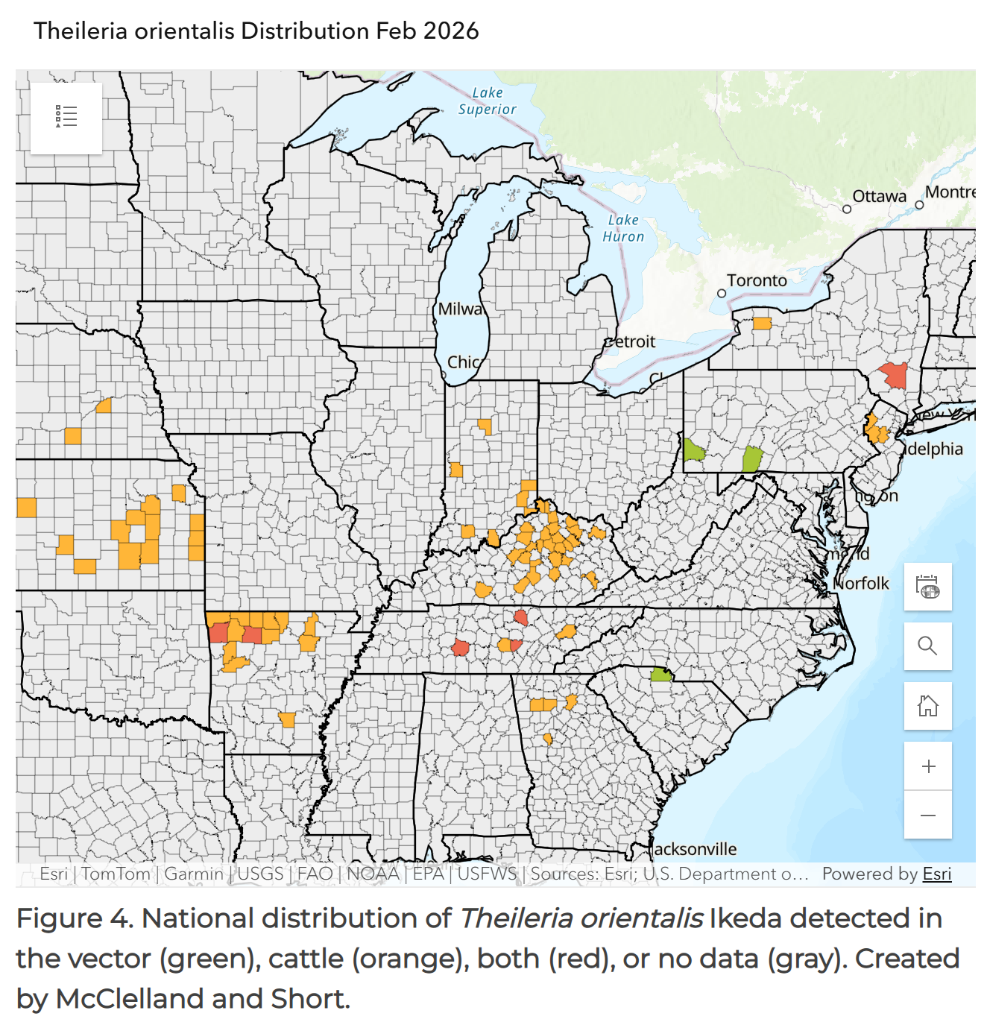
Asian Longhorn Tick and Theileriosis in the USA
Map is not comprehensive but gives an overview
  From voluntary data/submissions
  Some states with lots of Theileria not submitting data
22 states are positive for T. orientalis, reports of cattle with Theileria moving around (some states have a prevalence of >75% positive)
In Missouri, T. orientalis has now been reported in 60 counties, moving westwards throughout the state
Case Report: Retrospective discovery of Theileria orientalis Ikeda in Haemaphysalis longicornis Neumann ticks on a cow-calf farm in Tennessee (US)
Detection of T. orientalis Ikeda in nymphal ALHT collected from cattle, domestic cats, raccoons, and Virginia opossums
Protozoan DNA was not found in the blood of these hosts
Haemaphysalis longicornis and Theileria | Exotic and Invasive Vector and Vector-borne Disease
Notes:
4

Slide 5
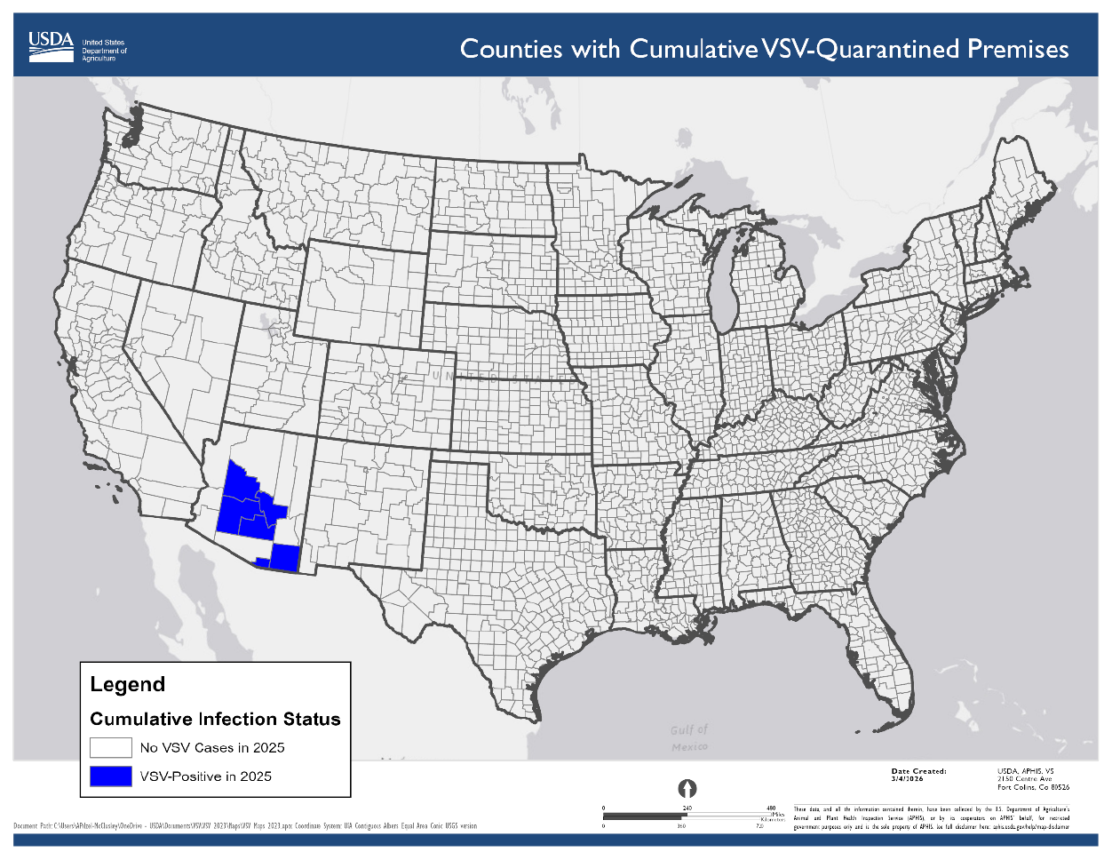
Vesicular Stomatitis in Arizona
USDA VSV Situation Report
Began in Arizona in October 2025
New Jersey Strain virus
13 premises affected across 6 counties
  Cochise County (2 initial cases - 2 released)
  Gila County (2 cases – 1 released)
  Santa Cruz County (2 cases – 2 released )
  Maricopa County (4 cases - 3 released)
  Pinal County (1 case – 1 released)
  Yavapai County (2 cases – quarantine)
No recent livestock movements onto the index premises
Suspect that vector movements across the border are the source of the outbreaks
5
Notes:
5

Slide 6
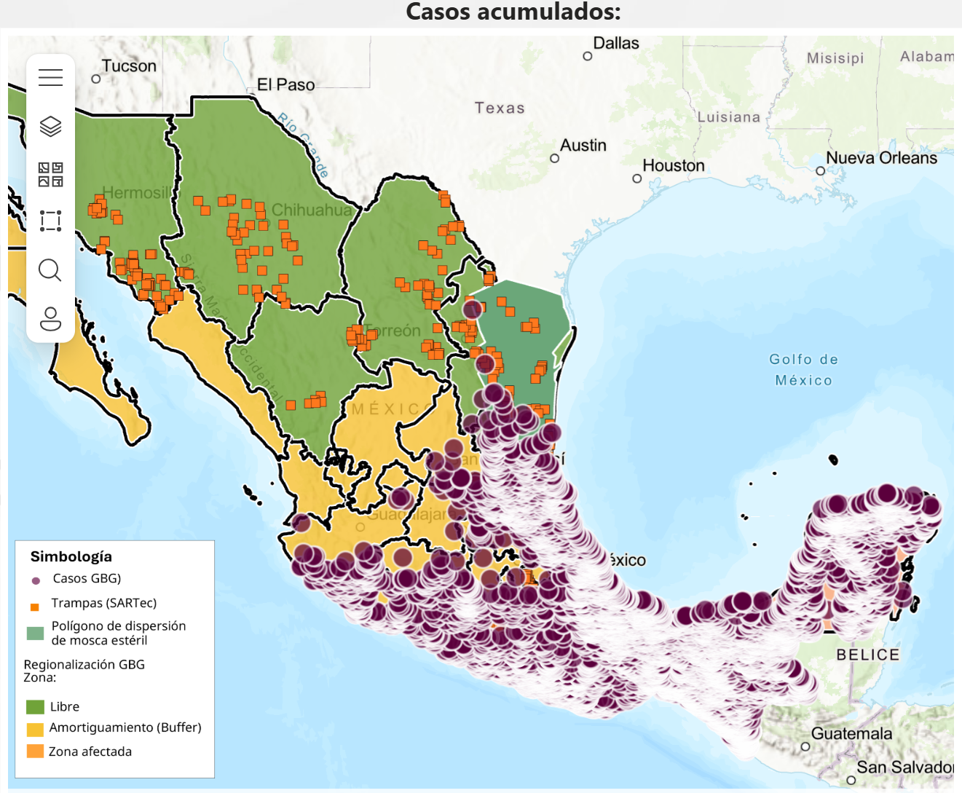
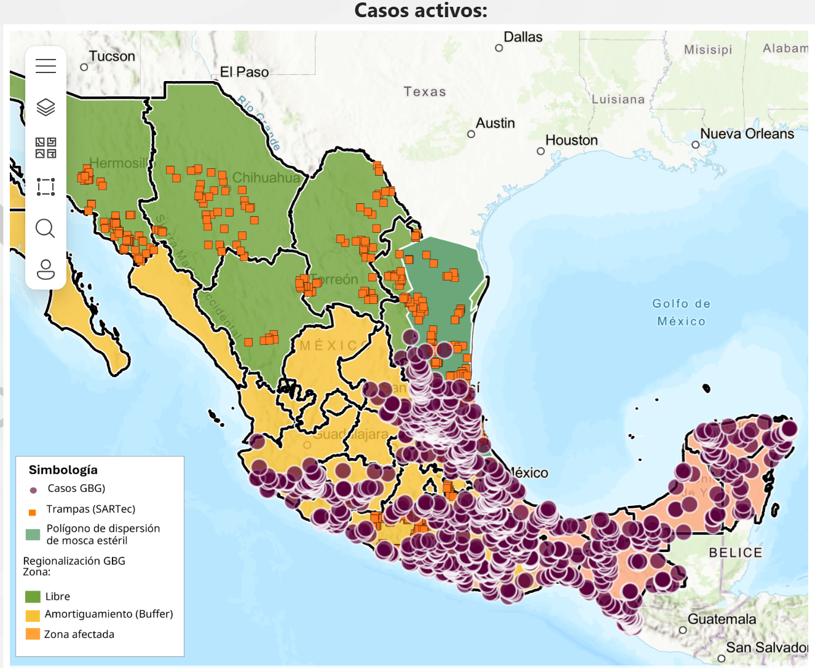
New World Screwworm
Mexico’s interactive dashboard displays 1,236 active cases of NWS in animals (19,744 cumulative)
NWS continues to spread northwest throughout the country
Mexico – 3,234 (~16.4%) cases in dogs, 86 cases in cats,
  Cases also reported in wildlife (red deer, howler monkey)
Mexico human cases now 204 (primarily in Chiapas)
Honduras reported 76 NWS human cases for 2026
USA - Florida reported NWS in a horse imported from Argentina
February - Sterile fly dispersal facility completed in Texas, dispersal shifted northwards
USA/Mexico border remains closed – recent discussions about limited “reopening strategy”
6
Notes:
6

Slide 7
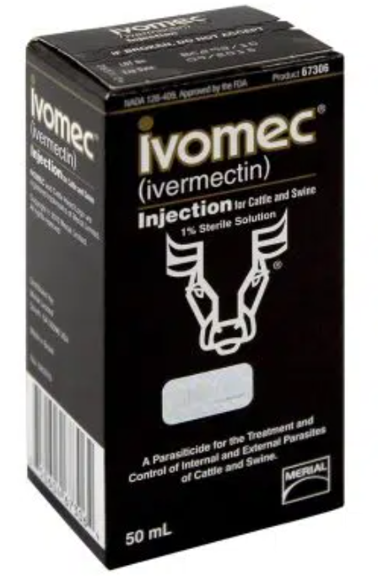

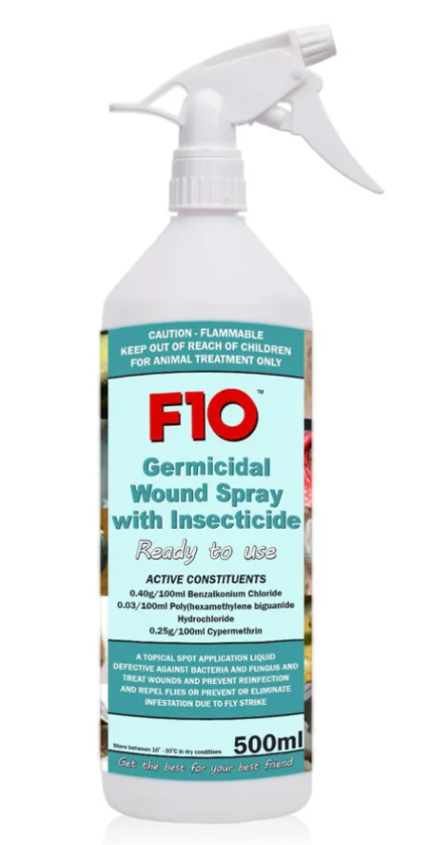
New World Screwworm
Previously - FDA Conditionally Approved Treatments
  Credelio Quattro-CA1 (Elanco) chewable tablets for dogs
  Exzolt Cattle-CA1 (Merck) fluralaner topical solution for beef cattle
  Dectomax-CA1 (Zoetis) injectable for cattle
Recent - FDA Conditionally Approved Treatments
Ivomec (10 mg/mL of ivermectin) injectable solution for cattle (excluding female dairy cows)
NexGard (afoxolaner) chewable tablets for the treatment of NWS in dogs & NexGard COMBO (esafoxolaner, eprinomectin, and praziquantel topical solution) for NWS in cats
F10 Antiseptic Wound Spray with Insecticide (benzalkonium chloride, polyhexanide, and cypermethrin topical solution) for the prevention and treatment of NWS
7
Notes:
7

Slide 8
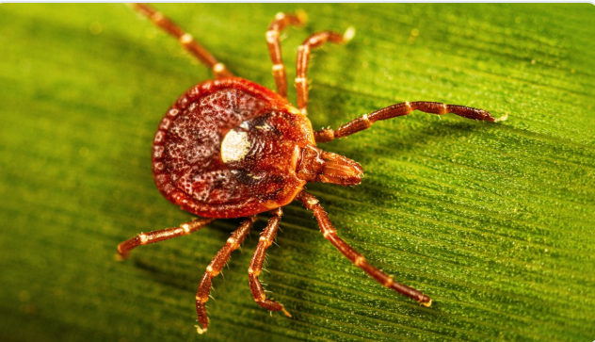
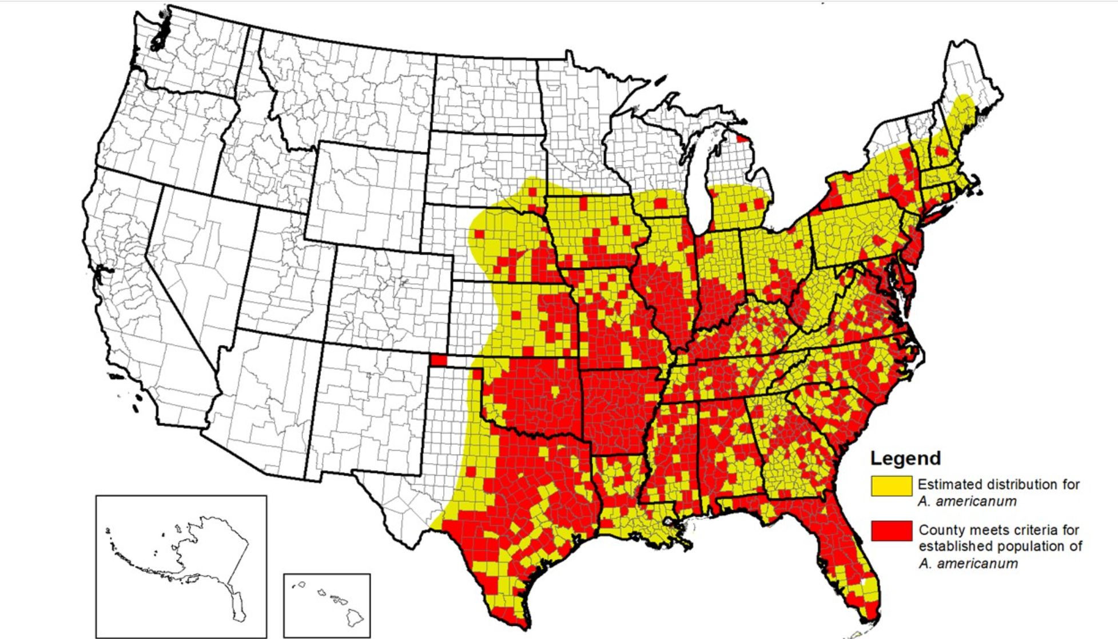
Alpha Gal Syndrome
AGS is a tick‑borne food allergy caused by an immune reaction to alpha‑gal (galactose‑α‑1, 3‑galactose), a sugar found in most mammals
People with AGS can have allergic reactions after eating red meat (e.g., beef, pork, lamb)
AGS often develops after a tick bite, particularly from the lone star tick in North America
AGS appears to be increasing in prevalence, along with lone star tick expansion
Australia recently reported a retrospective death from AGS dated back to June 2022 in New South Wales
Lone Star Tick Surveillance | Ticks | CDC

Slide 9
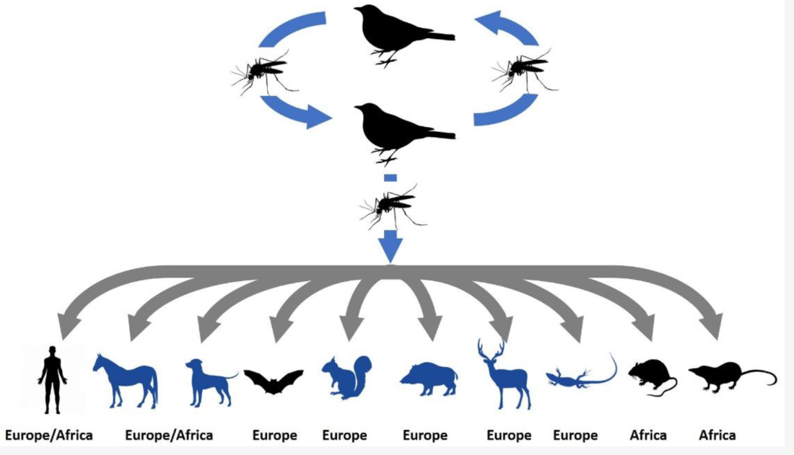
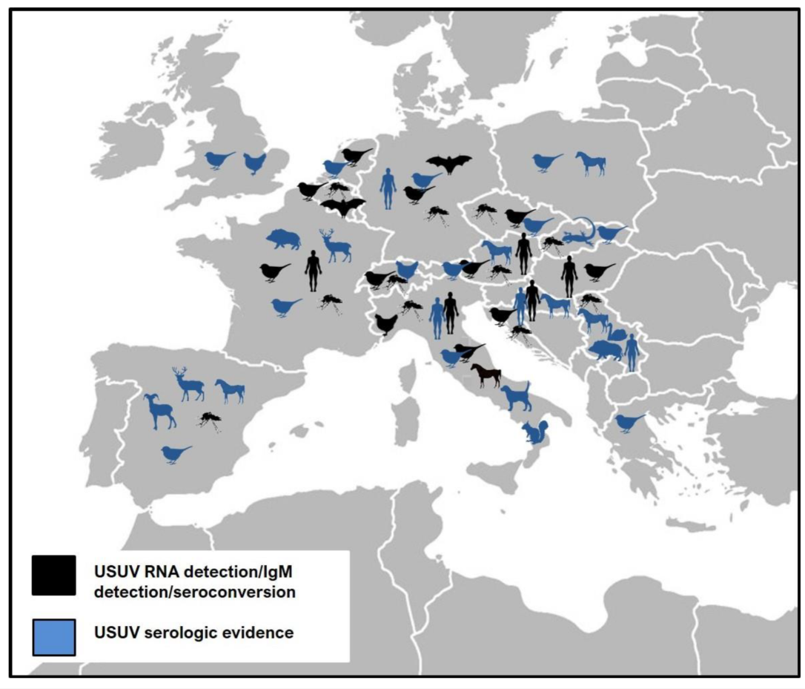
Usutu Virus in Europe
Usutu virus is a mosquito‑borne flavivirus
  Closely related to West Nile virus
Natural transmission cycle involves Culex mosquitoes as vectors and birds as amplifying hosts
Blackbirds and other passerines are particularly susceptible
First reports of USUV in Scotland (blackbirds) & Cyprus (mosquito)
Increase incidence of human infections in Austria, blood donors in Spain and Italy
Epidemiology of Usutu Virus: The European Scenario

Slide 10
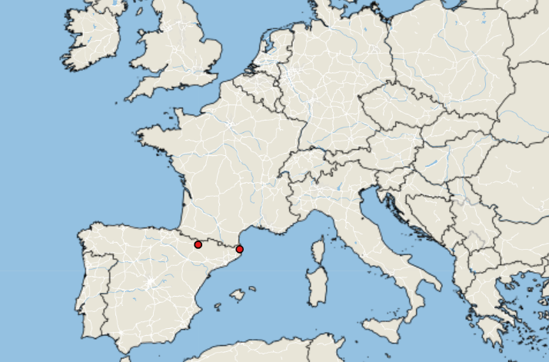
Lumpy Skin Disease in Europe & Asia
LSD Cases: January 1, 2026 – April 7, 2026
Empress +
Europe:
Situation appears to have stabilized, due to vaccination and colder weather
France: 117 total outbreaks reported
Italy: 80 total outbreaks, concentrated in Sardinia, with one cases in Lombardy (linked to animal movement from Sardinia), no new outbreaks reported since early November 2025
Spain: 20 total outbreaks - two new outbreaks reported in February/March – in the Huesca region (previously unaffected) close to French border
Asia:
Indonesia confirmed LSD in Bali after months of unofficial reports
10
Notes:
10

Slide 11
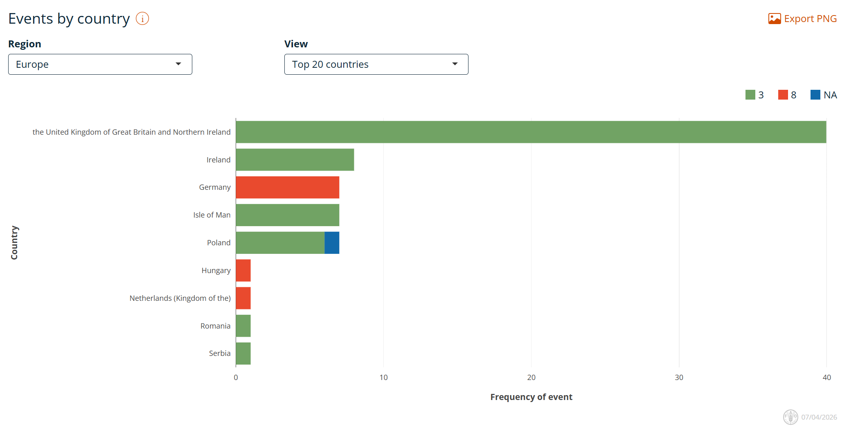
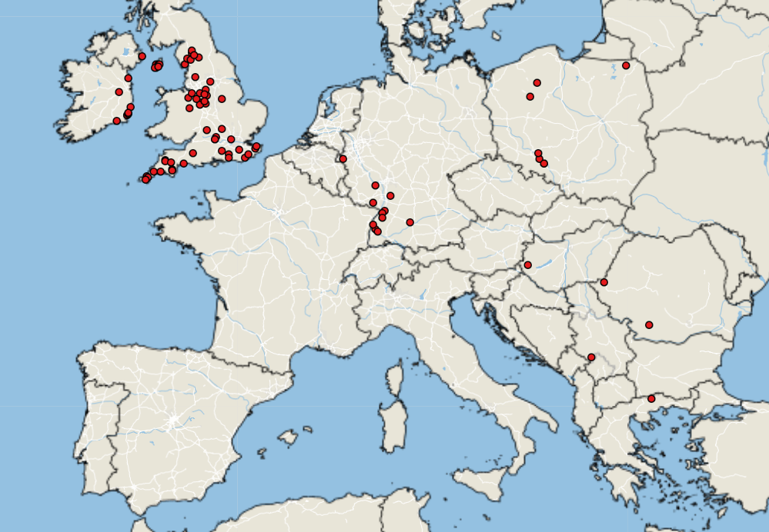
Bluetongue virus in Europe
Empres-Plus
BTV cases January 1, 2026 – April 7, 2026
Notes:
11

Slide 12
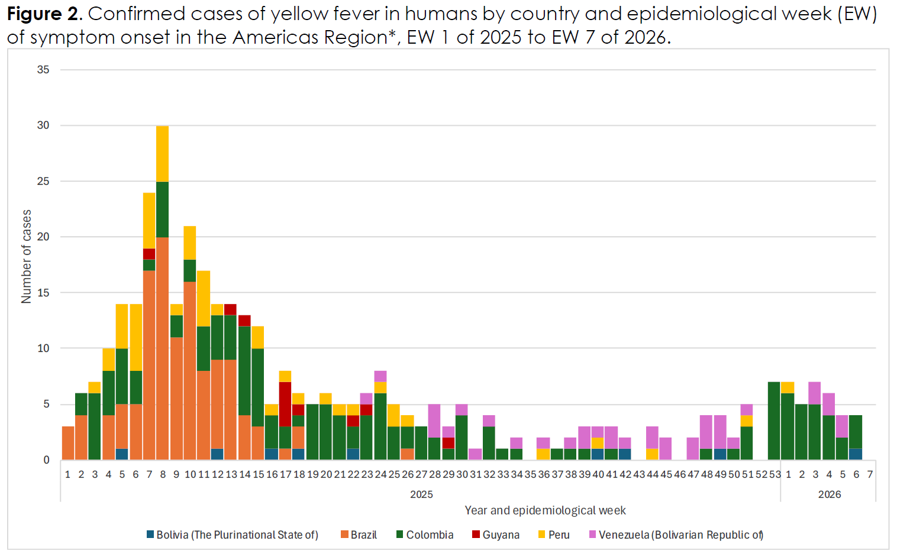
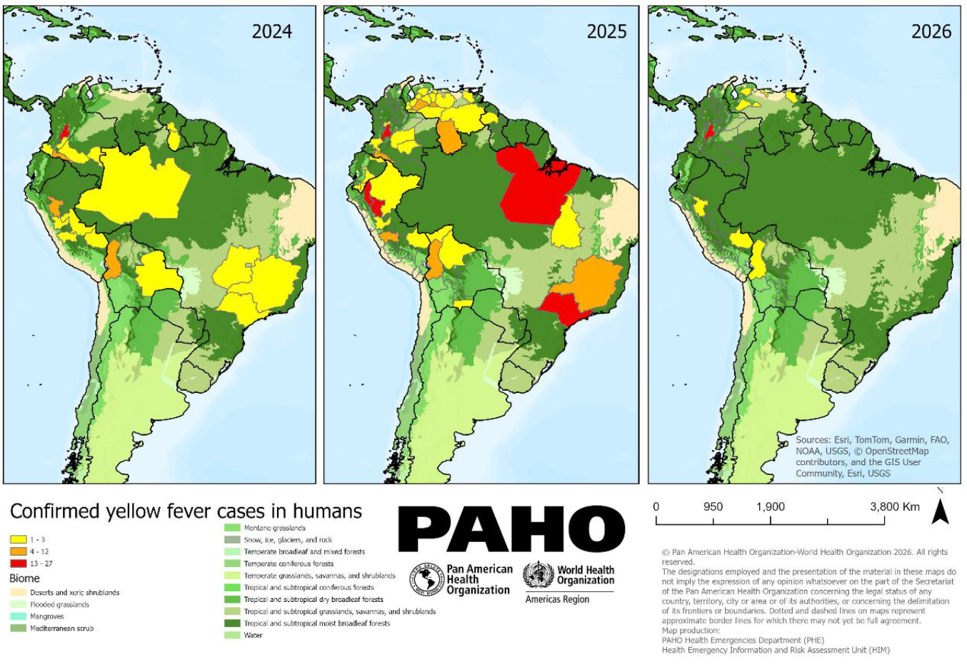
Yellow Fever in S. America
Mosquito‑borne Flavivirus closely related to Dengue, West Nile, and Zika
Vector transmission - primarily Aedes aegypti in urban settings and Haemagogus or Sabethes species in forested environments
Three transmission cycles
  Sylvatic, Intermediate, Urban
Live-attenuated vaccine available
2026 – Colombia (25), Peru (1), Bolivia (2), and Venezuela (6)
March - CDC issued a travel notice (Level 2 - Practice Enhanced Precautions) for Venezuela
PAHO - Epidemiological Alert: Yellow fever in the Americas Region - 13 March 2026

Slide 13
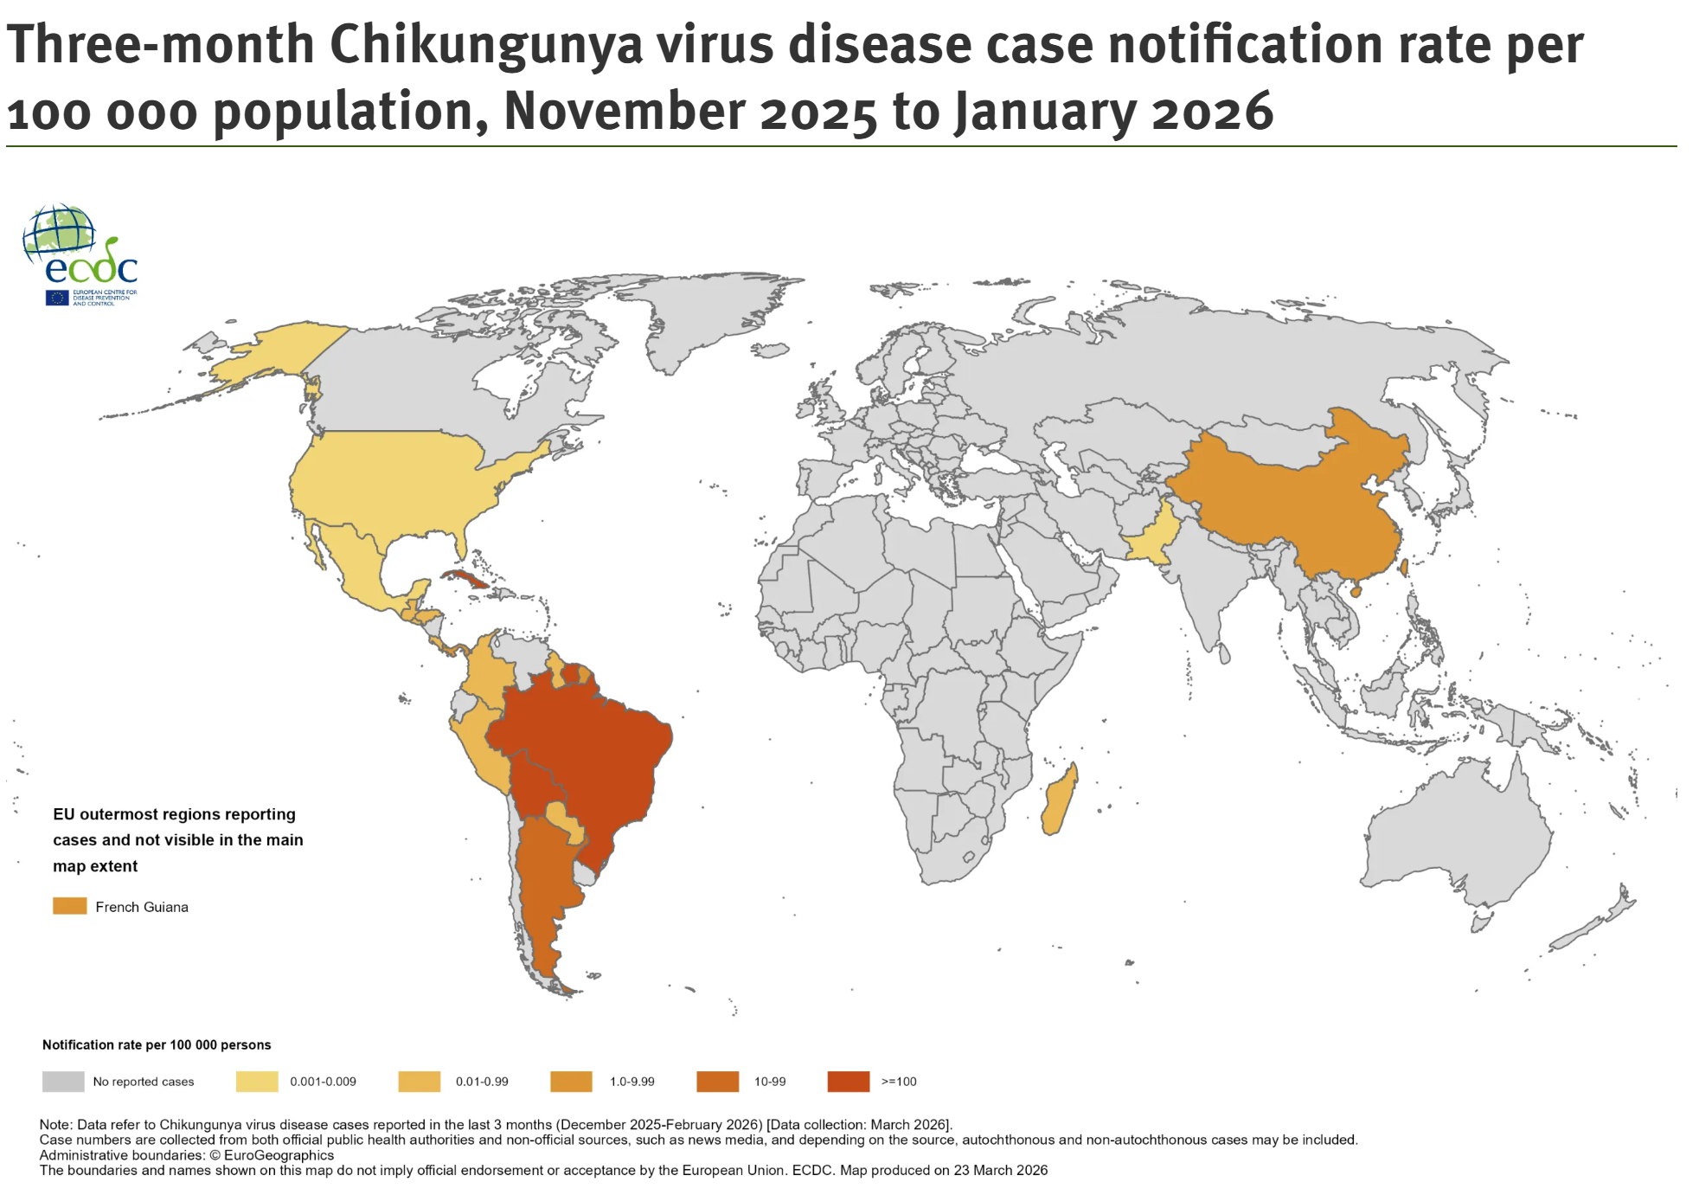
Chikungunya Worldwide
In 2026, 18 countries have ongoing CHIKV outbreaks
32 729 CHIKV cases and nine associated deaths reported worldwide
Cases have decreased when compared to the same period in 2025
Asia: Pakistan
Africa: Madagascar, Mauritius, Seychelles(imported traveller cases to EU)
South America: Brazil, Bolivia, Argentina, Cuba, Suriname, St. Lucia, French Guiana, Costa Rica…& more
North America: USA (Florida – onset Dec 2025)
PAHO - Epidemiological alert Chikungunya - 10 February 2026
Chikungunya virus disease worldwide overview
13
Notes:
13

Slide 14
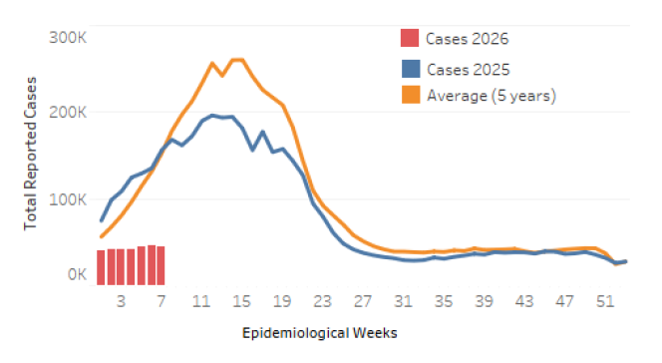
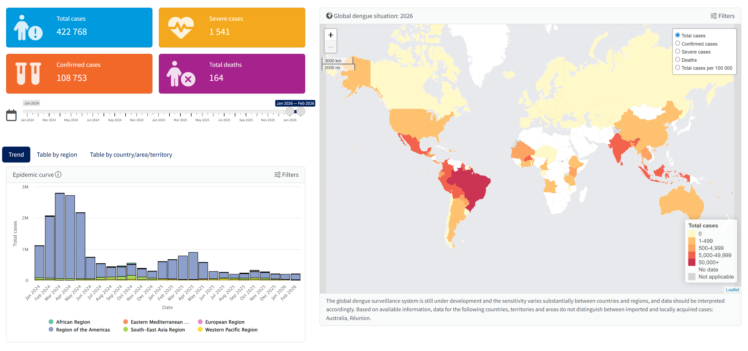
Dengue
PAHO Dengue: analysis by country
PAHO released an epidemiological update on Dengue in the Americas on March 16, 2026
WHO Dengue Dashboard – Data up to March 18, 2026
Bangladesh has reported 1983 cases and 4 deaths so far in 2026
In Africa, Sudan is reporting a worsening dengue outbreak amid medicine shortage and ongoing conflict
In Oceana, Samoa is reporting an ongoing dengue outbreak, appear to be slowing down
14
Notes:
14

Slide 15
Scientific Findings
Unravelling the genomic landscape of Canadian Borrelia burgdorferi: a comparison across global strains
Endemic potential of Chagas disease in the U.S. southwest: updated surveillance of infected Triatomines from the U.S.-Mexico border region
Aspects of the blood meal of mosquitoes (Diptera: culicidae) during the crepuscular period in Atlantic Forest remnants of the state of Rio de Janeiro, Brazil
Re-emerging Oropouche virus infections: insights into maternal–fetal crosstalk, coinfections, and expanding public health threats
Detection of Oropouche and Punta Toro Virus Infections by Enhanced Surveillance, Panama, 2023–2024
What are the vector species of the Oropouche virus?
Dermacentor occidentalis Ticks and Link to Rickettsia lanei Infections, California, USA
Pre-print: Comparative vector competence of post-2015 St. Louis encephalitis virus in Culex tarsalis and Culex quinquefasciatus mosquitoes
An African Lineage Zika Virus Infecting Free-Living Neotropical Primates in Southern Brazil
Detection of Bartonella schoenbuchensis and a novel sigmavirus within the microbiome of deer keds (Lipoptena cervi) from the United Kingdom
Emergence of autochthonous Leishmania infantum infection in dogs from Costa Rica confirmed by multimodal diagnostics: a case series
15
Notes:
15

Slide 16
Scientific Findings
Tularemia in New York, USA, 1993–2023
Clinical characteristics of two companion canines with severe fever with thrombocytopenia syndrome virus (Bandavirus dabieense) in Seoul, Republic of Korea
First detection of West Nile virus in Belgium through wild bird surveillance, Belgium, 2025
Expansion of cluster 3 Tembusu virus in Guangdong geese with hepatitis-splenomegaly syndrome and evidence of recombination
Comparative vector competence analysis reveals differential Tembusu virus transmission efficiency between Aedes albopictus and Culex quinquefasciatus
Crimean-congo hemorrhagic fever in Iraq, 2021–2024: epidemiological and clinical data analysis with proposed severity indicators for resource-constrained settings
Seroprevalence of rift valley fever virus and associated risk factors in small ruminants at human-livestock-wildlife interface within Uganda’s conservation areas
Seroprevalence and risk factors of epizootic hemorrhagic disease and bluetongue in Northwestern Tunisia: a comprehensive seroepidemiological study
Temperature-sensitive incubation, transmissibility and risk of Aedes albopictus-borne chikungunya virus in Europe
Serological evidence of tick-borne encephalitis virus in limousin, France
Pathogenicity of a novel orthonairovirus, Iwanai Valley virus, in mice
Airport Malaria Cluster in Certified Malaria-Free Country, Libya, 2024
16
Notes:
16

Slide 17
Scientific Findings
Bluetongue in China: Current Status of Viruses, Vectors, Detection Methods, and Vaccines
Global Seroprevalence of bluetongue virus in camels: a first systematic review and meta-analysis
Detection of Anaplasma marginale (Rickettsiales: Anaplasmataceae) in host-seeking adult Dermacentor variabilis (Acari: Ixodidae) on cattle pastures, Missouri, United States
Rickettsia lanei Rickettsiosis, Oregon, USA, 2025
County-level surveillance for the American dog tick (Dermacentor variabilis) and Rickettsia species in Kentucky
Human-to-Human Transmission of Severe Fever With Thrombocytopenia Syndrome Resulting in Fatal Cases: A Case Series
17
Notes:
17

